Slide 1
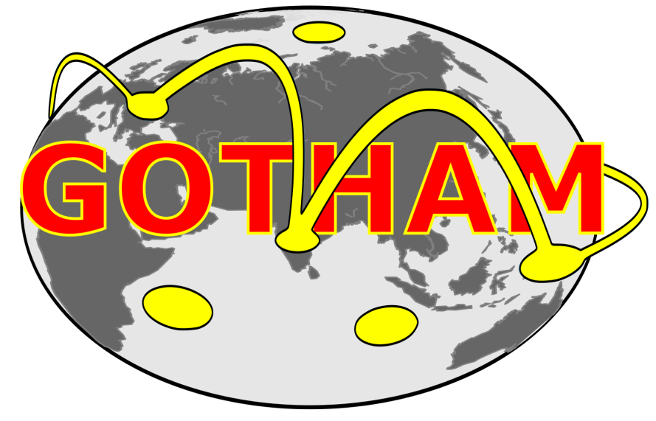
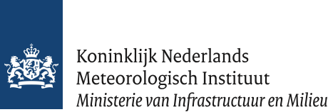


Midlatitude Circulation
Observed & modeled dynamical changes relevant for summer extremes
Dim Coumou
Kai Kornhuber, Marlene Kretschmer
Jascha Lehmann, Sonja Molnos

Slide 2
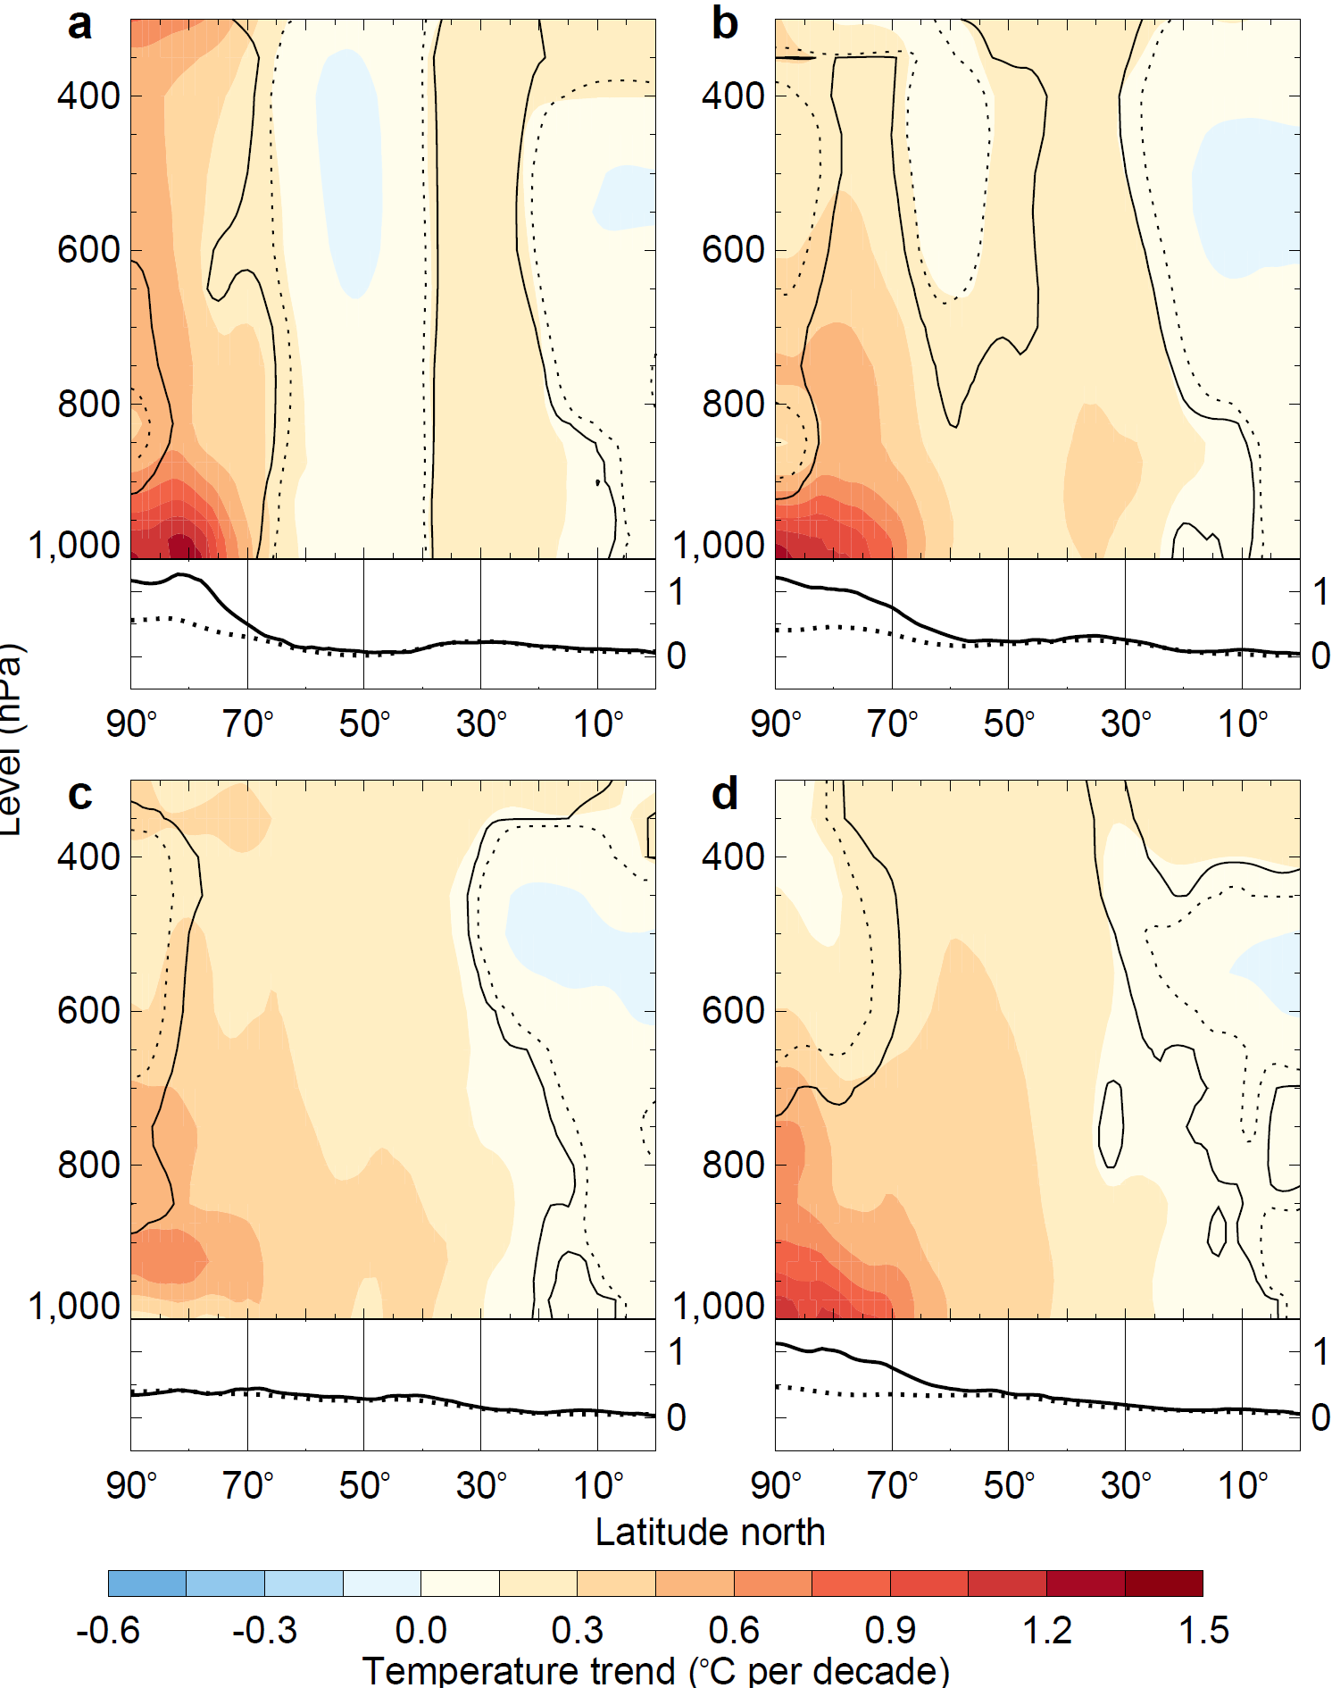
Warming trends
Temperature trends 1979-2014
DJF
MAM
Strongest amplification in cold seasons
JJA
SON
Cohen et al (2014)

Slide 3
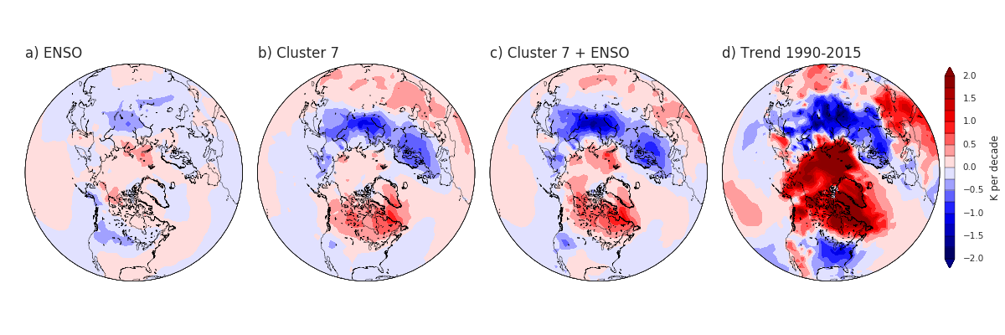
Winter: Warm-Arctic Cold-Continent pattern:
Some long-term cooling trends over continents observed
Linear trend 1990-2016 (DJF)
Kretschmer et al, in press

Slide 4
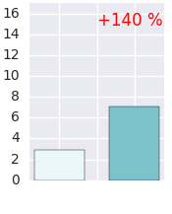

Increased weak SPVs can explain most of the cooling
(e.g. talk by Dorthe Handorf)
Weak stratospheric
polar vortex
Downward influence of planetary waves
Kretschmer et al,BAMS (in press)
Cold air outbreaks
Troposphere
1979-
1996
1997-
2015
ENSO
weak SPV
weak SPV + ENSO
Trend 1990-2015

Slide 5
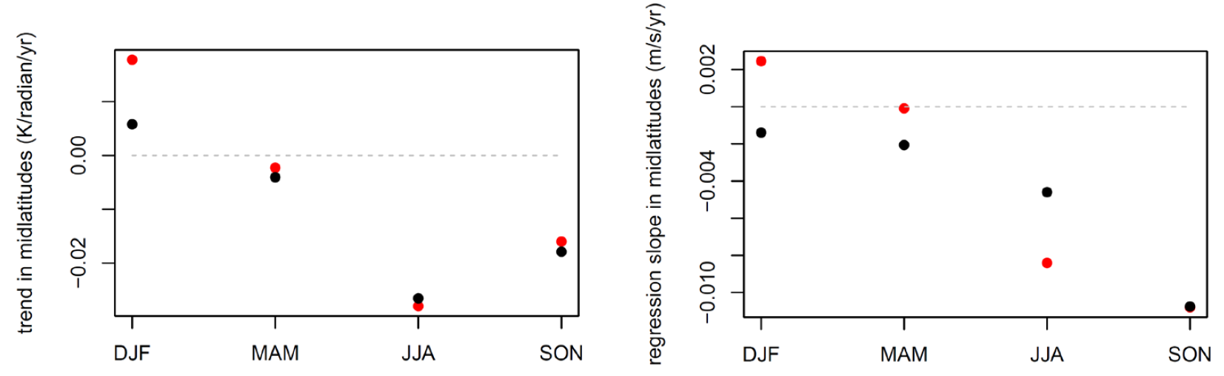
Warming trends
Temperature trends 1979-2014
DJF
MAM
Strongest amplification in cold seasons
0.1
Trend dT/dy
(K/rad/decade)
0
-0.1
JJA
SON
-0.2
Mid-latitude temperature gradient reduced most in summer
Cohen et al, Nat Geo (2014)

Slide 6
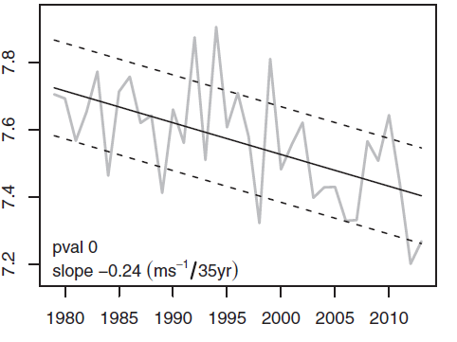
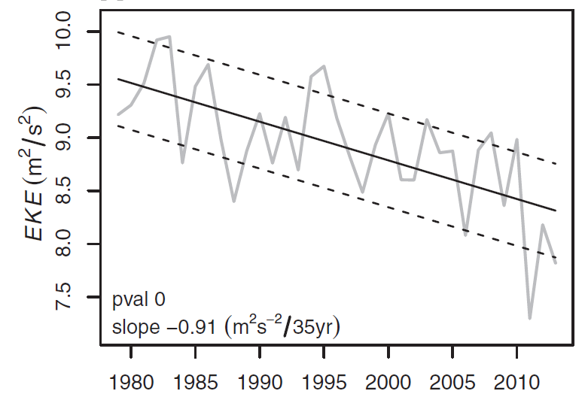
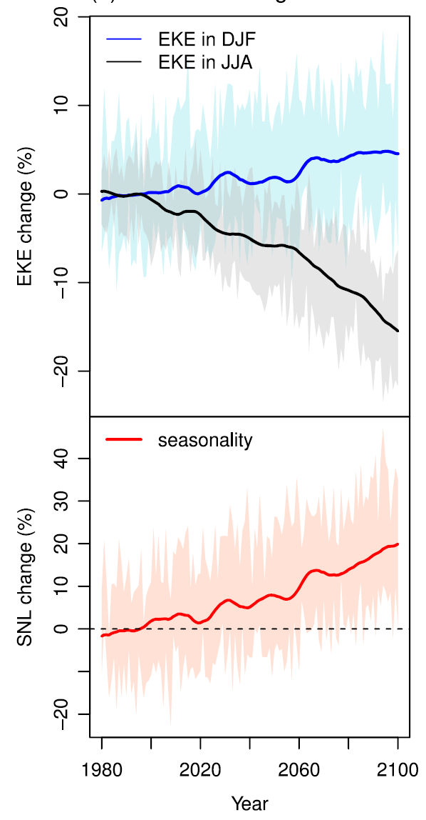
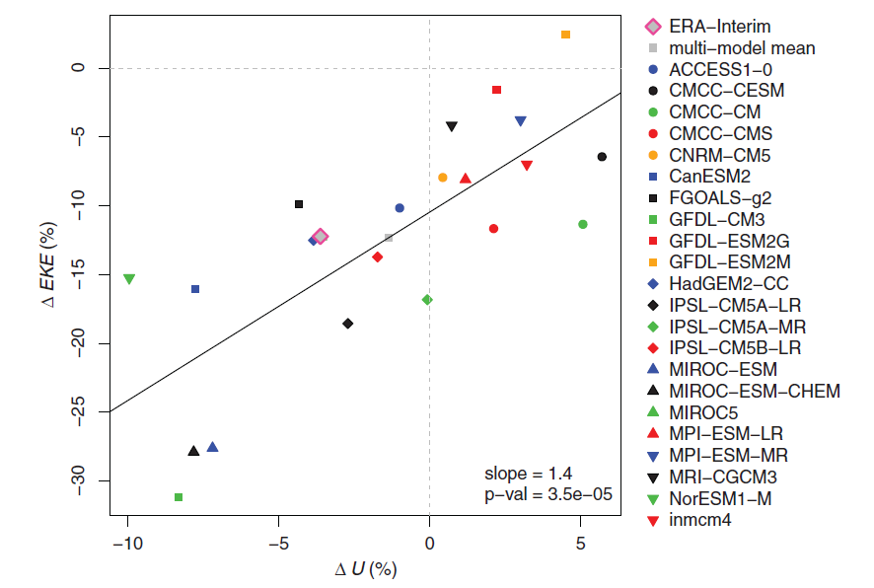
Weakening Mid-latitude Summer Circulation
Zonal Wind (-5%)
Eddy Kinetic Energy (-15%)
Observed
U (m/s)
EKE (m²/s²)
Projections
EKE (%-change)
EKE (%-change)
Coumou et al, Science (2015)
Coumou et al (2015), Lehmann et al (2014), Chang et al (2016)
U (%-change)

Slide 7
Effect of weakening westerlies & storm tracks on surface weather conditions
Reduced synoptic variability → reduction in frequency and/or intensity of daily extremes (short timescales, sub-synoptic)
Synoptic storms have a moderating effect on summer temperatures by bringing wet, cloudy and relatively cool maritime air. Weakened storm tracks might favor buildup of heat over continents
Effects likely to be different for different regions and different weather regimes (e.g. feedbacks between soil-moisture and continental-scale circulation)
e.g. Schneider et al (2015): Focus on cold season
e.g. Coumou et al (2015), Chang et al (2016)
e.g. Haarsma et al (2015), Fischer et al (2012)

Slide 8
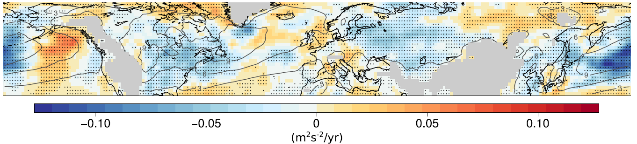
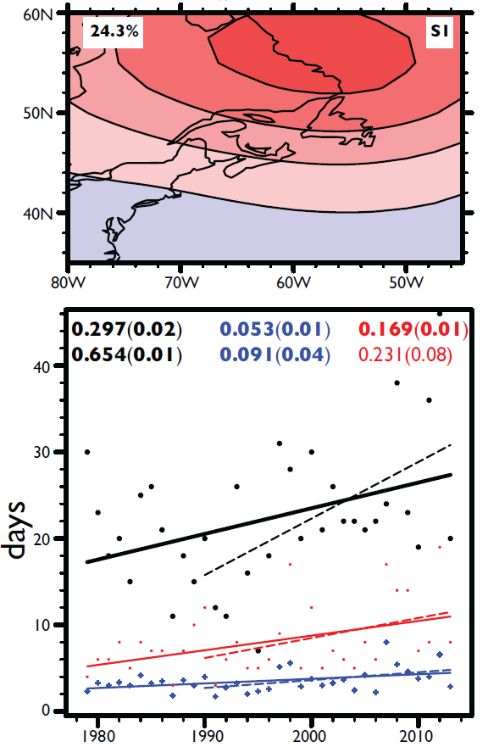
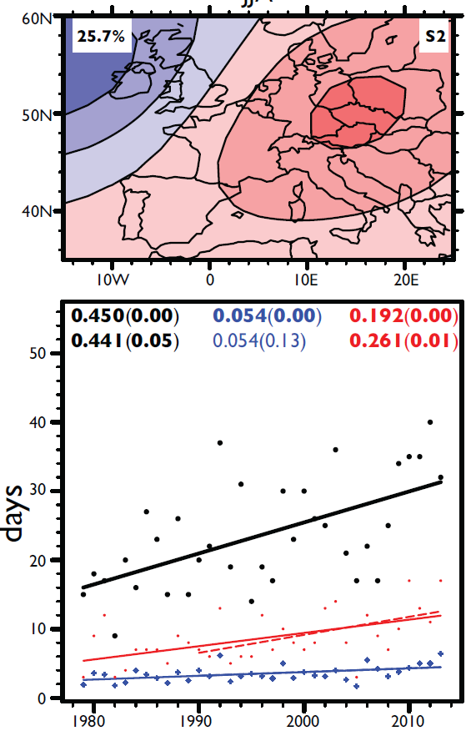
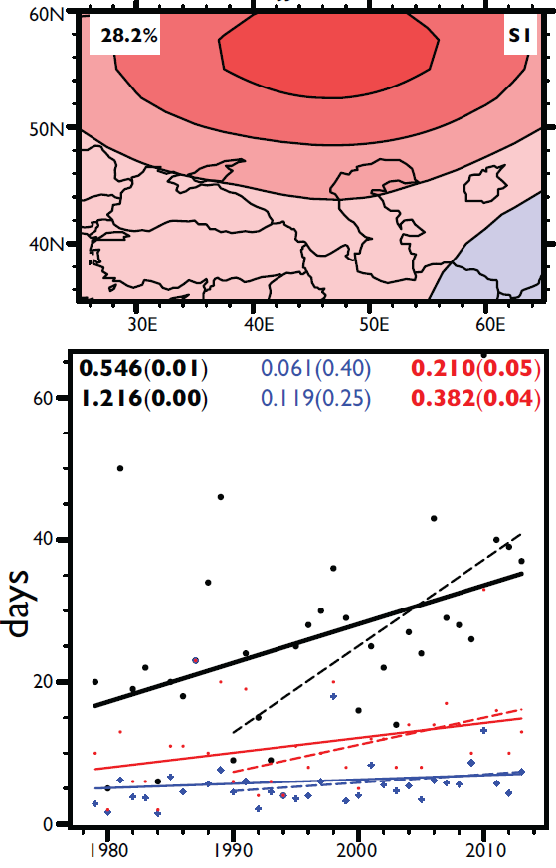
More-persistent anti-cyclones in storm track affected regions
Linear trend in summer EKE (1979-2015)
Lehmann et al (2015)
Eastern America
Horton et al (2015)
Europe
Western Asia
Upward trends in anticyclonic summer circulation, both in frequency and in persistence
BUT:
used 500mb GPH instead of SLP
Frequency (days)
Maximum Duration (days)
Persistence (days)

Slide 9
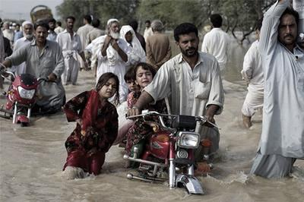
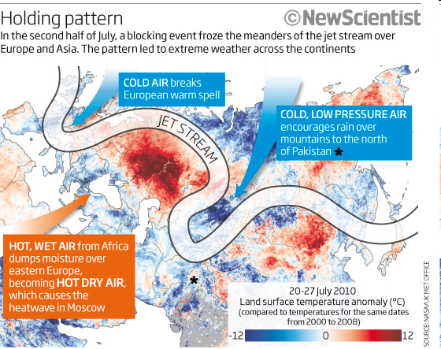
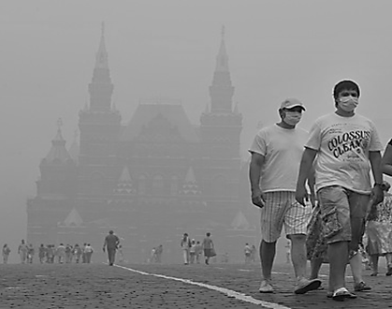
Eurasia, Summer 2010
Pakistan Flooding
Russian heat wave

Slide 10
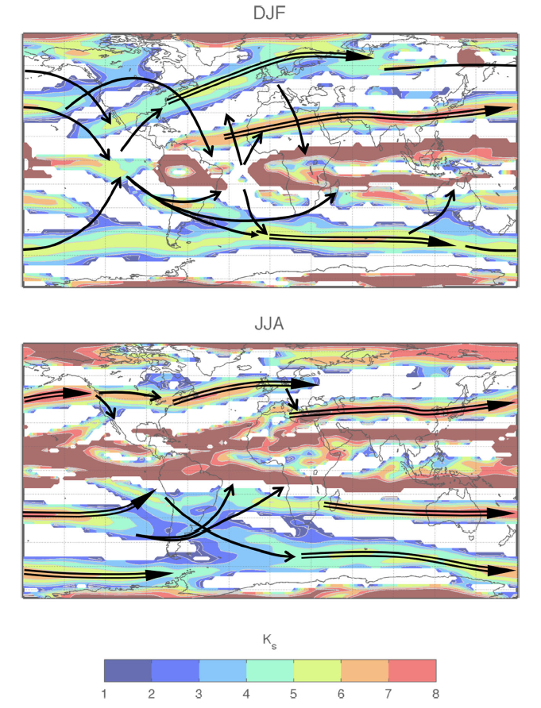
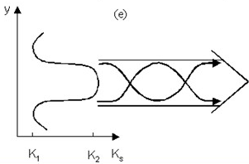

Waveguides
$$K_{s}^{}2=\frac{β}{U}$$
Stationary wavenumber:
Jets can guide waves with range of wavenumbers
Waves tend to arch equatorwards at the waveguide exit points
NH Summer:
Higher wavenumbers (weaker westerlies): 6, 7, 8, …
More zonally oriented waveguides → Possibility for circumglobal waveguide
Hoskins & Ambrizini (1995), Hoskins & Woollings (2015)

Slide 11
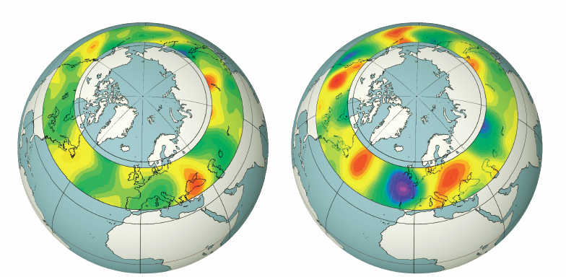
Wave-resonance
Conditions needed:
Circumglobal waveguide
Full wavenumber: Trapped wave should (nearly) exactly „fit“ around hemisphere
Non-zero wave-forcing
Normal: July 1980
Extreme: May 2013
Meridional Windspeed (m/s)
Illustration: Focus 2013, Nr. 28/13

Slide 12
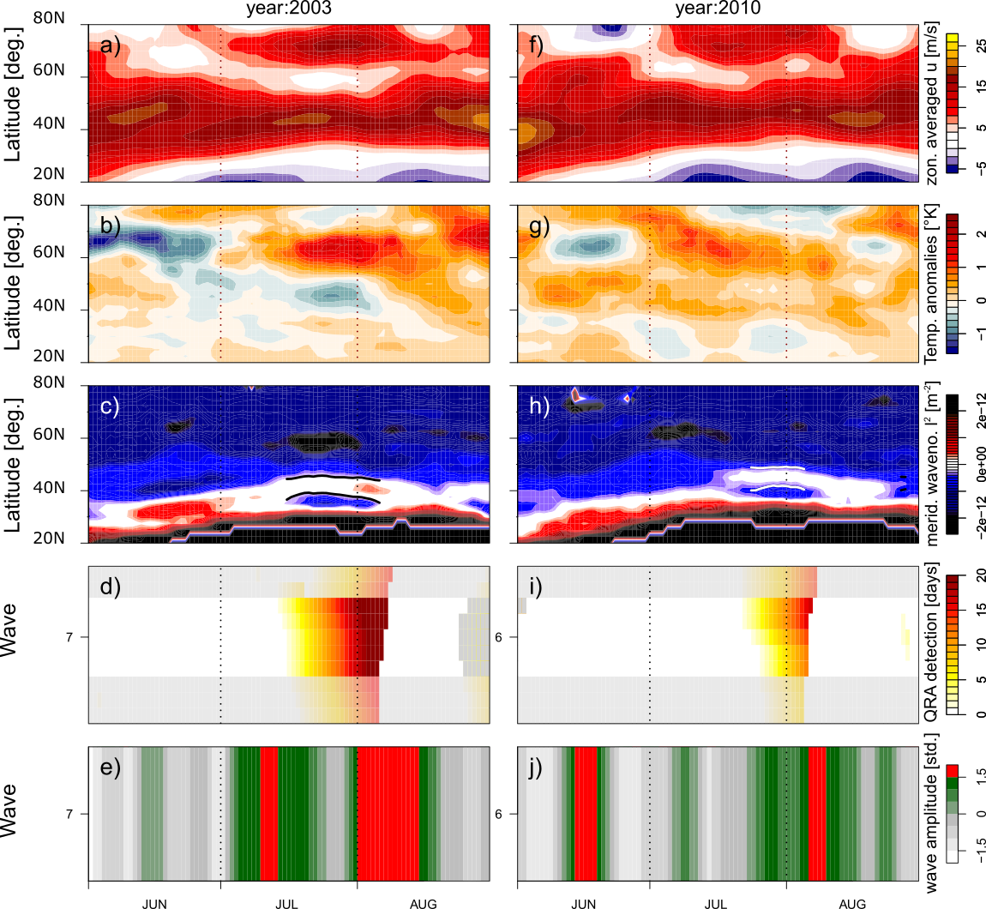
Wave-Resonance:
Dynamical Mechanism to create High-Amp Quasi-Stationary Waves in Summer
Summer 2003
Summer 2010
Waveguide:
Trapping of synoptic-scale wave in mid-lats
+
Right forcing:
High-amp, quasi-stationary waves (6, 7 or 8).
Often associated with summer extremes
Zonal Wind
Double Jet
T anomaly
2 Turning Points
Zonal-mean Hovmöller diagrams
Waveguide
Resonance
Petoukhov et al.(2013)
Coumou et al.(2014)
Kornhuber et al. (2016)
Wave Amp

Slide 13
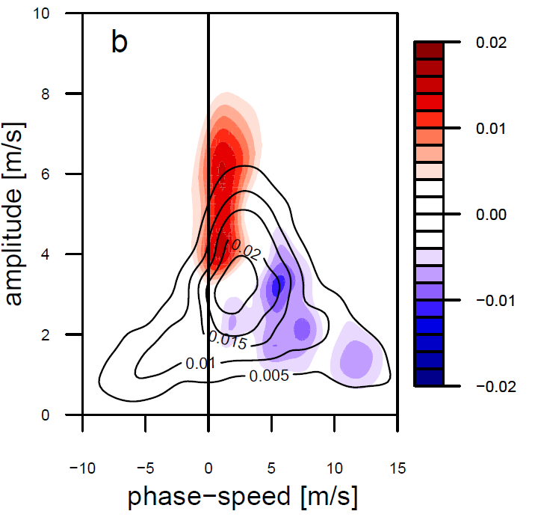
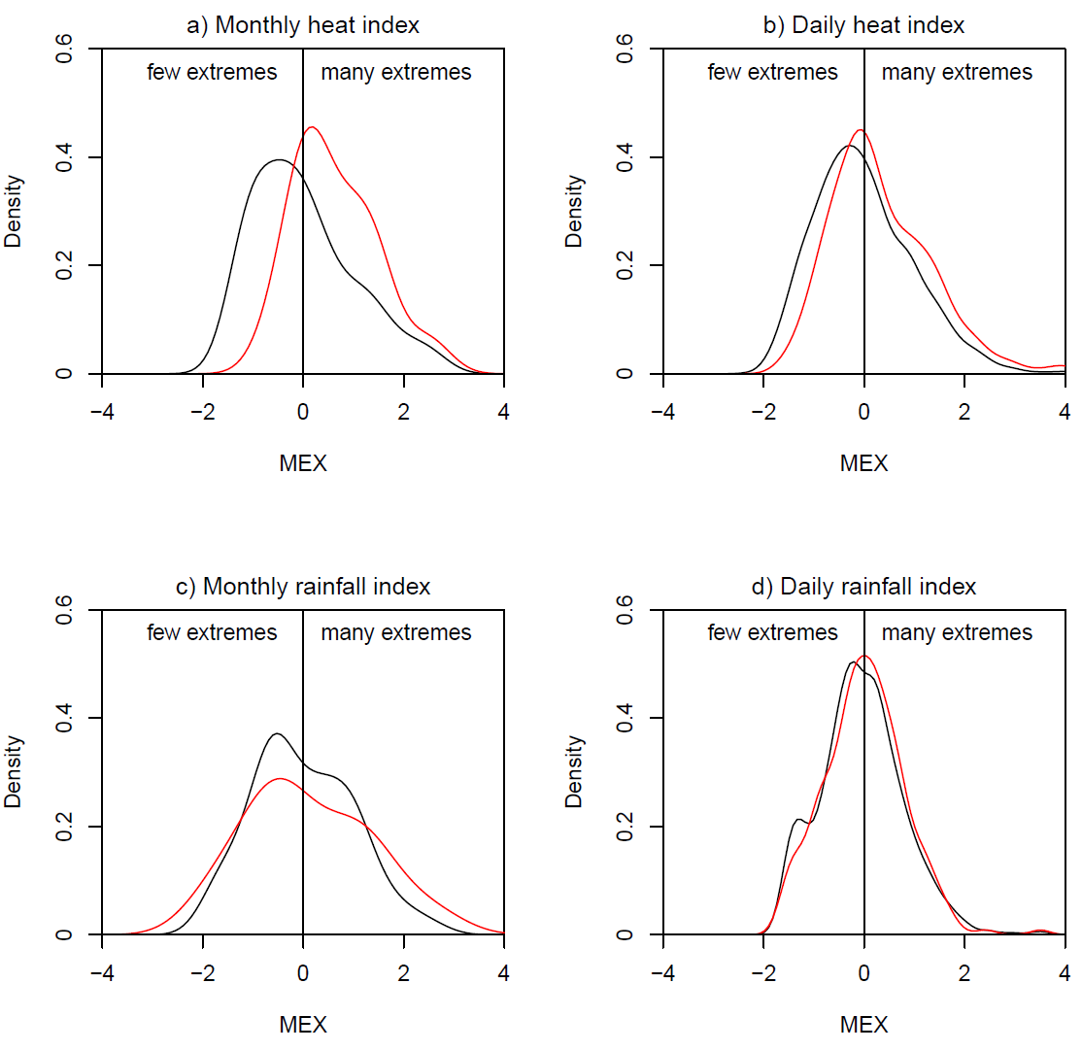
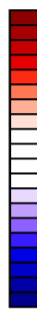
Statistics: Resonance vs Summer Climatology
300mb meridional wind dominated by high-amplitude quasi-stationary waves
Surface weather more extreme, especially on multi-day timescales
10
0.02
8
0
Climatology
6
Resonance
Wave Amplitude [m/s]
4
-0.02
2
0
-10
0
10
Phase speed [m/s]
Mid-latitude Extreme Index
During ~1/3 of all high-amp waves (6-8), resonance conditions were met
Wave 7 events have the longest duration with a mean duration of 10 days
Notes:
So, the tendency in C_w to decrease with decreasing U is observed in the resonance-months as well (moreover, as seen in Fig.3 b, in the case of U < 8 m/s, C_w drops in the resonance-months from 3-4 m/ s at U ≈8 m/s to nealy zero at U ≈6 m/s).

Slide 14
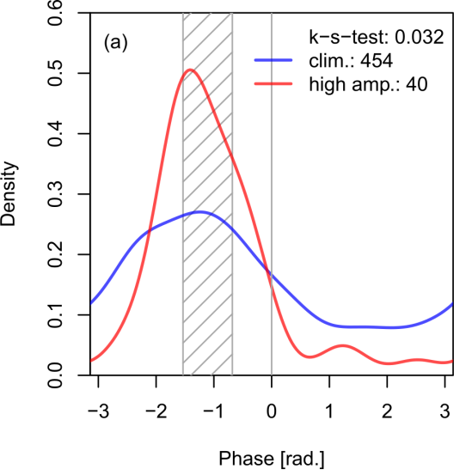
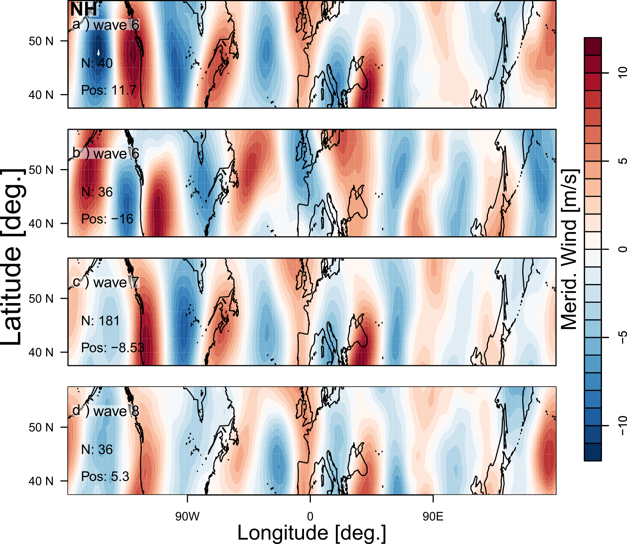
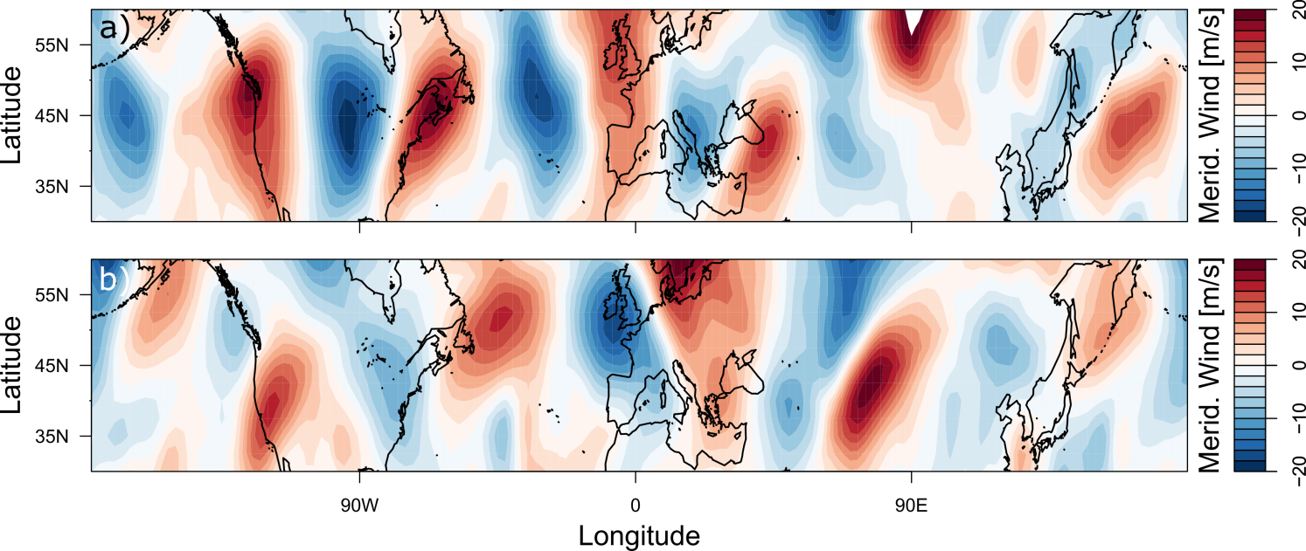
Wave-7 teleconnection due to preferred phase position
When wave-7 gets amplified its longitudinal position will settle in a preferred position
Composite wave-7 resonance
Meridional Wind
Summer 2003
Meridional Wind

Slide 15
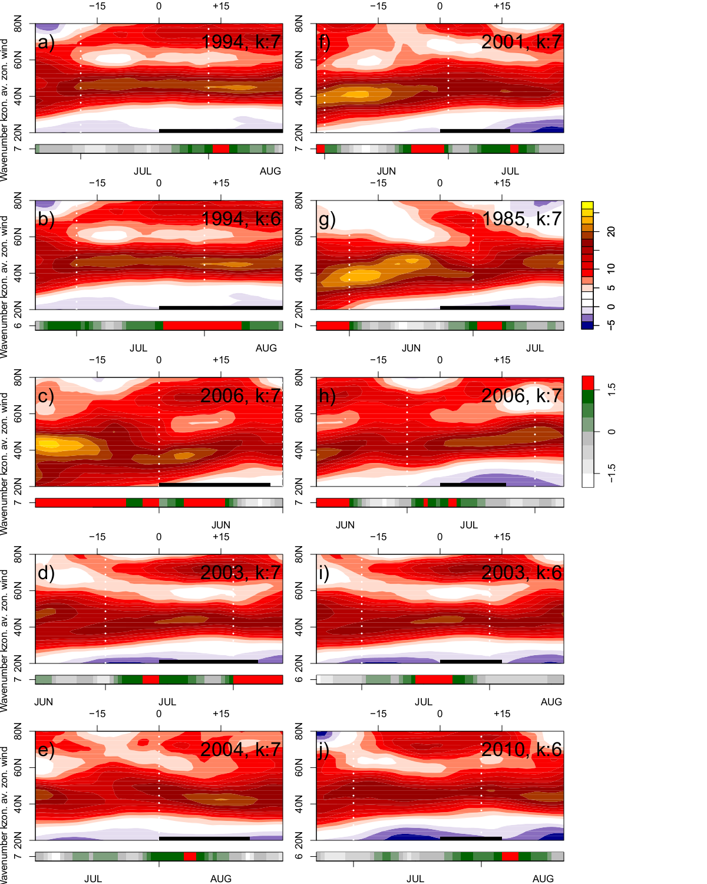
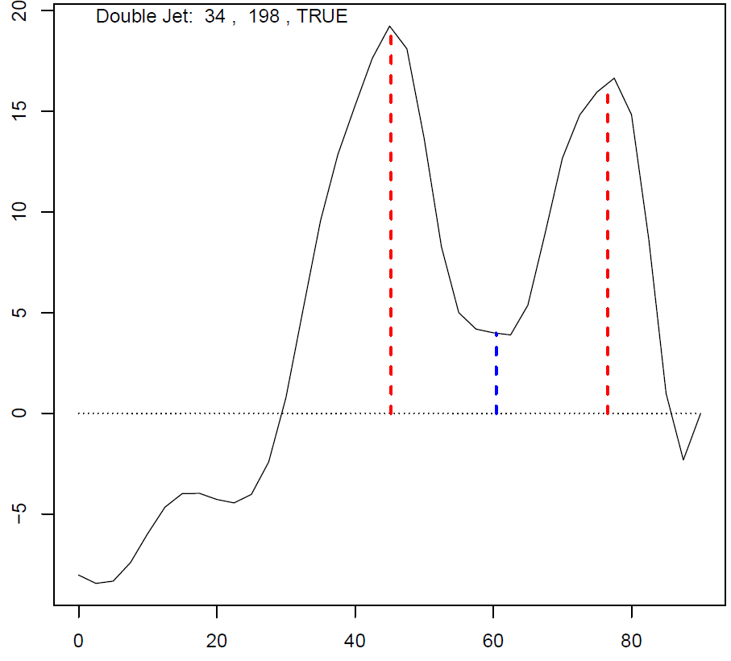
Prolonged Resonance Events
Kornhuber et al. (2016)
2 during 1979-1999
6 during 2000-2014
windspeed [m/s]
Double jets + High-amplitude waves
Recent cluster of prolonged resonance events
latitude

Slide 16
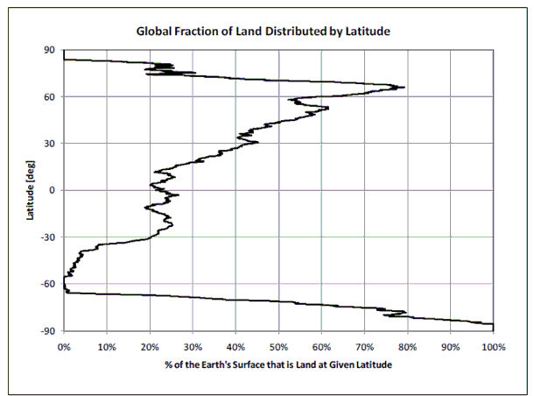
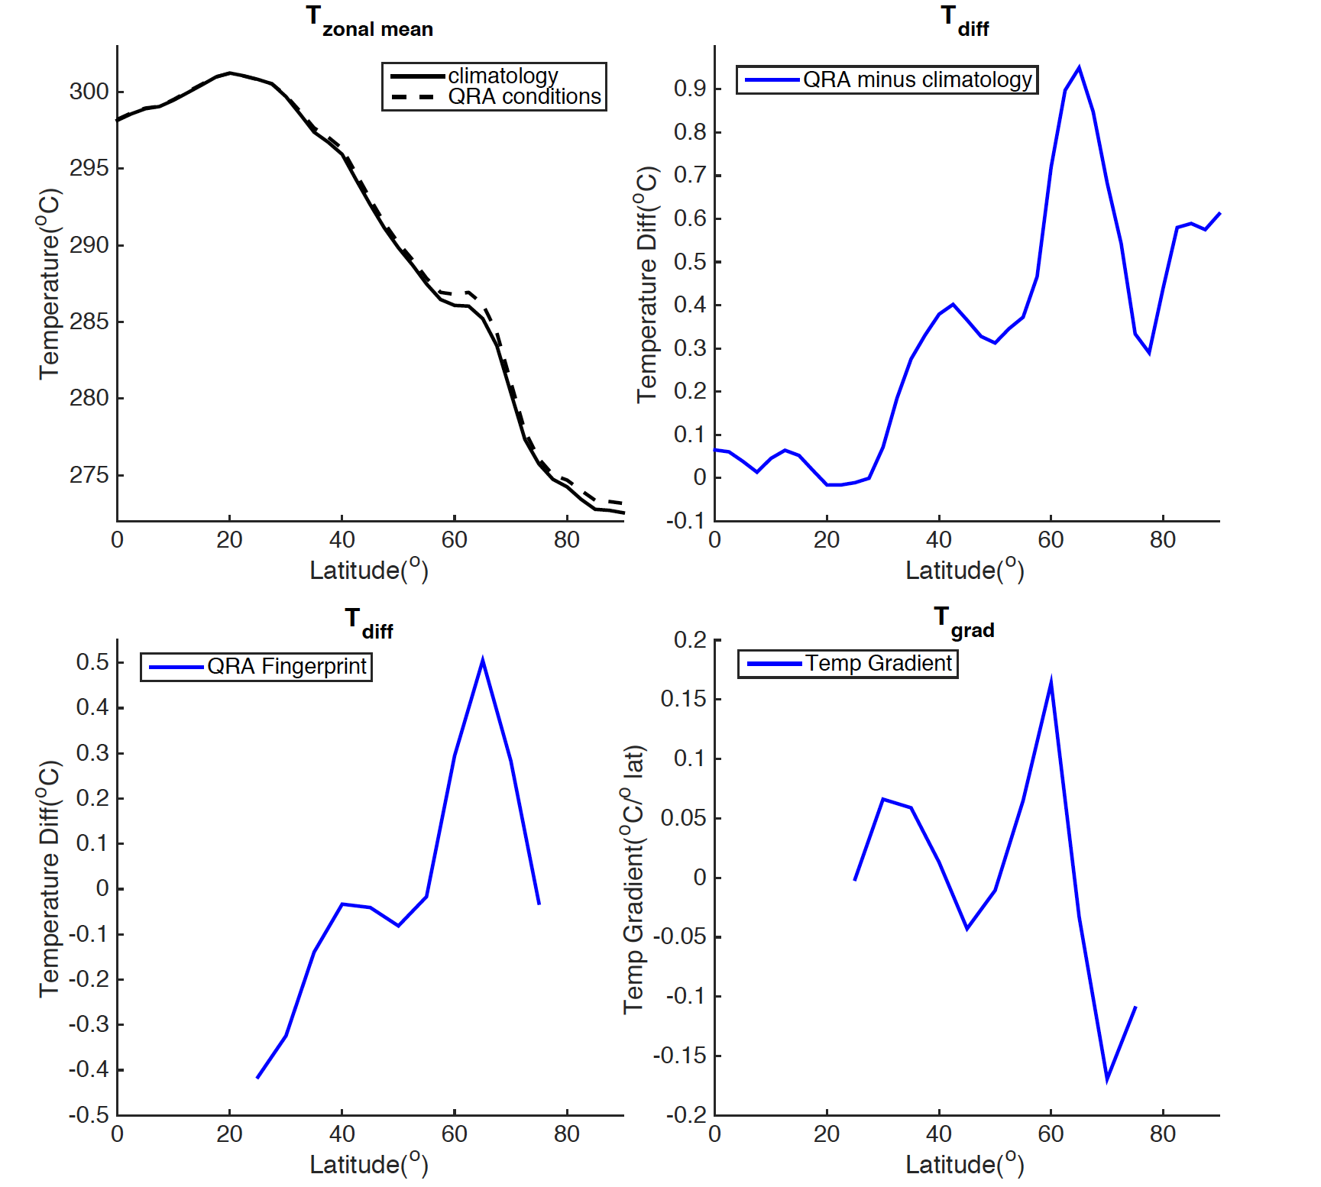
Fingerprint analyses
100
Surface temperature during resonance characterized by enhanced high-latitude warming and enhanced land warming
Percentage of Land Area (%)
50
0
Mann et al. (2017)

Slide 17
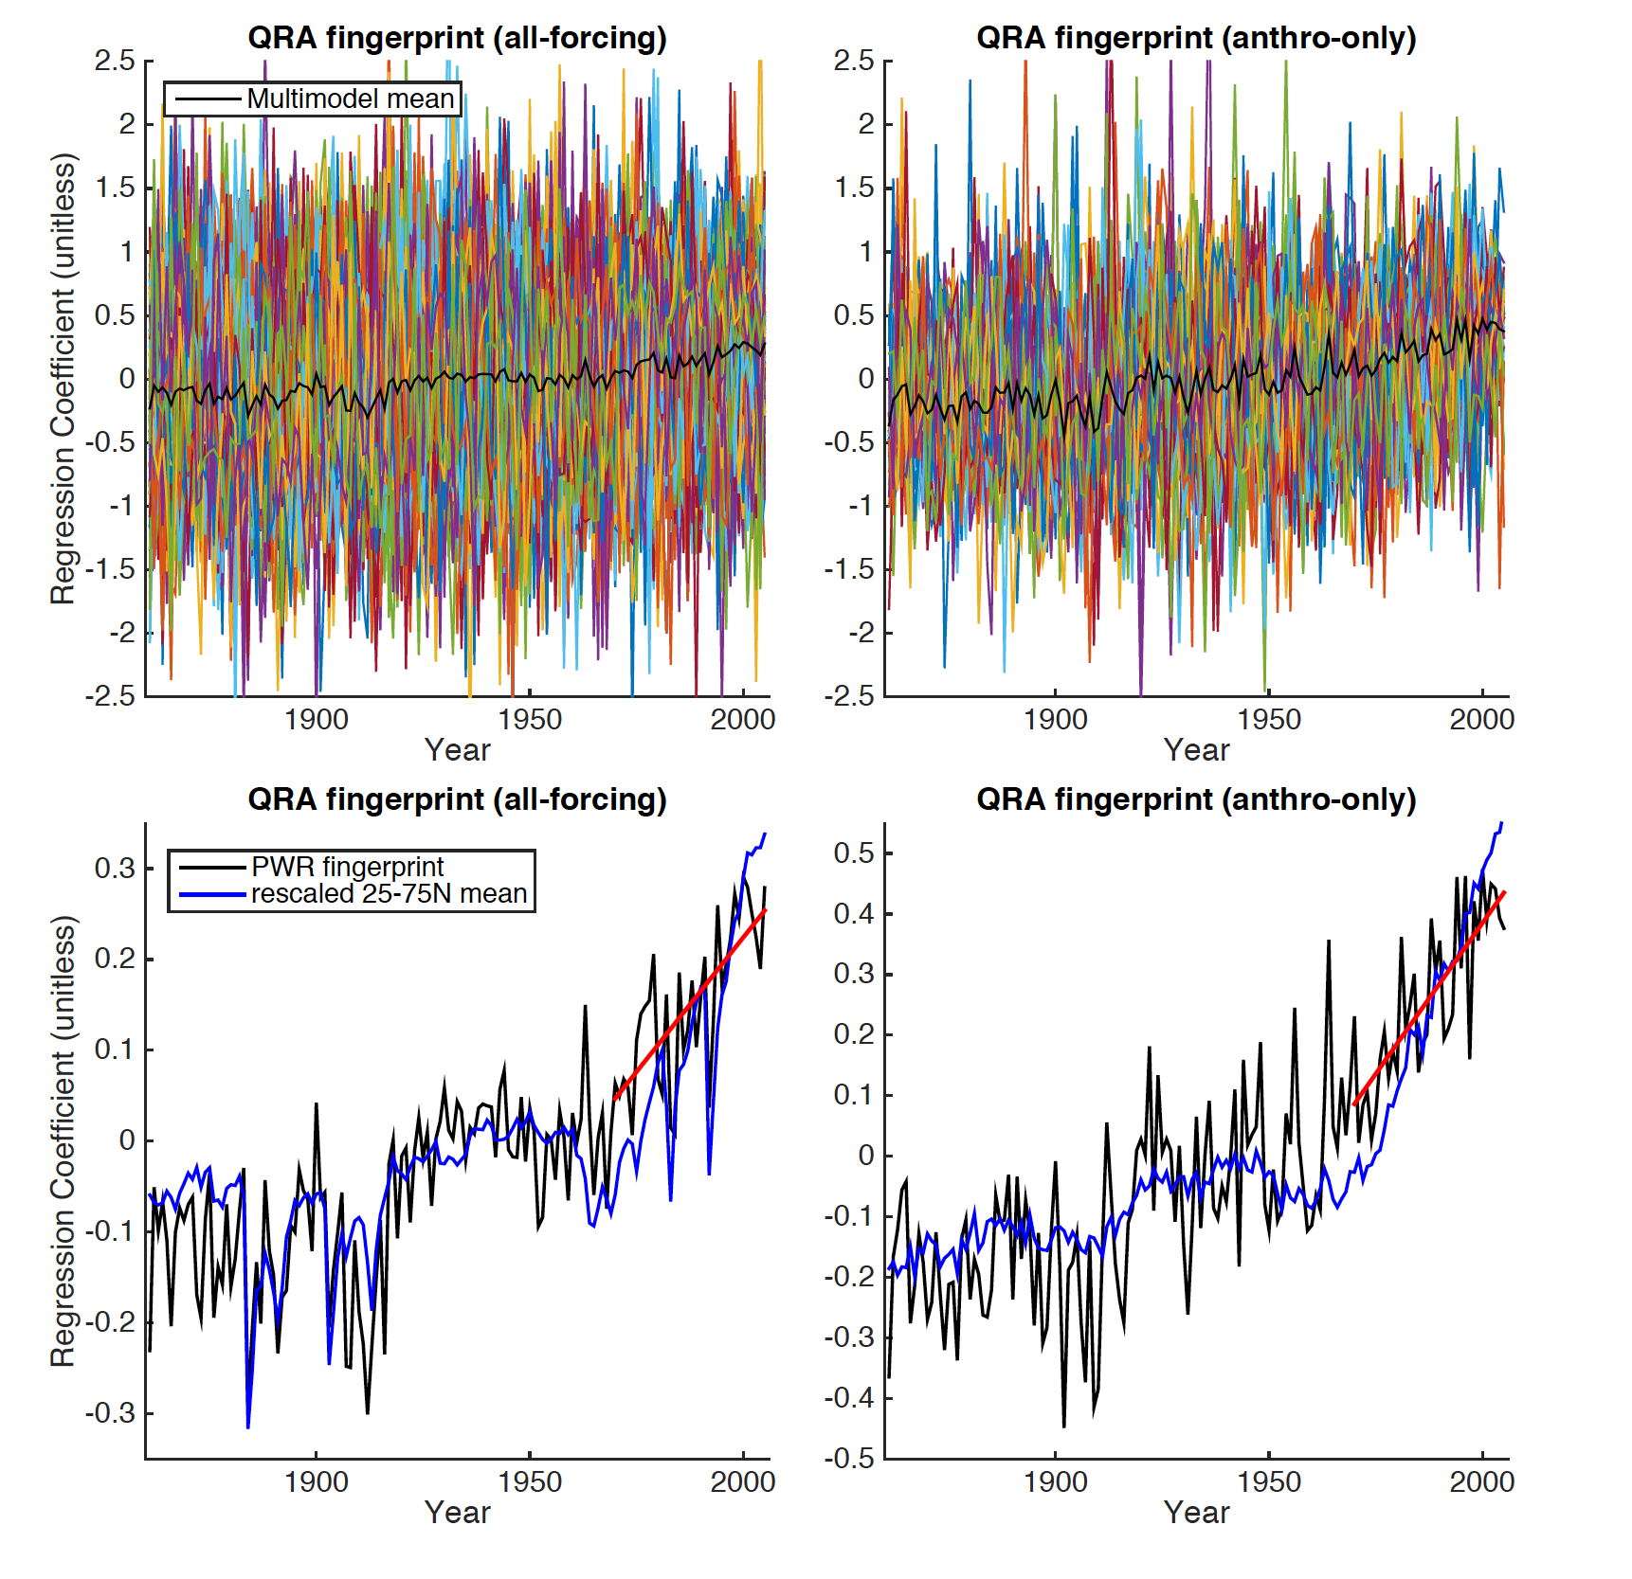
Resonance Fingerprint in Historic CMIP5 simulations
Individual runs show large variability
68% of all-forcing and 88% of anthro-only runs have significant post-1970 trend
Ensemble-mean clearly upward

Slide 18
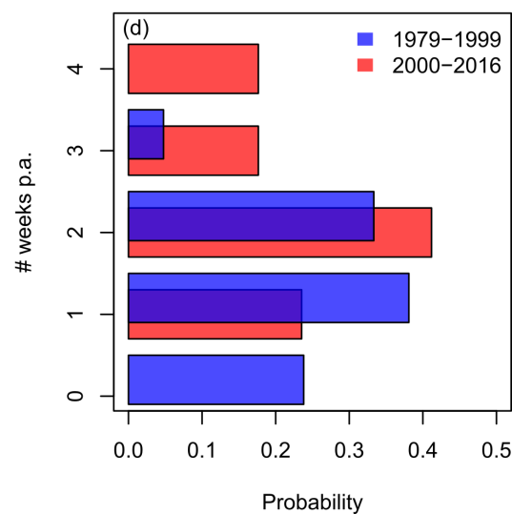
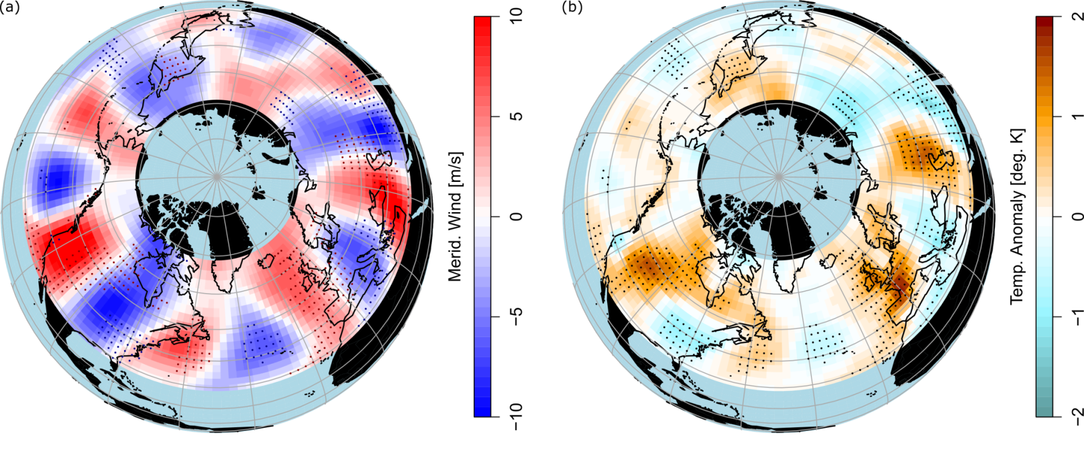
Prolonged resonances since 2000
Increasing heat wave risks in some regions
Kornhuber et al. (in prep.)

Slide 19
Connecting some dots…
Enhanced Land Warming
Tropical Broadening
Arctic Amplification
Increased possibility of double jets
?
Weakened jet, storm tracks
?
Sharp sub-tropical jet
(Slightly) increased stationary wavenumber
Sub-tropical Turning point
?
RESONANCE
…work in progress
Null-hypothesis seems certainly defensable
Land-surface feedbacks likely important

Slide 20
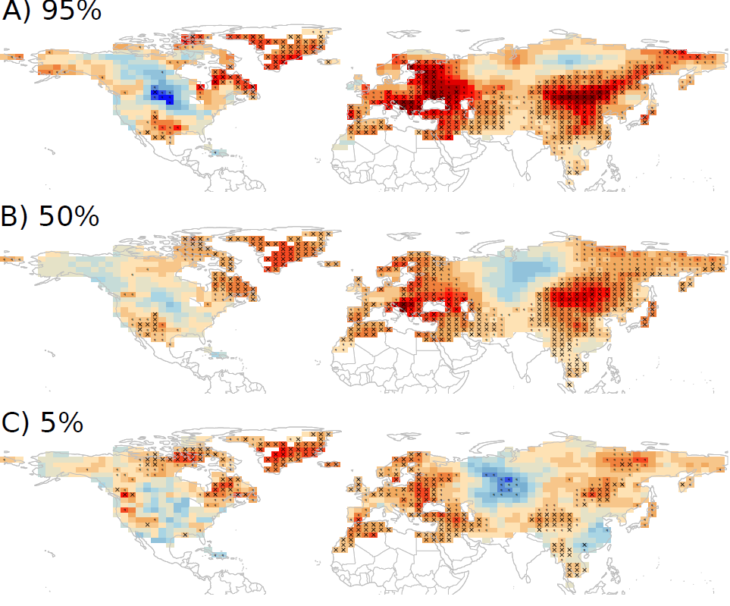
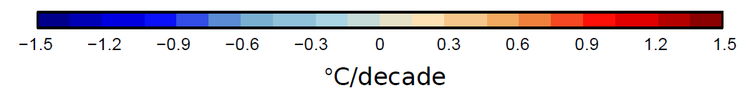
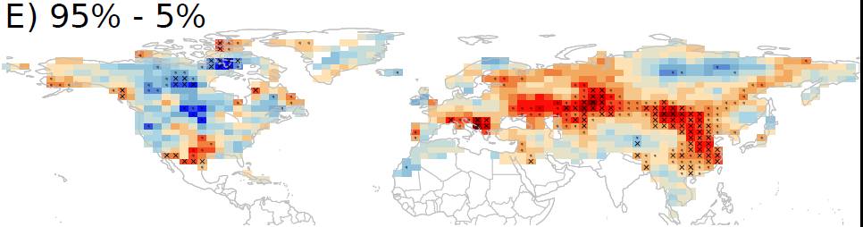
Hot tail of temperature distribution warms faster
Possible indication for dynamically induced increase in heat extremes
1980-2015 HadGHCND daily summer temperature trends

Slide 21
Preliminary conclusions
Summer circulation changes: Weakened jet & storm tracks, more-frequent double jet states
Likely partly attributable to GHG forcing: Arctic amplification + enhanced land warming
These changes seem to favor persistent weather situations
Detected changes just emerging from noise: null-hypothesis defensible

Slide 22
References:
K. Kornhuber, V. Petoukhov, S. Petri, S. Rahmstorf, D. Coumou, Evidence for wave resonance as a key mechanism for generating high-amplitude quasi-stationary waves in boreal summer. Clim. Dyn. (2016)
V. Petoukhov, S. Petri, S. Rahmstorf, D. Coumou, K. Kornhuber, H-J. Schellnhuber, The role of quasiresonant planetary wave dynamics in recent boreal spring-to-autumn extreme events, Proc. Nat. Ac. Sci. (2016)
L. Stadtherr, D. Coumou, V. Petoukhov, S. Petri, S. Rahmstorf, Record Balkan floods of 2014 linked to planetary wave resonance, Science Advances, 2, 4, 2016
J. Lehmann and D. Coumou, The influence of mid-latitude storm tracks on hot, cold, dry and wet extremes, Scientific Reports 5, 17491, 2015
D. Coumou, J. Lehmann, J. Beckmann, The Weakening Summer Circulation in the Northern Hemisphere Mid-latitudes, Science, 348 (6232), p.324-327, 2015
J. Lehmann, D. Coumou, K. Frieler, A. Eliseev and A. Levermann,Future changes in extratropical storm tracks and baroclinicity under climate change, Environ. Res. Lett., 9, 2014
D. Coumou, V. Petoukhov, S. Rahmstorf, S. Petri and H-J. Schellnhuber, Quasi-resonant circulation regimes and hemispheric synchronization of extreme weather in boreal summer, Proc. Nat. Ac. Sci., 111(34), p.12331-12336, 2014
V. Petoukhov, S. Rahmstorf, S. Petri and H-J. Schellnhuber, Quasiresonant amplification of planetary waves and recent Northern Hemisphere weather extremes, Proc. Nat. Ac. Sci., 111(34), p.12331-12336, 2013

Slide 23
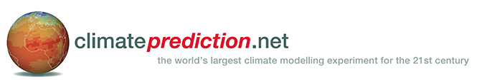
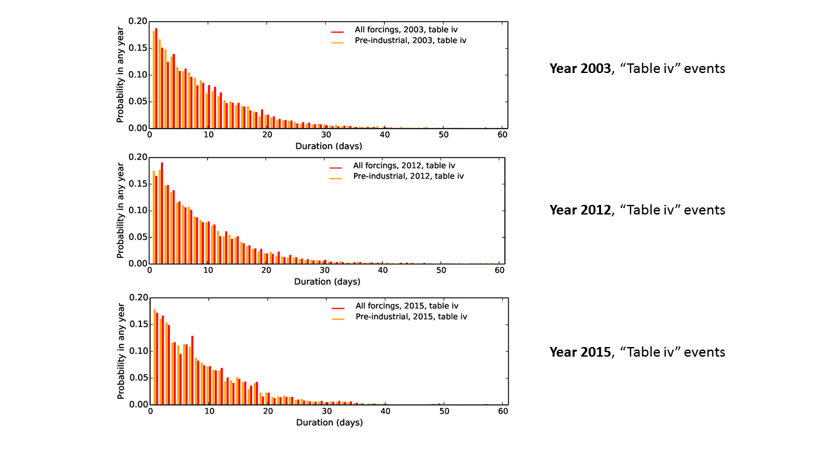
Understanding drivers
Collaboration with Dann Mitchell, Myles Allen, Chris Huntingford
Preliminary results
Frequency & duration similar as observed
Appears to be little influence of GHG forcing
Year-to-year changes in SST patterns seem more important
To do´s
How well is resonance reproduced in model?
More generic modeling experiments to understand drivers
…and more.
Globally Observed Teleconnections and their role and representation in a Hierarchy of Atmosphere Models

Slide 24
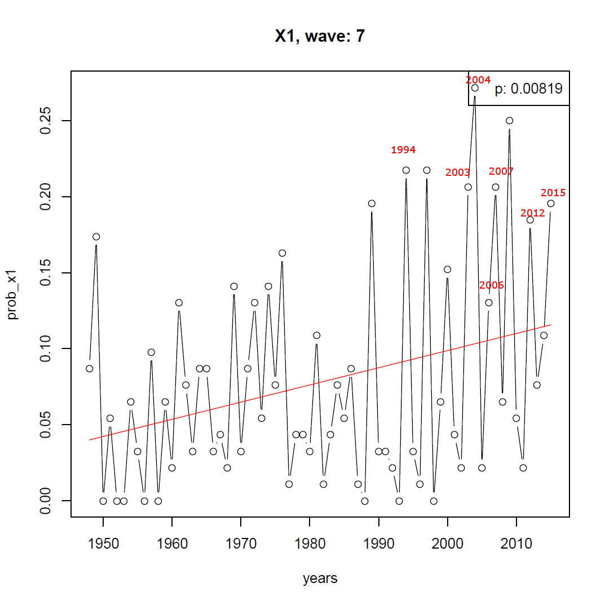
Increasing probability of high-amp quasi-stationary wave-7

Slide 25
Motivation
Summer, with most biological and agricultural production, is probably the season when future changes in extremes will have the most-severe impacts
Tail risks: In summer, any dynamically induced changes in heat wave intensity/persistence act on top of thermodynamic drivers
Summer circulation less thoroughly studied compared to winter circulation

Slide 26
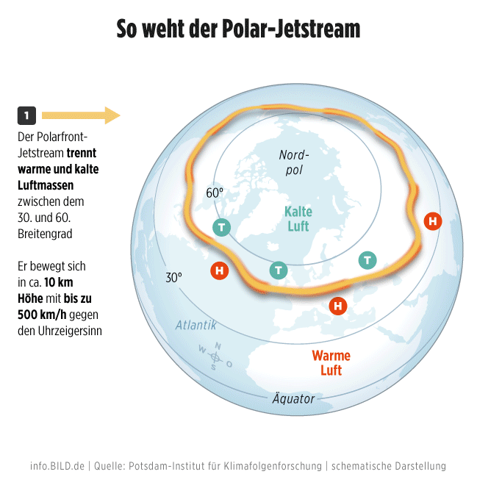
Info.Bild.de | Quelle: PIK / SacreX | schematische Darstellung

Slide 27
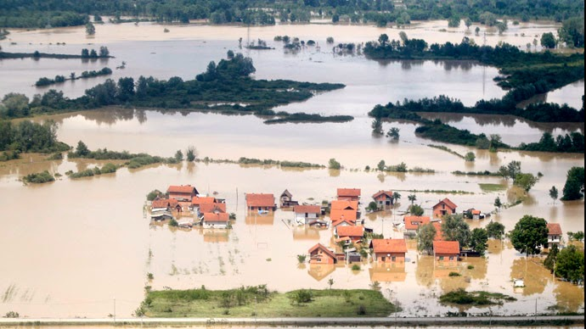
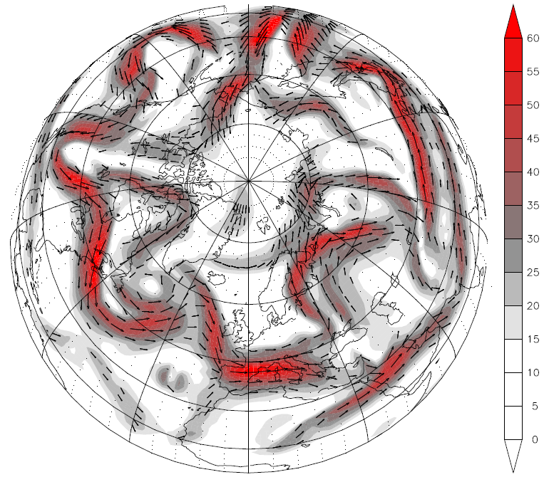
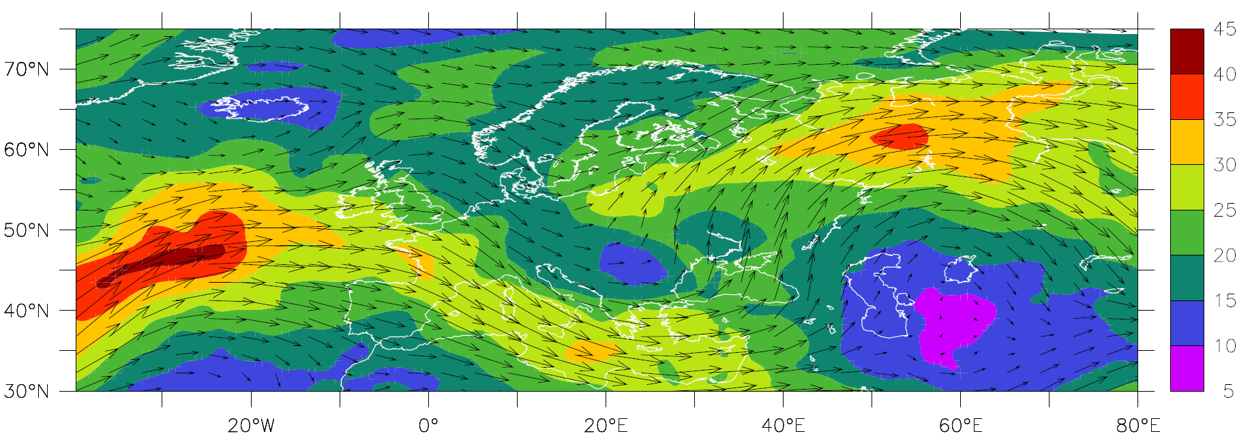
Balkan flooding in May 2014
Wavy Jetstream
7th – 22nd of May 2014
Wavy Jetstream, which was almost stationary over Europe
Wind speed [m/s]
L
H
Stadtherr et al, Sci. Adv. (2016)

Slide 28
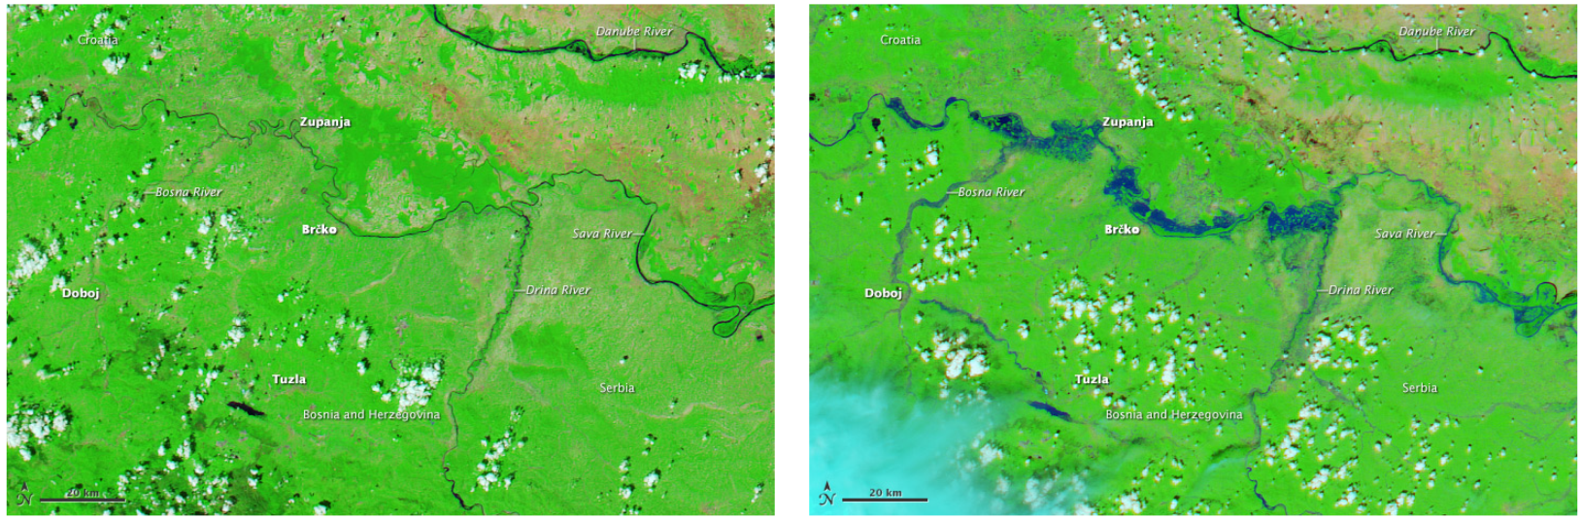
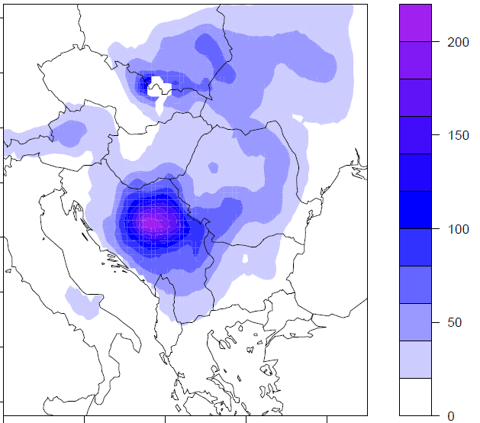
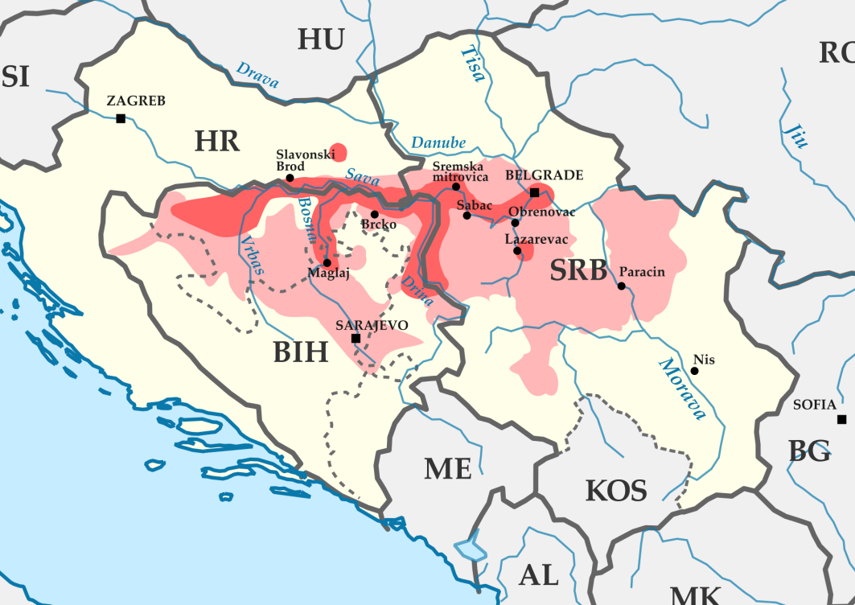
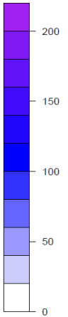
Quasi-stationary Vb cyclone
Cyclone track + Accumulated Rainfall
17th
15th
16th
14th
Rainfall [mm]
13th
Stadtherr et al, Sci. Adv. (2016)

