Slide 1
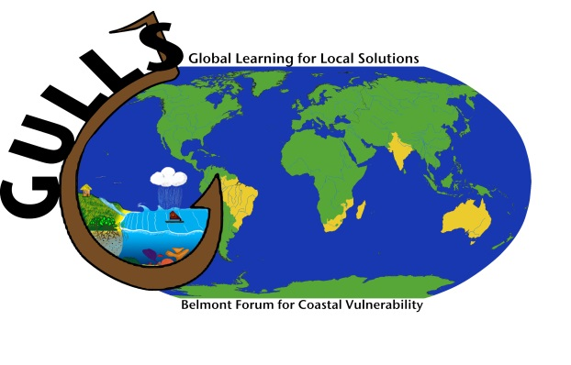
Global learning for local solutions: Reducing vulnerability of marine-dependent coastal communities: GULLS
Ekatrina Popova and Warwick Sauer
Presentation to Belmont Mid-term Meeting, September 2014, Rotterdam, The Netherlands
Notes:
Understanding human behaviour and its drivers is key to marine environmental outcomes
Why ….. Predict potential responses to economic, ecological and regulatory changes
Modelling human drivers (economic, social, cultural, psychological ) and behaviour can be incorporated into (combined with) biological, ecological, and physical models.
also called Marine socio-ecological systems models (SES) models

Slide 2
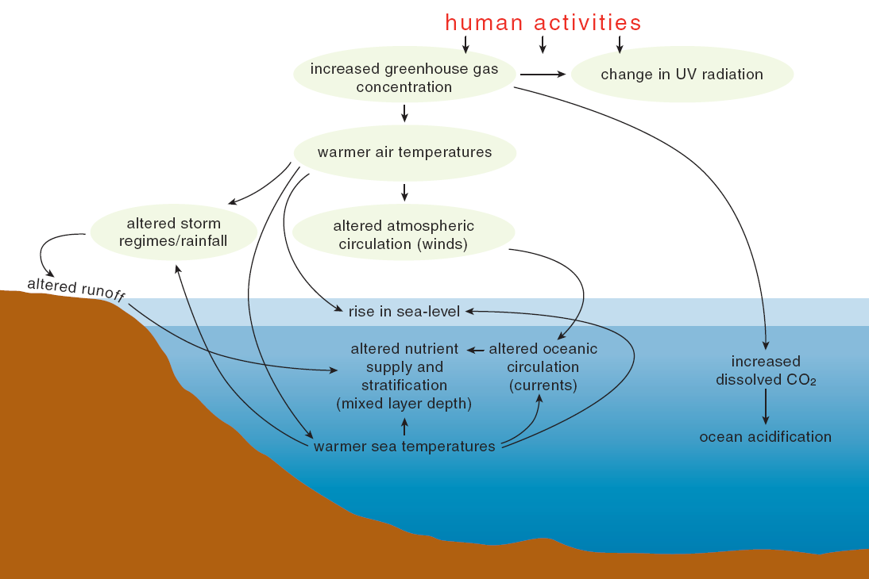
Climate Change Impacts on the Ocean
Poloczanska et al 2007

Slide 3
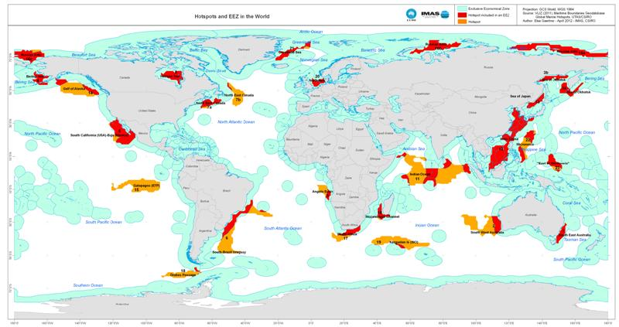
Global marine hotspots
From Hobday and Pecl. Reviews in Fish Biology and Fisheries, 2014

Slide 4
The GULLS Response
A holistic approach will be developed and applied to five southern hemisphere hotspot regions: Brazil, India, the Mozambique Channel, southern Benguela (South Africa) and South East Australia). The project will deliver a comprehensive set of options to reduce vulnerability of coastal communities, particularly in relation to the role of coastal resources for food, thereby contributing to an improved future
GOAL
This project will contribute to to improving community adaptation efforts by characterizing, assessing and predicting the future of coastal-marine food resources through the provision and sharing of knowledge across regional "hotspots“.

Slide 5
Project objectives
Build regional skill-sets that can reduce coastal vulnerability by evaluating and characterizing likely impacts,
Create predictive systems that will inform decision makers about the expected consequences of coastal changes;
Deliver alternative options in terms of adaptation and transformation within coastal communities; and
Define the long-term implications of selecting a particular option in terms of economic, social and environmental outcomes.

Slide 6
GULLS Core Activities in Each of the Hotspots
  Phase 1
  Assess direct and indirect drivers and observed impacts on biological and human components of coastal systems in each hotspot;
  Using a common VA framework in participatory mode, determine the vulnerability of coastal peoples with regard to climate-related marine food security;
  Exchange visits and training to develop skills and train early career researchers for the in-country work.
  Phase 2
  Develop and apply predictive, integrated frameworks and models to help to develop future scenarios and adaptation options with local communities, managers and policy-makers.
  Develop and disseminate education and communication tools, a vulnerability assessment framework, and options for adaptation and transformation within coastal communities.

Slide 7
The Hotspots

Slide 8
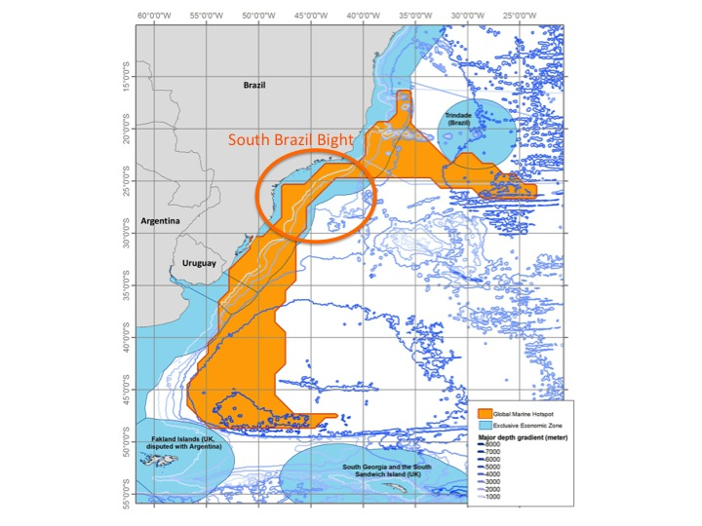
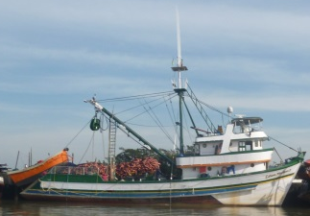
Brazil hotspot
Potential shifts in distributional range of commercially important species
  Climatic anomalies, patches of sea overwarming, coastal erosion
Fisheries are socially and economically important regional industries
  Sardine, shrimps, skipjack tuna
Changes affecting people’s livelihoods
infrastructure,, fisheries
  Fishing communities are vulnerable to global
  change
Focal work in the hotspot
  Social vulnerability assessment
  Small scale and commercial fishers perceptions of the marine environmental change
  Modelling to detect change, projections, and options to reduce social vulnerability and maintain food security and local seafood access

Slide 9
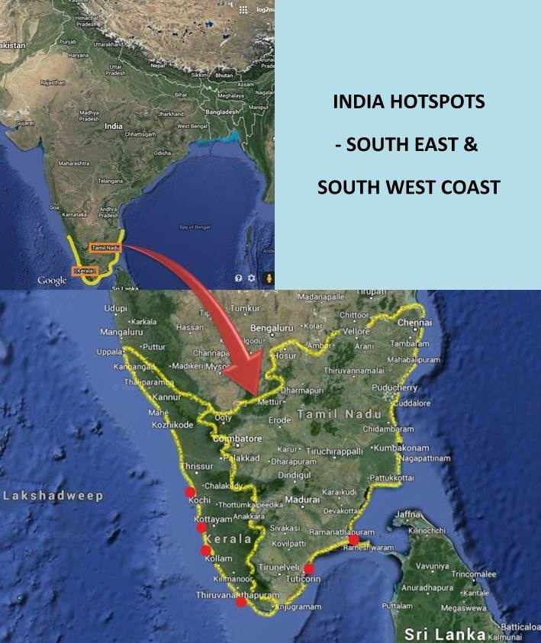
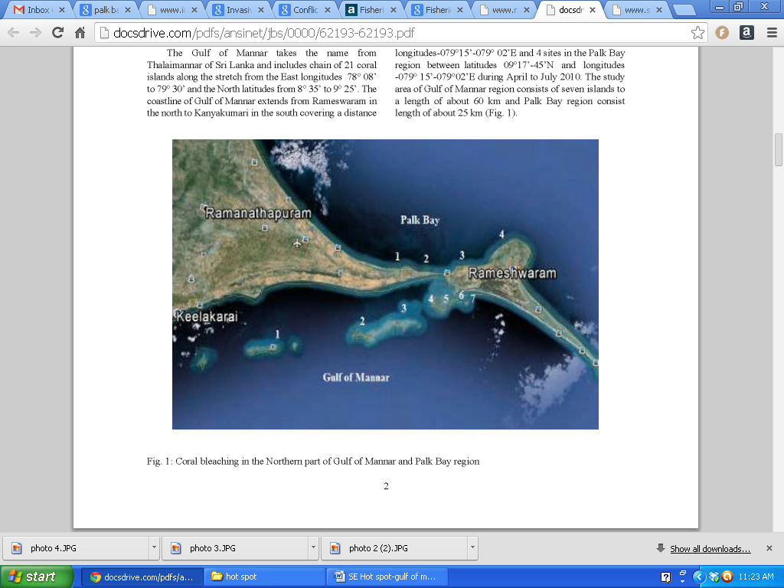
INDIA HOTSPOTS INDIA HOTSPOTS
INDIA HOTSPOTS
Southern India- predicted to warm substantially faster than the global average
Small pelagics extend their boundaries, some species may be found in deeper waters -
Indian Oil Sardine and Mackerel
Phenological changes- thread fin breams
Changes in species composition of phytoplankton
Temperatures have risen by an average of 0.90±0.1ºC per century in the Gulf of Mannar
Coral Bleaching
Sea level rise in the Indian seas
Focal work in the hotspot
  Social vulnerability assessment
  Climate Resilient Village Adaptation and
  Mitigation Plan
    Climate Informed fishers
Coral bleaching

Slide 10
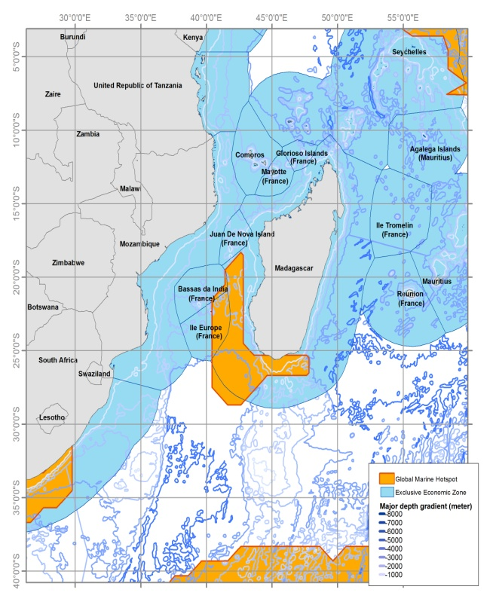
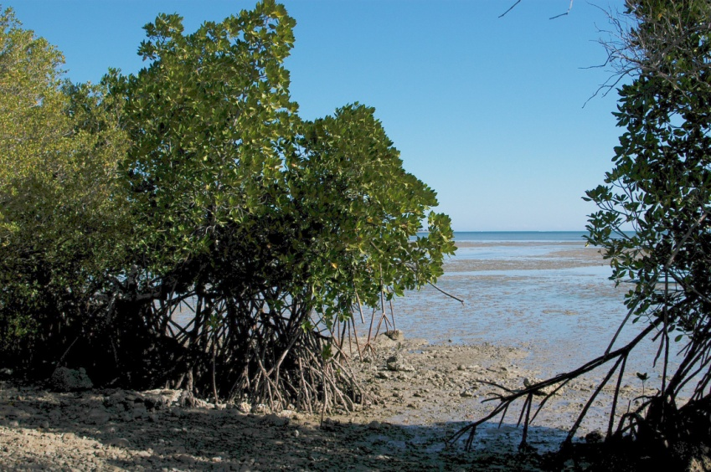
Mozambique Channel
Covers an area of over 330 000 km². This hotspot is found in the Mozambique Channel, with 76% taking in the exclusive economic zone of Madagascar.
Madagascar’s marine environment is an essential source of both food and income
Coastal communities are vulnerable to climate change impacts on key ecosystems: coral reefs, mangroves, seagrass beds, coastal lagoons.
Low adaptive capacity – alternative livelihoods
Focal work in the hotspot
  ROMS-IBM modelling
  Climate change model projections
  Ecosystem model
  Species vulnerability assessment
  Socio-economic surveys
  Adaptation options and recommendations

Slide 11
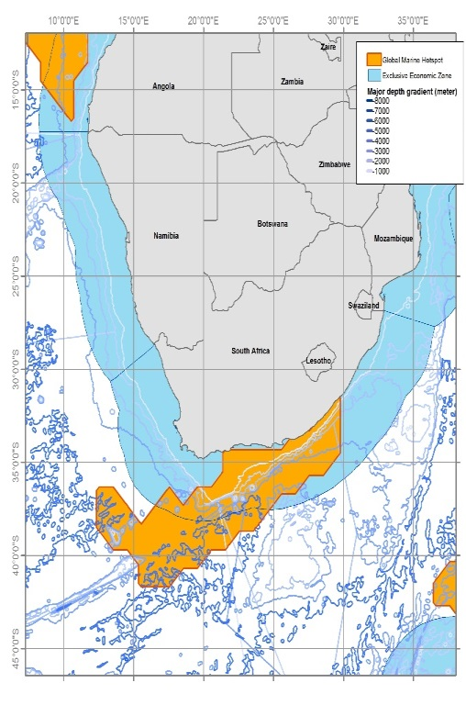
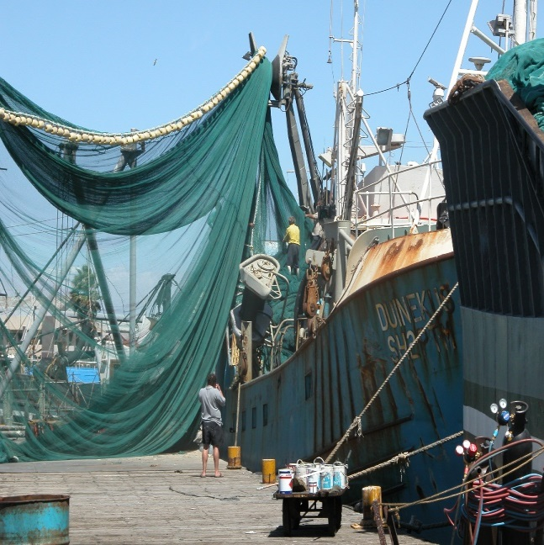
Southern Benguela hotspot
Covers the West and South Coast of South Africa (Orange River Mouth to East London), with an area of ~ 220 000 km².
Commercial, recreational and small-scale fisheries are important activities on the region.
Changes in the distribution of species of ecological and economic importance.
Overfishing causing major declines in the abundance of non-target species.
Negative effects on the livelihoods of fishers and communities.
Medium and high vulnerability of the different fisheries sub-sectors to environmental change and variability.
Focal work on the hotspot
- Ecological and social vulnerability assessments
  - Integrated modelling to explore optimal management approaches and other adaptations to reduce vulnerability to future changes
  - Socio-economic studies
Notes:
Key concerns
Changes in the distribution of species of ecological and commercial importance. i.e. eastward shifts in the distribution of rocky shore organisms, West Coast rock lobster, sardine and anchovy.
Over-fishing of target species causing major declines in the abundance of fish, invertebrate and birds species.
Distribution changes and over-fishing of commercial species have affected a large number of fishers and communities because they are strongly dependent on these resources for their livelihoods.
Freshwater flow reduction as a result of changing rainfall patterns.
Medium and high vulnerability of some of the different fisheries sub-sectors to environmental change and variability due to low ability to adapt to reduced catches and catch rates, in particular West Coast rock lobster, the subsistence and small-scale and small pelagic fisheries.

Slide 12
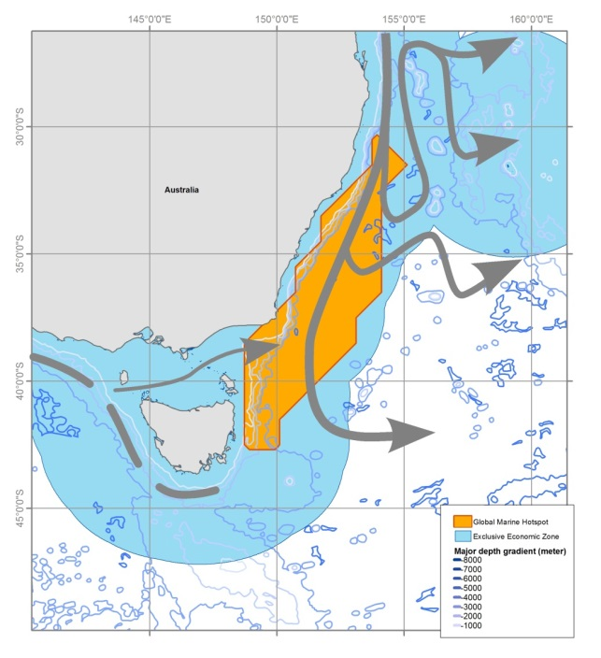
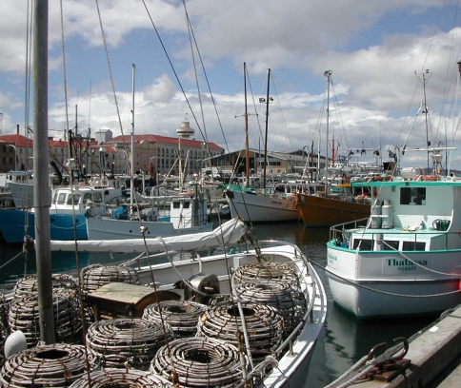
South-east Australia hotspot
Many species moving further south
  Habitats changing too
Commercial fisheries are important regional industries
  Abalone, rock lobster, finfish
Changing species distributions impact on fishing profitability
  Heightened conflict between commercial and recreational fishers
Focal work in the hotspot
  Social vulnerability assessment
  policy mapping to determine key influencers
  integrated modelling to assess options to reduce social vulnerability and maintain food security and seafood access

Slide 13
Methods and Approaches

Slide 14
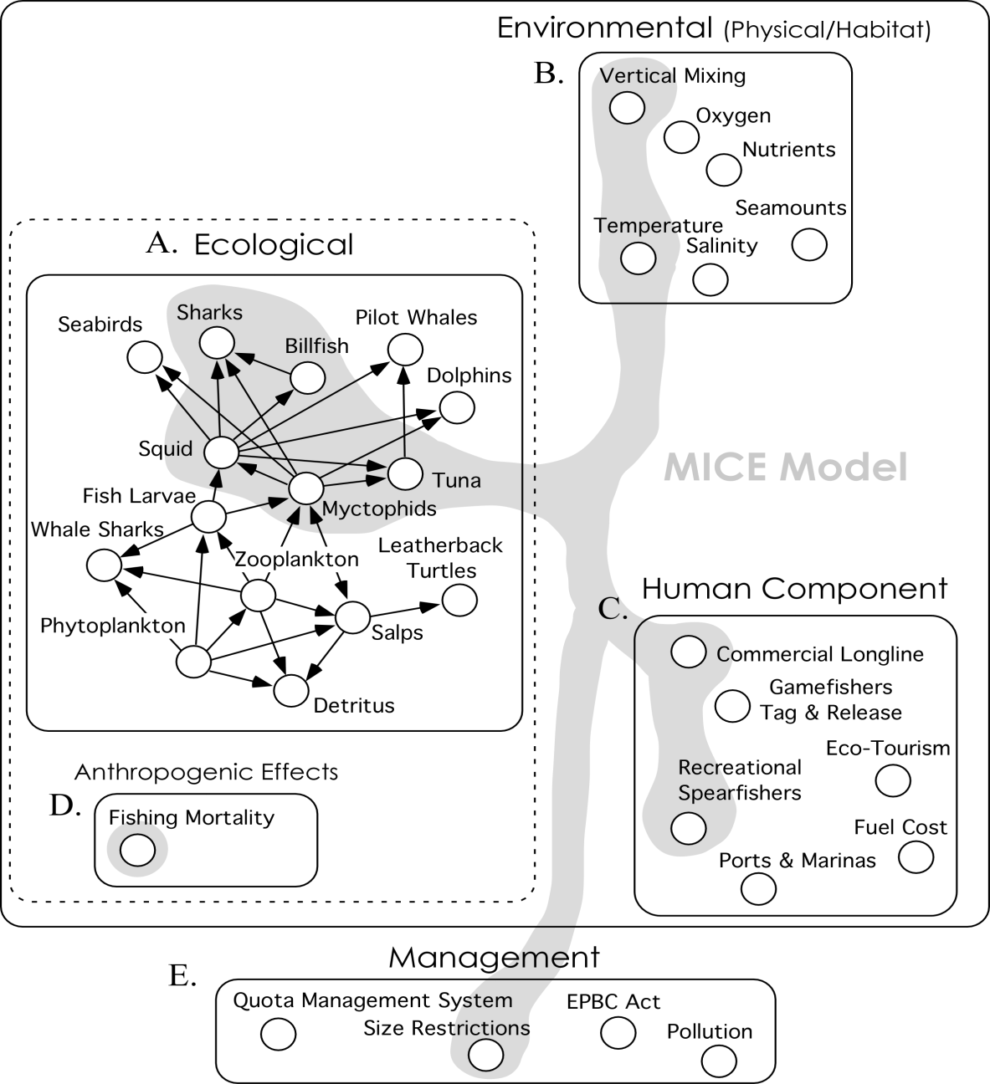
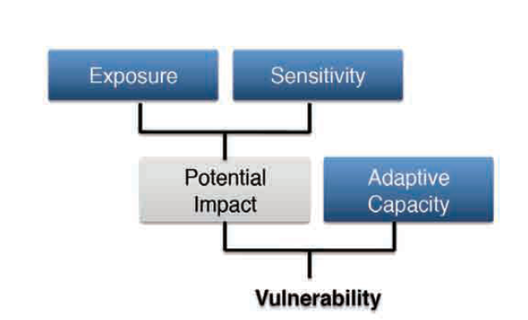
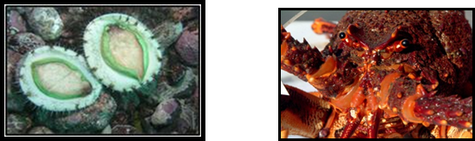
Ocean models, system models and risk assessments
1. DYNAMIC MODELS
Climate drivers
e.g. Biophysical model
Conceptual / Understanding
Strategic decision tools
e.g. Whole ecosystem models such as Atlantis, EwE
Tactical decision tools
e.g. Extensions to stock assessment models, Models of Intermediate Complexity (MICE)
OBJECTIVES
RE MANAGEMENT
APPLICATIONS
2. ECOLOGICAL RISK ASSESSMENTS
e.g. Approaches building on Ecological Risk Assessment for Effects of Fishing (Hobday et al. 2007)
Estimate sensitivity of species to climate drivers based on ABUNDANCE, DISTRIBUTION and PHENOLOGY
Conducted for SE Australia, being repeated in South Africa and Western Indian Ocean and possibly adapted for India and Brazil
(as per Pecl et al accepted, Climatic Change)
Notes:
NOTES:Tools in support of ecosystem-based fisheries management include a range of models as well as ecological risk assessment approaches. Models range from simple to complex, qualitative to quantitative with different models used based on the objectives as below, and climate drivers either explicitly included or coupled biophysical models used as drivers:
Conceptual/understanding: of the structure, functioning and interactions of the ecosystem, or sub-system, under consideration. May not be used explicitly in decision-making or scientific advice but forms the underlying context for any detailed management planning and decision-making
Strategic decisions: linked to policy goals and are generally long-range, broadly-based and inherently adaptable
Tactical decisions: aimed at the short-term (e.g. next 3-5 years), linked to an operational objective and in the form of a rigid set of instructions e.g. tactical decision to change quota
Whole ecosystem or end-to-end models include eg Atlantis (Fulton et al 2011 – Fish Fisheries) InVitro model (Ningaloo Reef, Australia) (Fullton, E. A. 2010 Approaches to end-to-end models. Journal of Marine Systems 81, 171-183).
MICE (Plaganyi et al 2013 Fish Fisheries) are intermediate in complexity between single-species and whole-of-ecosystem models in terms of the number of components (e.g. species or functional groups) or processes represented. MICE attempt to explain the underlying ecological processes for a limited group of populations (typically <10) subject to fishing and anthropogenic interactions MICE provide the ability to address tactical questions, are fit to data and account for major uncertainties
RISK ASSESSMENT APPROACHES (eg Approach builds on Ecological Risk Assessment for the Effects of Fishing (ERAEF, Hobday et al. 2007)
High-level ‘screening’ species sensitivity assessment to determine research and adaptation investment based on potential for change
Outputs: relative sensitivity ranmkings highlighting eg species at risk of range contraction or species at risk of range extension (per Pecl et al accepted, Climatic Change)

Slide 15
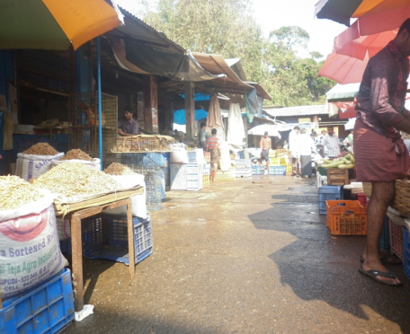
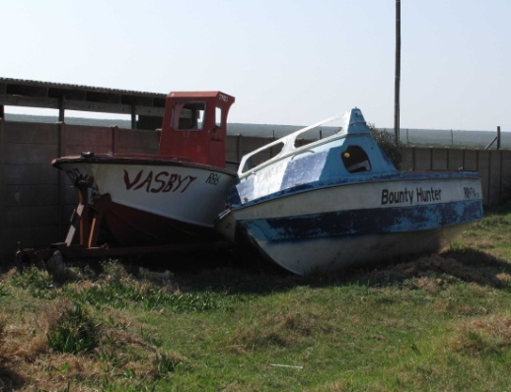
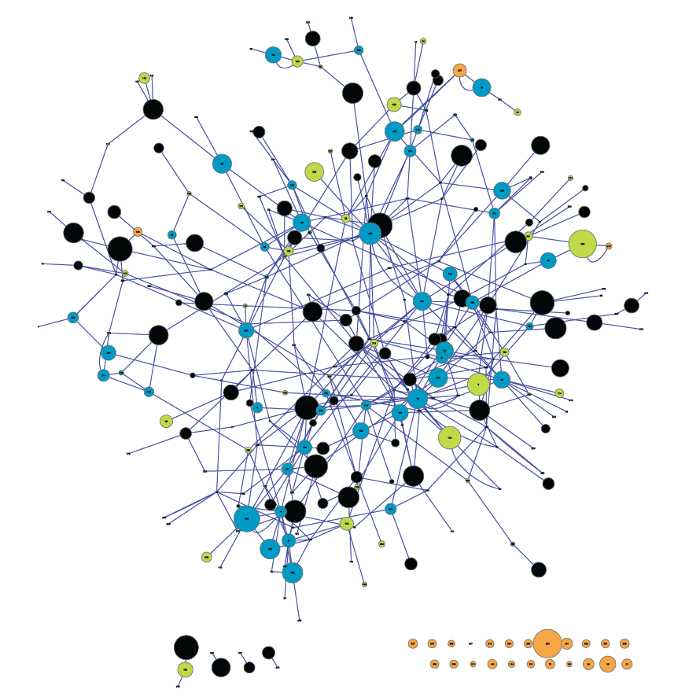
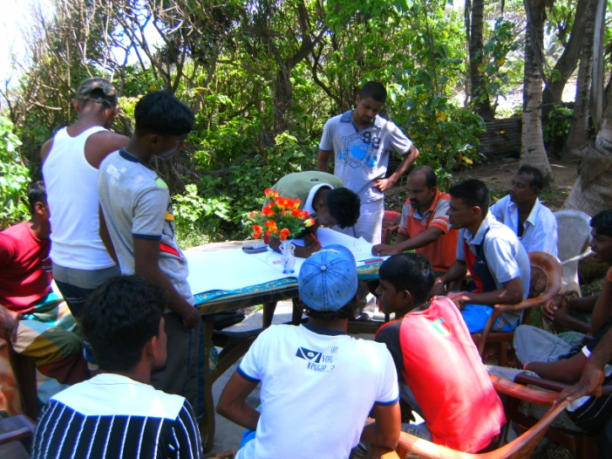
Social models and approaches
Expanded social vulnerability assessments (VA) in 3-5
coastal communities per hotspot
Establish community objectives and adaptation options
Model indicator relationships between community
objectives and vulnerability indicators - Bayesian and
qualitative models
Supply chain analysis and mapping to scale up from
community to regional level & identify adaptation
options
Summary analyses – cross comparisons of modelled
relationships and adaptation options among hotspots

Slide 16
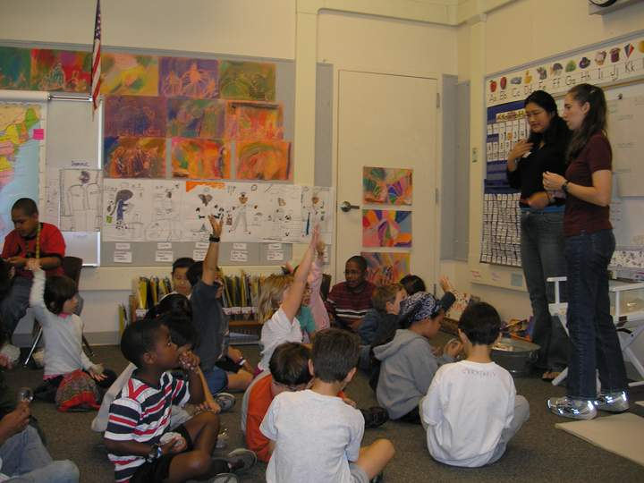
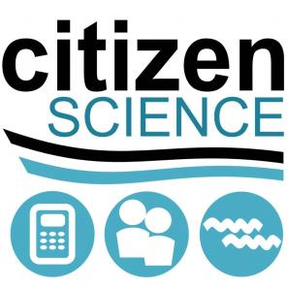
Education and Outreach – Empowering Costal Communities
Informing local communities about the ocean and environmental impacts of climate change on marine resources. We employ a wide range of education and outreach programs at each of the Hotspots, including professional development to local school teachers and academics through workshops, citizen science programs, and development of locally relevant scientific educational resources
Notes:
The GULLS project seek to inform the local population about the ocean and the environmental impacts of climate change on marine resources. To that end we are employing a wide range of education and outreach programs at each of the Hotspots. This includes professional development to local school teachers and academics through workshops and development of locally relevant scientific educational resources.

Slide 17
Synthesis and formulation of options for management and policy
Comparison across hotspots, and in-depth within each hotspot, based on social techniques, vulnerability assessments, and model simulations will reveal for;
Conservation – options to manage preservation conflict with resource use
Harvest – what are options for reducing vulnerability of resource users
Coastal development – what compromises may be need to support both conservation and harvest, and still allow for “development”
What agencies are the influencers in each region?

Slide 18
Conclusions and Next Steps
Project is on track to achieve goals of Phase 1 and preparations already underway for Phase 2.
The partnership is working well, with excellent cooperation and synergies. Cross-over sharing of expertise is a major strength. Demonstrates value of Belmont approach
More could be achieved with higher levels of funding, including ear-marked funding for project oversight and international coordination. One country has not yet received its funding.
Additional funds are being sought and would help project to reach full potential.
Second GULLS workshop scheduled for Brazil, March 2015. Will be an important opportunity for checking progress, reinforcing cooperation and ensuring on track for successful completion.

