Slide 1

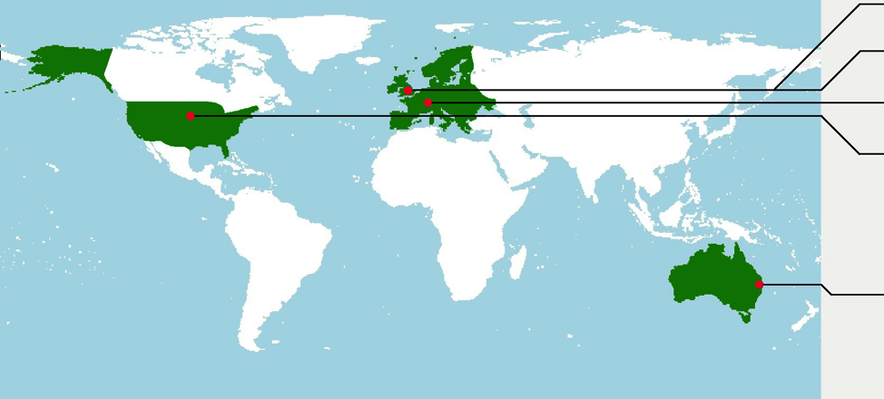




Drought Impacts:
Vulnerability thresholds in monitoring and Early-warning Research
Kerstin Stahl, Mark Svoboda, Jamie Hannaford,
Cody Knutson, Kevin Collins, Neville Crossman, Ian Overton, Matthew Colloff, Mike Acreman

Slide 2

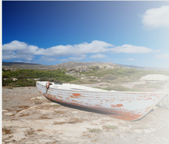
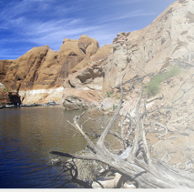

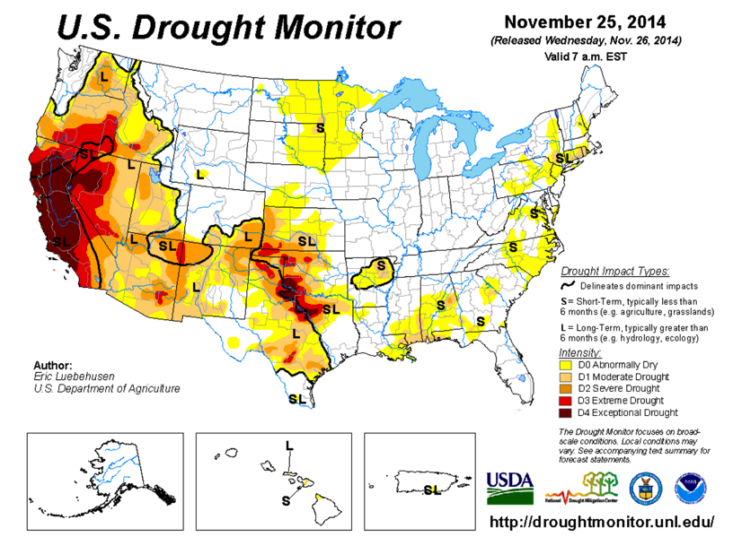
Background
Drought events threaten water security in virtually every climate zone and water use sector
Little can be done to prevent a drought
But actions can be taken to reduce the vulnerability, including the development of drought Monitoring and Early Warning (M&EW) systems
→ exisiting systems are often large-scale and consider hazard only
Sun: http://www.redapplereading.com
Monitoring: http://droughtmonitor.unl.edu

Slide 3
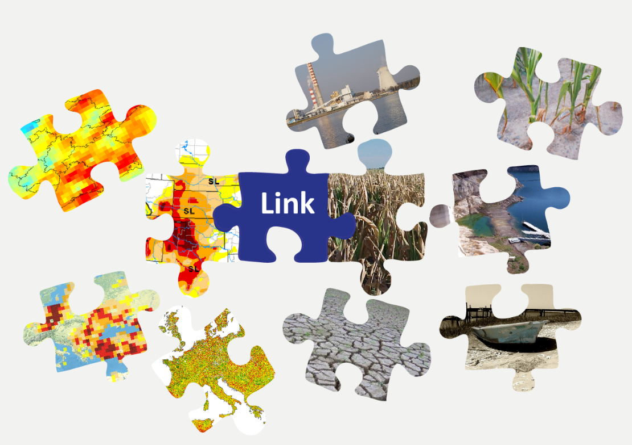
Research Gap to fill
Drought
Impacts
Drought
Monitoring

Slide 4
Inter- and Transdisciplinary Challenges
People’s perception
Governance
Drought
Impacts
Indicators for
Monitoring
Drought Management
Economic relevance of water sectors

Slide 5
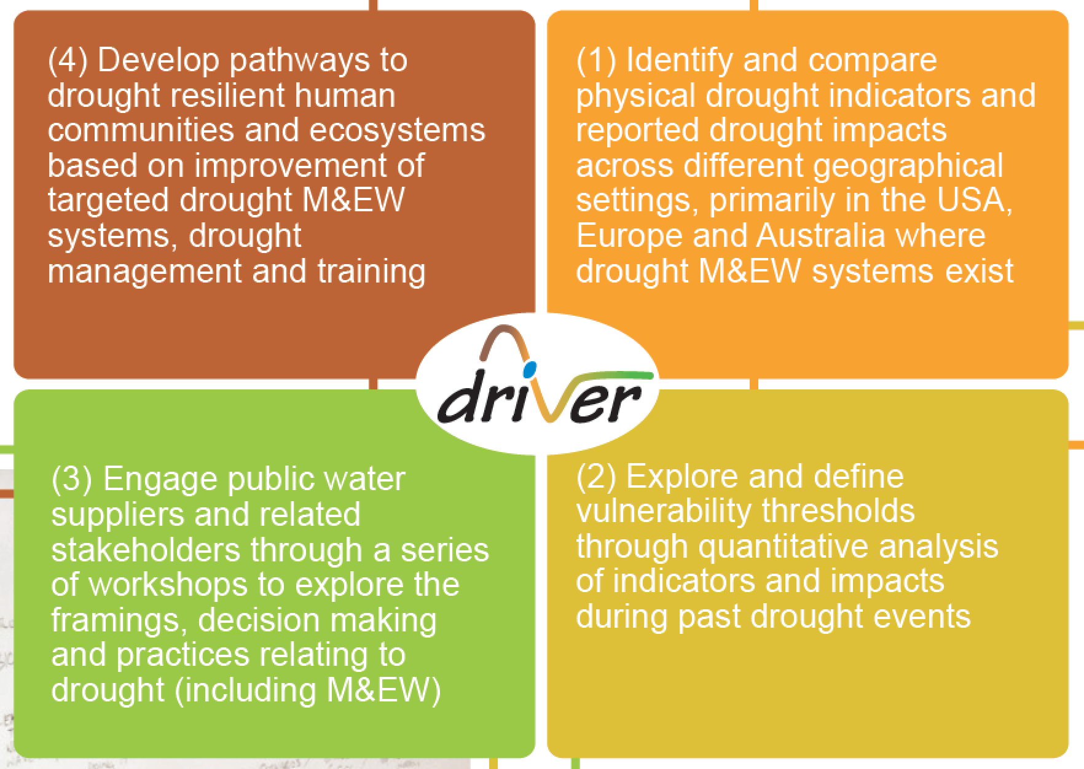
Objectives

Slide 6
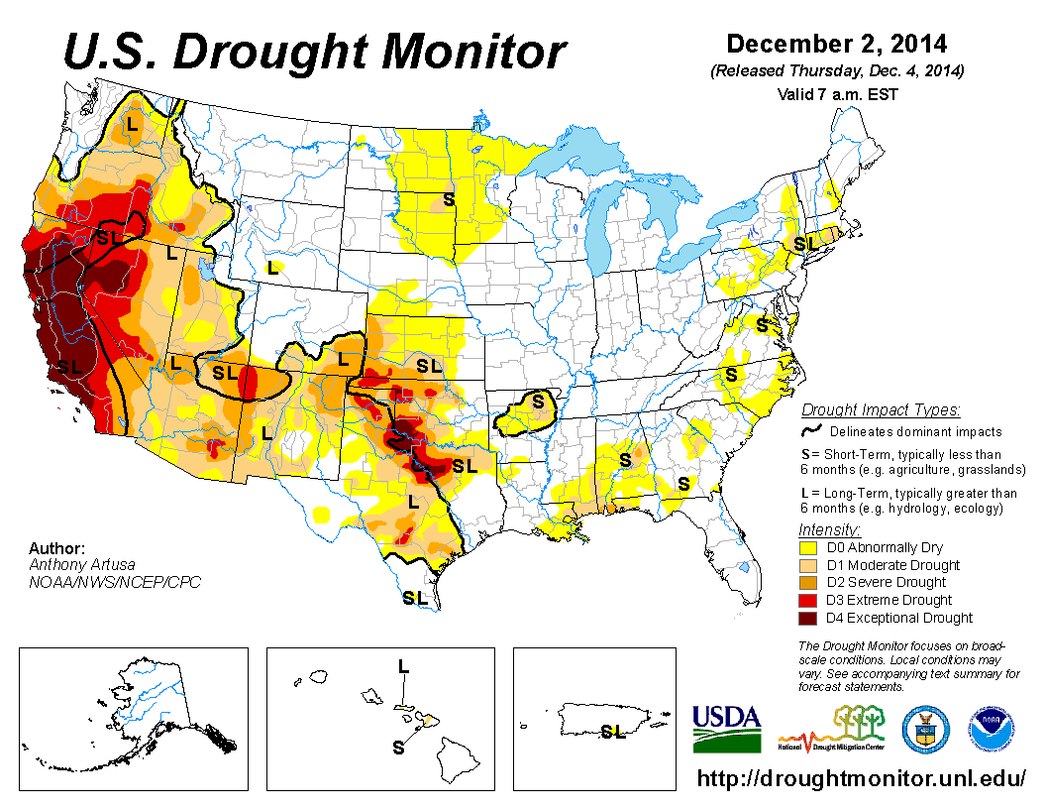
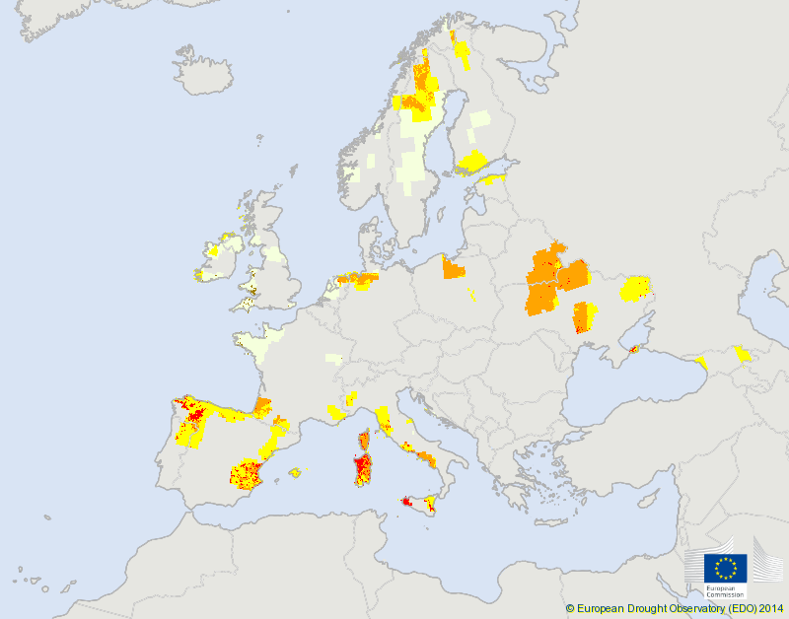
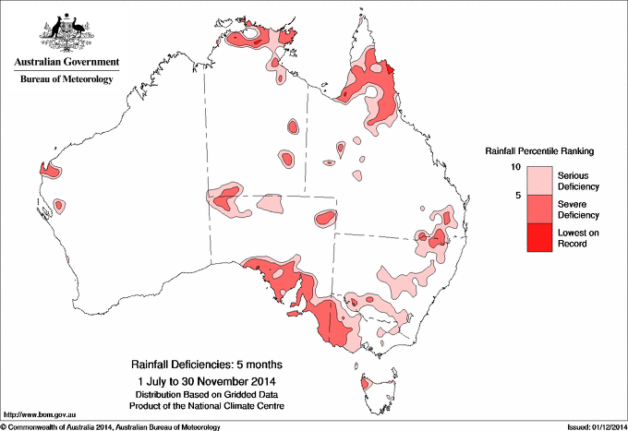
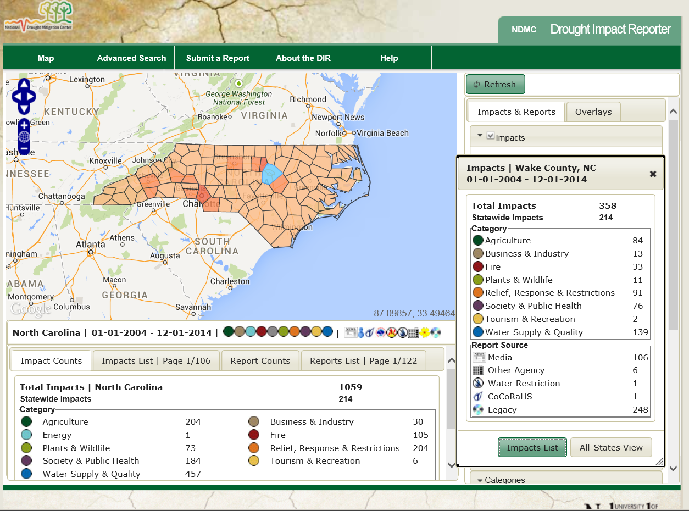
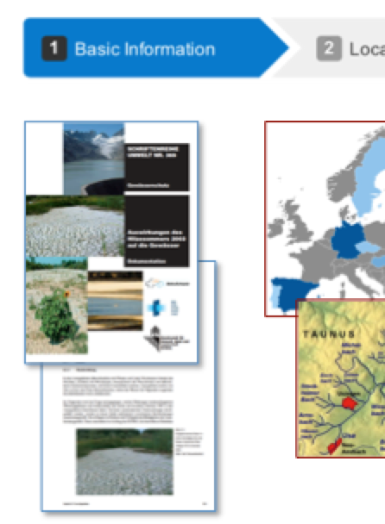
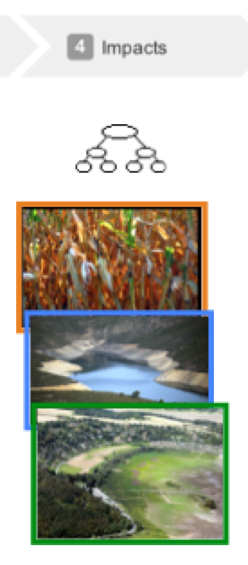
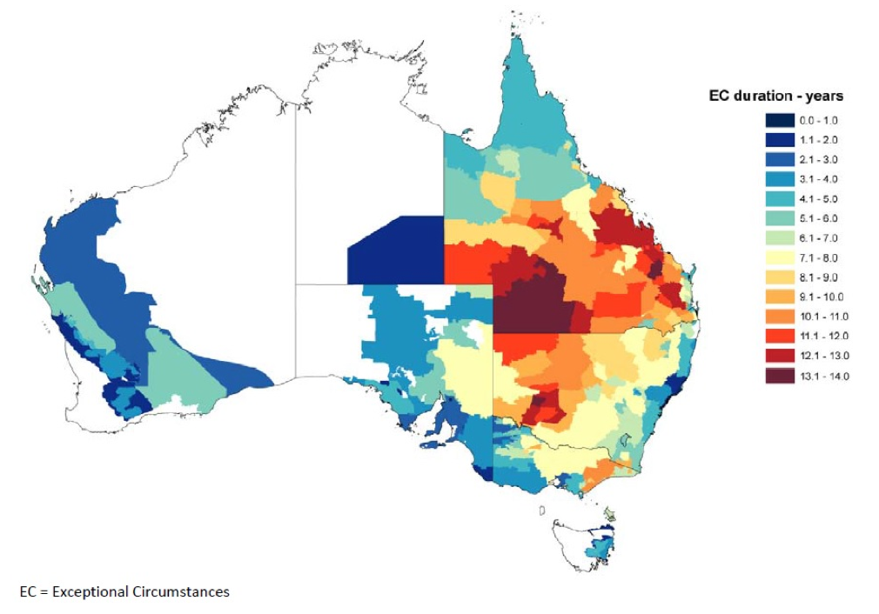
Drought M&EW on three continents
EDO by JRC (EU)
precipitation
soil moisture (model)
vegetation (RS)
BoM
precipitation
NDMC (grant funded)
Impact reporter &“agreed maps”
Advanced M&EW and participatory approaches
EDO: JRC (EC funded), collaboration with member states though DWSG
EDII Impacts: DROUGHT-R&SPI project
Bureau of Meteorology (Gov.)
Further information at basin scale, for agriculture, other.
Impacts: no concerted database but many sources
http://www.farminstitute.org.au

Slide 7
Objectives

Slide 8
Objectives

Slide 9
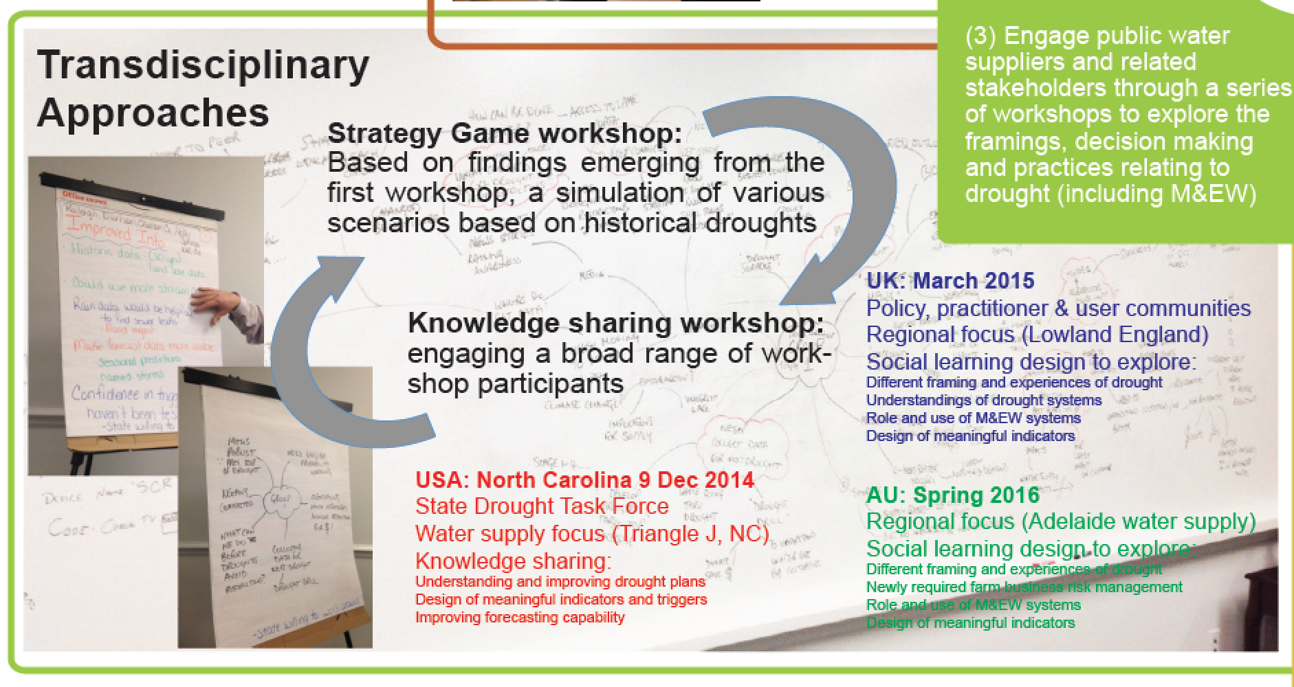
Workshop approach

Slide 10
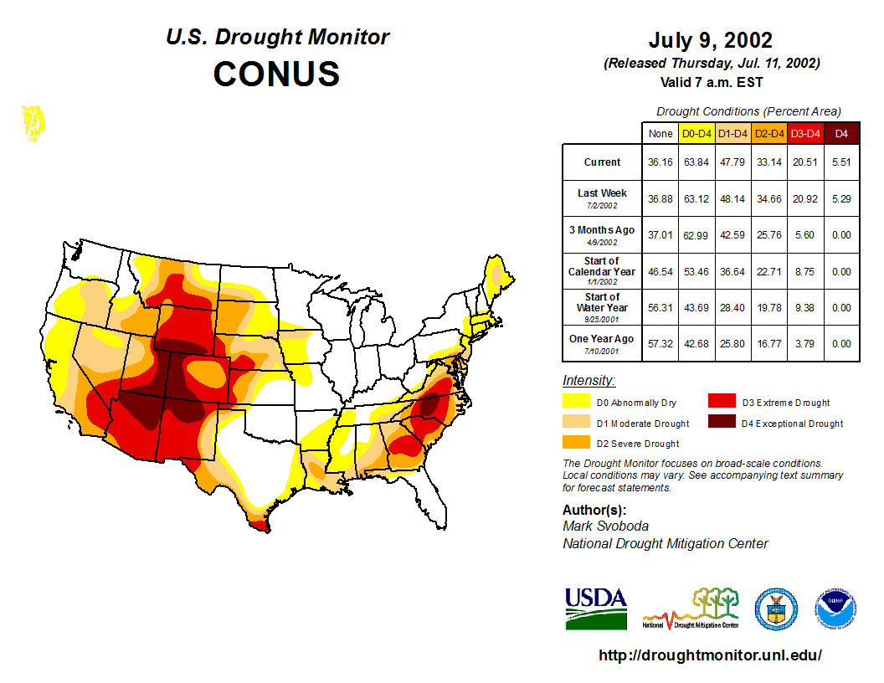
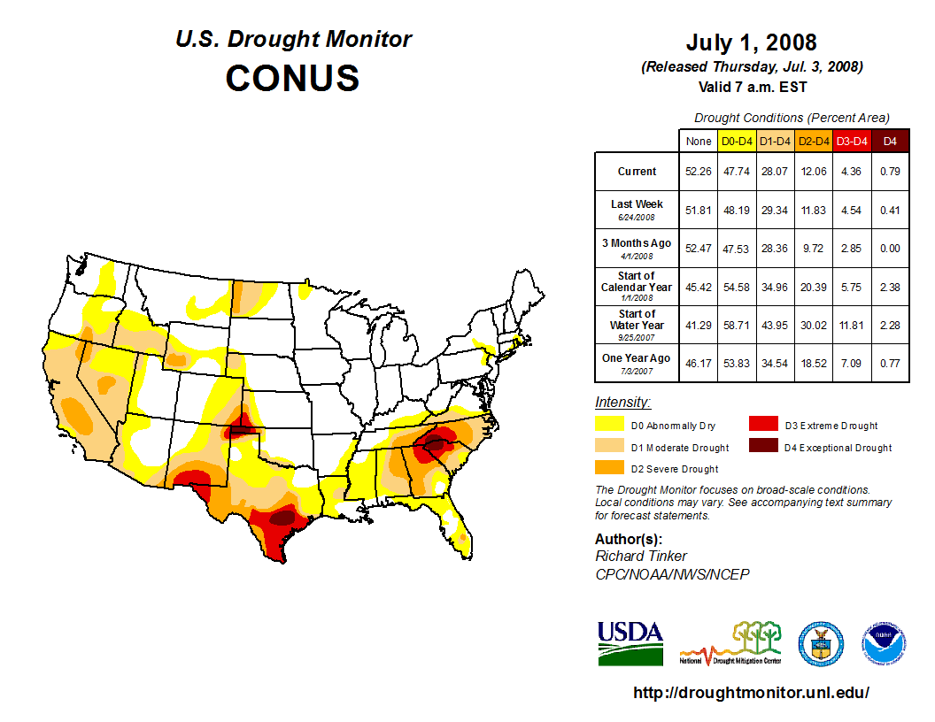
Results: knowledge sharing workshop USA
Neuse & Cape Fear Basins, NC
Enhanced historical comparisons (analogs)
Better data and models, especially, integrating climate change, land use, and customer behavioral data
Better education and communication before, during, and after drought to reduce risk
Drought drills with public service announcements for water conservation
Peer teams at the federal, state, and local levels

Slide 11
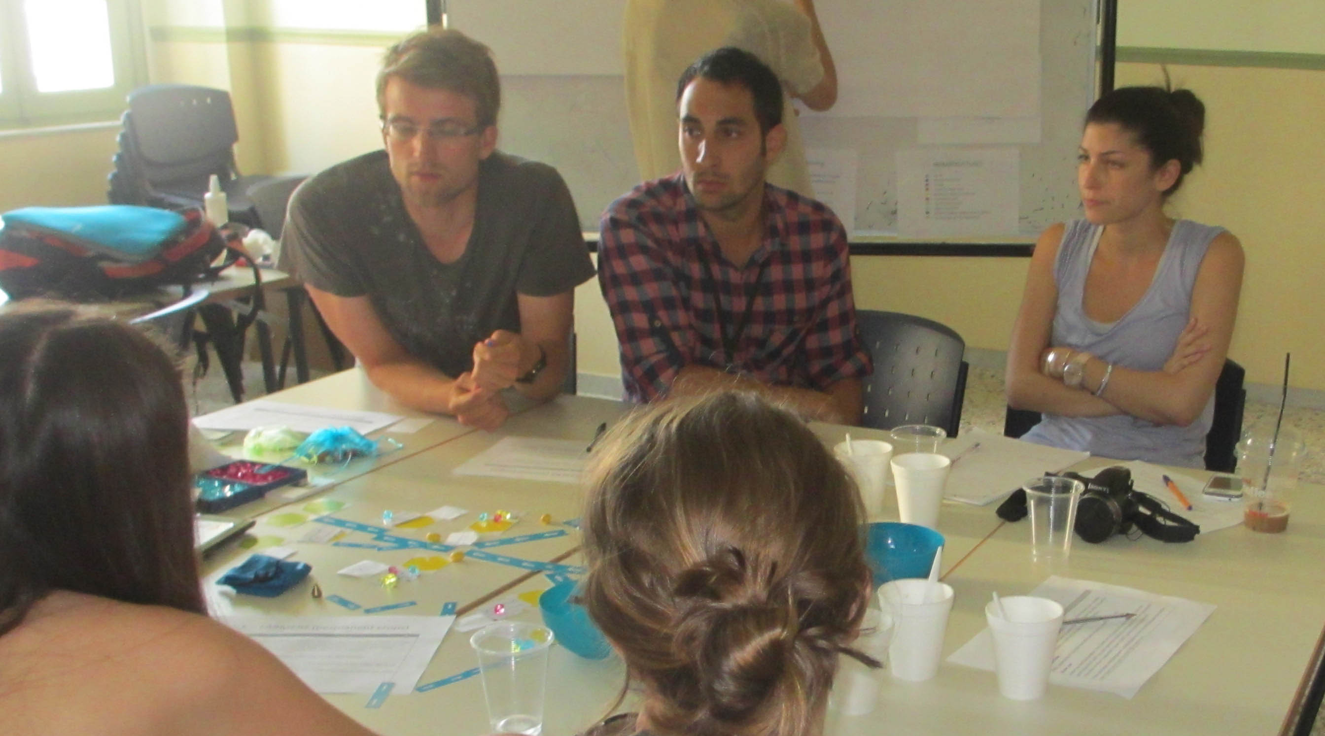
Objectives

Slide 12
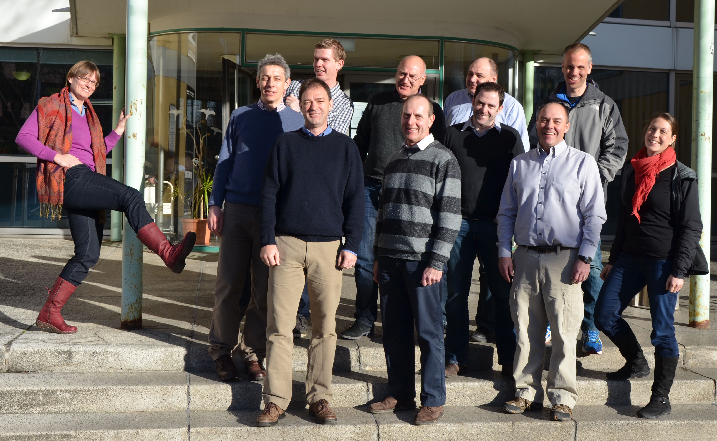
Thank you!

