Slide 1

Collaborative Research Action on Disaster Risk Reduction and Resilience (DR³):
A funding opportunity through the Belmont Forum
Participating Funding Agencies: FAPESP, MOST, JST, QNRF, UKRI and NSF

Slide 2
Overview
Belmont Forum brief overview
Scope of the DR³ CRA
Structure and Eligibility Requirements
How Researchers Can Engage

Slide 3
Belmont Forum
Partnership of funding organizations, international science councils, and regional consortia committed to the advancement of interdisciplinary and transdisciplinary science for sustainability sciences.
Scientist and stakeholder engage through Collaborative Research Actions (CRAs).
Project submitted in the Belmont Forum Grants Operations (BFgo) must be co-developed by natural scientists, social scientists, and stakeholders from at least three countries.
Open data policy and requirements.
Details about eligibility and available support can be found in the organizational annexes for each call for proposals.
Notes:
Scientist and stakeholder engage through Collaborative Research Actions (CRAs), which equivocate to a call for proposals

Slide 4
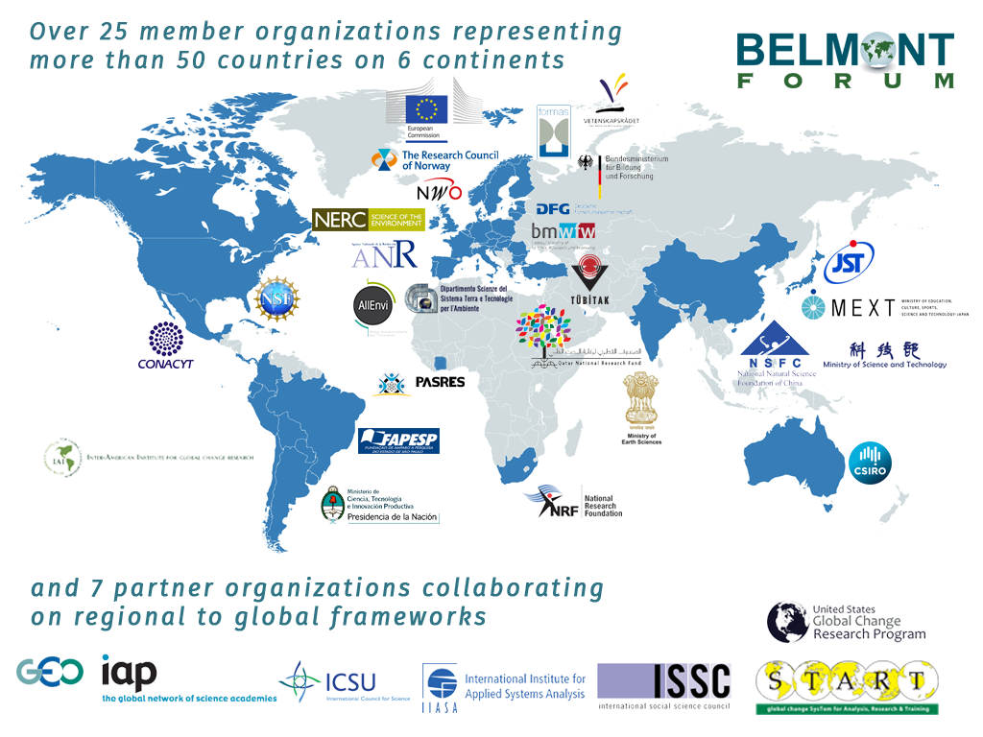
Notes:
The Belmont Forum is a partnership of funding organizations, international science councils, and regional consortia committed to the advancement of interdisciplinary and transdisciplinary science.
Forum operations are guided by the Belmont Challenge, a vision document that encourages international transdisciplinary research providing knowledge for understanding, mitigating and adapting to global environmental change.
Forum members and partner organizations work collaboratively to meet this Challenge by issuing international calls for proposals, committing to best practices for open data access, and providing transdisciplinary training.

Slide 5

Notes:
Proposals must be supported financially by at least three participating Partner Organisations established in three different countries and should include researchers from the natural sciences, health/medical sciences, social and economic sciences or humanities, as well as societal partners (i.e. public health organisations, civil society organisations).

Slide 6
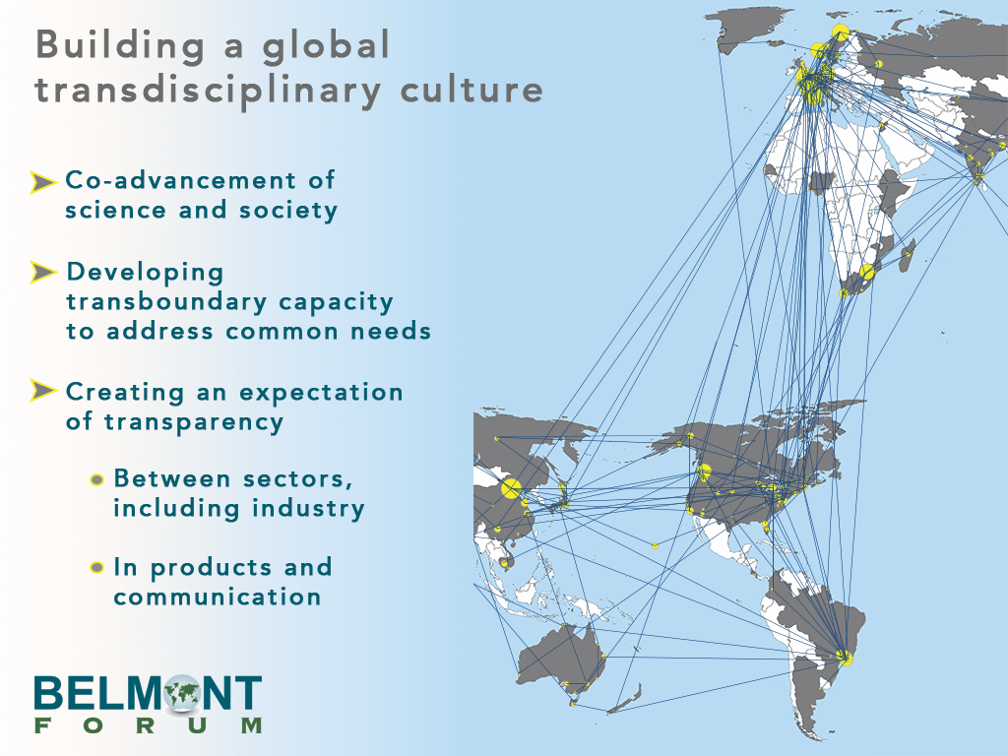
Notes:
Fundamentally, the Belmont Forum is building a global transdisciplinary culture…

Slide 7
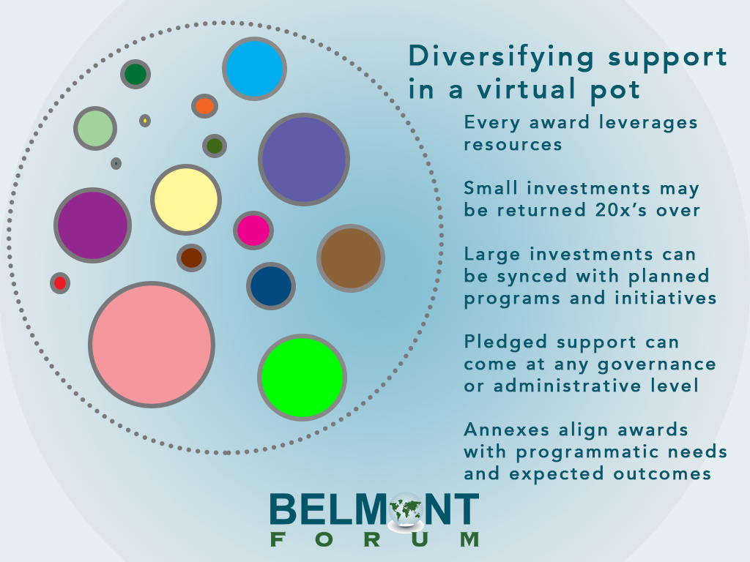
Notes:
The advantages of participating is a Belmont Forum Collaborative Research Action call is that investments are returned 20X over while having the opportunity to align your awarded proposals with programmatic needs and expected outcomes that are important to your organization.

Slide 8
“responds to the growing need for assessment and reduction of disaster risk, collaborative co-design of resilience strategies with a breadth of stakeholders, and scientifically and technologically enhanced responses to disasters.”
The DR³ CRA
6 Nations: Brazil, Chinese Taipei, Japan, Qatar, UK & USA
6 Total Funders: FAPESP, MOST, JST, QNRF, UKRI & NSF
~$10 million Euros

Slide 9
BACKGROUND
Policy and decision-makers need to understand, effectively prepare for and mitigate the devastating consequences of disasters.
Context derived from four priority areas in the Sendai Framework for Disaster Reduction:
  Understanding disaster risk;
  Strengthening disaster risk governance;
  Investing in disaster reduction for resilience;
  Enhancing disaster preparedness for effective response, and to “build back better” in recovery, rehabilitation and reconstruction.

Slide 10
DISASTERS
“Extreme environmental events that negatively impact coupled human-natural systems, including but not limited to impacts on economic, health, infrastructure, and social subsystems. Extreme environmental events may be generated by natural forces, including climate change, and/or anthropogenic causes.”
Notes:
Definition of disasters

Slide 11
MOTIVATION
Collaborative engagement of all sectors through the integration of interdisciplinary scientific understanding for the effective management of disaster mitigation.
Key questions:
How can we measure disaster loss reduction in the absence of reliable loss data on the economic and human impacts?
What resilience measures may be valuable in terms of reduction of potential loss & damage plus reduced future risk?
What types of pre-disaster planning and investments are strategic to resilient development?
What disaster risk governance modalities are effective in enabling collaboration to effectively manage disasters?
Notes:
Collaborative engagement of all sectors of our society through the integration of interdisciplinary scientific understanding with stakeholder knowledge for the efficient and effective management of disaster mitigation.

Slide 12

RESEARCH THEMES
Assessment and Reduction of Disaster Risk – innovative and implementable strategies and technologies for disaster risk reduction and enhancing societal coping capabilities.
Enhancing Disaster Resilience – leverage transdisciplinary knowledge, technological options, policy prescriptions, the continuity of survival between normal and crisis situations, local and community response, risk reduction and resilience.
Cyber-Enabled Effective Disaster Response – advance capabilities in complex scenario modeling and AI for rapid disaster response. Innovative and stakeholder-appropriate communication methods to inform decision-makers and/or transmit actions.
Notes:
Assessment and reduction of disaster risk: Connecting end-to-end demands and supplies for strengthening disaster management and related governance mechanisms.

Slide 13
PROPOSAL AIMS
Proposals should aim to take an end-to-end approach to address two or more of the elements below in their project:
Specific description of a systems approach to develop, test, and implement effective measures to mitigate disaster impacts
Focus beyond design events to include consideration of the entire possible spectrum of events related to disasters
Ensure infrastructure robustness to disasters
Increase the recovery capacity of a society
Demonstrate outcomes of disaster risk reduction practices that enable enhanced societal resilience in the future

Slide 14
PROPOSAL ELIGIBILITY OVERVIEW
  Transnationality - supported financially by at least three participating partner agencies established in three different countries;
    Research can take place within one or more countries anywhere in the world, but the team must be eligible for support from three funding organizations participating in the CRA.
  Data Management – requirement of a data management plan.

Slide 15
PROPOSAL ELIGIBILITY OVERVIEW (cont’d)
  Transdisciplinarity - project must be co-developed and co-implemented by natural scientists, social scientists, and stakeholders;
    Stakeholder use is broad - potential to work with communities, policymakers, business and industry, unionized bodies, tribal organizations, non-governmental organizations, and many others.
    Social science includes the full breadth of social disciplines, including economics and the humanities.
  Individual partner organization criteria – comply with all partner eligibility requirements as applicable.

Slide 16

ANNEX: Sao Paulo Research Foundation (FAPESP)
The total available budget for researchers from the State of Sao Paulo funded by FAPESP is approximately 4.39 million BRL (approximately 1 million Euros).
The maximum total budget request for all State of Sao Paulo researchers in a single consortium must not exceed 70,000 BRL per year including overhead costs, plus one Post-doctoral fellowship.
One Post-doctoral fellowship can be requested only if the proponent, who will be the supervisor, meets the usual criteria.

Slide 17
ANNEX: Sao Paulo Research Foundation (FAPESP)
Proponents from the State of Sao Paulo must be established researchers with a track record of participating in international interdisciplinary projects.
Applicants should consider the rules and conditions of a Regular Research Grant (APR) and must consult FAPESP (chamada-bf-dr3@fapesp.br) by May 20th 2019 regarding their eligibility.
Call website: www.fapesp.br/en/12749

Slide 18

ANNEX: Ministry of Science and Technology (MOST)
The total available budget for investigators from the Chinese Taipei funded by the MOST is approximately 24.1 million TWD (approximately 0.7 million Euros).
Applicants are advised to contact ygchen@ntu.edu.tw or hrliao@most.gov.tw regarding their eligibility prior to the proposal preparation.

Slide 19

ANNEX: Japan Science and Technology Agency (JST)
The total available budget for Japanese investigators funded by JST is approximately 29.9 million JPY (approximately 0.24 million Euros).
The maximum total budget request to JST for all Japanese investigators in a single consortium must not exceed 5 – 10 million JPY per year including indirect costs, pending the availability of funds.
Any independent researcher personally affiliated with (and actively conducting research at) a domestic Japanese research institution, regardless of nationality, is eligible to apply.

Slide 20
ANNEX: Japan Science and Technology Agency (JST)
Applicants must complete a research ethics training program and declare completion of the program to JST.
Japanese applicants will have to register their applications on the Cross-Ministerial R&D Management System (e-Rad: https://www.e-rad.go.jp/index.html).
Please consult our contact if you have any questions.
Call website:
https://www.jst.go.jp/inter/english/program_e/announce_e/announce_belmont_disaster2019.html

Slide 21

ANNEX: Qatar National Research Fund (QNRF)
Each award is up to US$ 250,000 per year and for up to three years. 100% of the QNRF total annual grant of the proposal and 100% of the proposed funded research efforts must be conducted inside Qatar.
The Lead Principal Investigator (LPI) of the Qatar-based team must be affiliated with a QNRF approved institution from Qatar.
The LPI should have a terminal degree and at least five single- or co-authored peer-reviewed publications.
The LPI from a research end-user entity may not hold a terminal degree, but they must have a track record in managing technology development projects/research projects, and a minimum of five peer reviewed publications, technical reports or authored patent applications/patents.

Slide 22
ANNEX: Qatar National Research Fund (QNRF)
QNRF requests Qatar-based researchers to ensure their proposals are aligned to at least one of the detailed themes below;
Capacity building on disaster risk management.
Cascade effects and disruption of critical infrastructure.
Gulf water pollution
Identification, understanding and assessment of disaster risks in hot and arid environments.
Infrastructure resilience.
Low frequency and high impact natural hazards: vulnerability, exposure, prediction & mitigation.
Multi-hazard early warning systems and risk information for large events.
Pre-disaster recovery planning, and risk communication frameworks.
Risk assessment and modelling of natural and technological disasters.
Trans-epidemic diseases.

Slide 23
ANNEX: Qatar National Research Fund (QNRF)
Full proposals must also be submitted through the QNRF submission channel on https://oss.qgrants.org/ and vetted by the Submitting Institution Research Office.
A webinar for Qatar-based researchers will be held on 8th May at 12:00 PM (Doha time). For registration use: https://attendee.gotowebinar.com/register/604828550726164493
For any Inquiry, please use; http://support.qnrf.org/index.php?/Tickets/Submit.
More information are available on; http://www.qnrf.org/en-us/Funding/Research-Programs/Thematic-and-Grand-Challenges-Research-Program/Belmont-Forum

Slide 24

ANNEX: UK Research and Innovation (UKRI)
The total available budget for UK investigators funded by UKRI is approximately 4 million GBP (approximately 4.6 million Euros).
UKRI anticipates that a total of 8 – 10 consortia will be supported over three years, pending the availability of funds.
Applicants may apply for a maximum of 400,000 GBP (100% fEC) which may be increased to 700,000 GBP (100% fEC) if participating with a partner on the OECD DAC list of recipients.
Notes:
Organization for Economic Corporation Development Assistant Committee

Slide 25
ANNEX: UK Research and Innovation (UKRI)
To determine countries on the OECD DAC list of recipients visit: http://www.oecd.org/dac/financing-sustainable-development/development-finance-standards/DAC_List_ODA_Recipients2018to2020_flows_En.pdf
A maximum of 50% of the total budget may be requested for the DAC-list partner.
Applicants from DAC-list countries which are themselves participating in the call OR are members of the Forum are not eligible for funding under this agreement.
Notes:
Organization for Economic Corporation Development Assistant Committee

Slide 26

ANNEX: National Science Foundation (NSF)
The total available budget for US investigators funded by the NSF is approximately 3 million USD (approximately 2.6 million Euros).
NSF anticipates that a total of 10 consortia will be supported over three years, pending the availability of funds.
The maximum total budget request to NSF for all US investigators in a single consortium must not exceed 300,000 USD including indirect costs.

Slide 27
HOW TO ENGAGE
Engage collaborators from at least two other countries that are participating in this CRA in the development of a project concept that addresses the themes and aims of the DR3 CRA.
Read the DR³ CRA Annexes and encourage each of your partners to read the institutional Annexes of their own countries (or countries from which they are eligible for funding) well ahead of time to determine their own eligibility and funding procedures, should the proposal be selected for funding through the BF review process.

Slide 28
HOW TO ENGAGE (cont’d)
Remember that while each multinational team looking for funds/in-kind support must submit one joint proposal to the Belmont Forum, each participating PI/Co-PI will also have to follow the eligibility criteria and guidelines laid out in the annex of the institution to which they are applying.
Submit your proposal by 10 June 2019, 23:59 UTC.

Slide 29
DR3 CRA TIMELINE
Activity | Estimated Deadline
Call Launch | 5 March 2019
Proposals Open | 19 March 2019
Deadline for full proposals | 10 July 2019 (23:59 UTC)
Review of Proposals | August 2019
Projects funding start* | December 2019 – February 2020
*Based on the availability of funds

Slide 30
Additional Information and Contacts
Agency Contacts
Agency Contacts
FAPESP: Alexandre Roccatto
aroccatto@fapesp.br
MOST: Yue-Gau Chen or
Hong-Ru Liao
ygchen@nth.edu/tw or hrliao@most.gov.tw
JST: Soichi Kubota, Haruhiko
Tanaka or Oscar Rudenstam
Belmont@jst.go.jp
QNRF: Sadim Jawhar (admin) or Omar Boukhris (scientific)
http://support.qnrf.org/index.php?/Tickets/Submit.
UKRI: Liam Haydon
Liam.Haydon@ukri.org
NSF: Maria Uhle
MUhle@nsf.gov

