Slide 1


Collaborative Research Action on Climate, Environment and Health:
A funding opportunity through the Belmont Forum
Participating U.S. Funding Agencies: NSF, NOAA, NIH and USDA-NIFA

Slide 2
Overview
Belmont Forum basics
Scope and Themes of the CEH Collaborative Research Action
Structure and Eligibility Requirements
How Researchers Can Engage

Slide 3
Belmont Forum
Partnership of funding organizations, international science councils, and regional consortia committed to the advancement of interdisciplinary and transdisciplinary science
Scientist and stakeholder through Collaborative Research Actions (CRAs), which are the Forum equivalent of a call for proposals.
Proposal submitted to a CRA theme in the Belmont Forum Grants Operations (BFgo) must consist of a project co-developed by natural scientists, social scientists, and stakeholders that hail from at least three countries (and health scientists for this CRA).
Open data policy and requirements
Details about eligibility and available support for interested applicants can be found in the organizational annexes for each call for proposals.

Slide 4
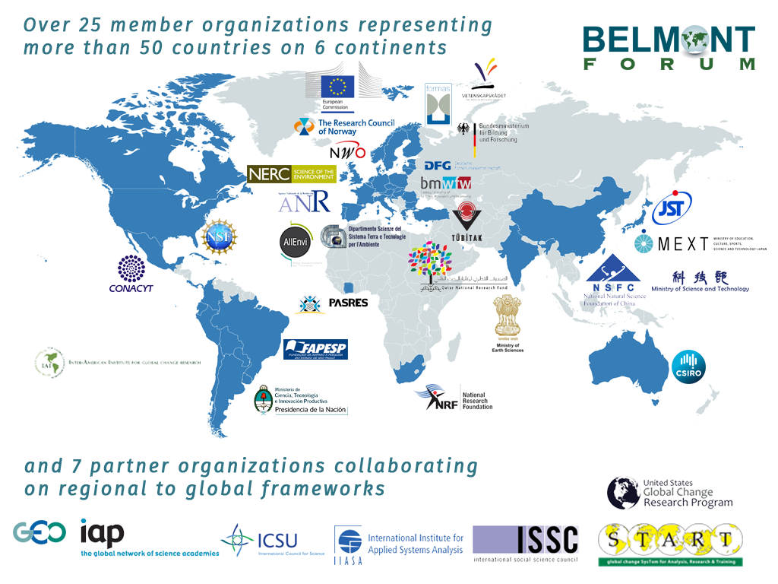
Notes:
The Belmont Forum is a partnership of funding organizations, international science councils, and regional consortia committed to the advancement of interdisciplinary and transdisciplinary science.
Forum operations are guided by the Belmont Challenge, a vision document that encourages international transdisciplinary research providing knowledge for understanding, mitigating and adapting to global environmental change.
Forum members and partner organizations work collaboratively to meet this Challenge by issuing international calls for proposals, committing to best practices for open data access, and providing transdisciplinary training.

Slide 5
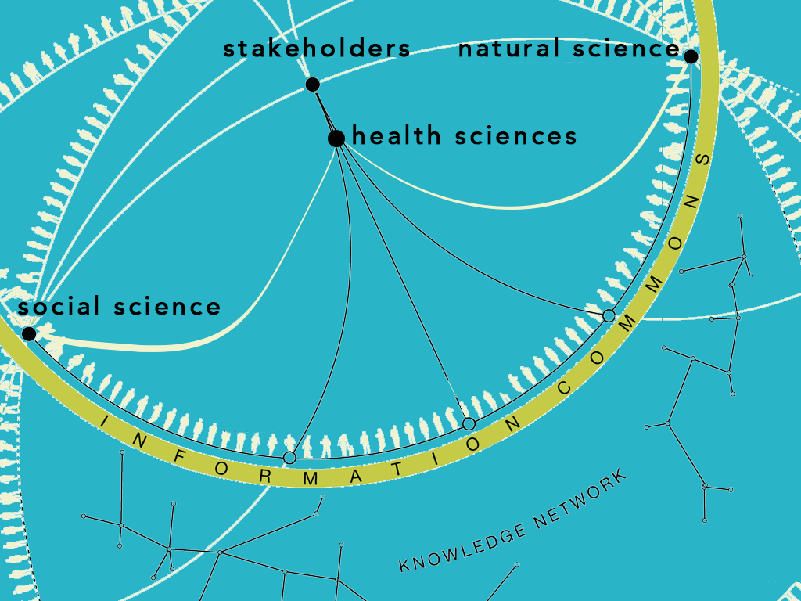
Notes:
Proposals must be supported financially by at least three participating Partner Organisations established in three different countries and should include researchers from the natural sciences, health/medical sciences, social and economic sciences or humanities, as well as societal partners (i.e. public health organisations, civil society organisations).

Slide 6
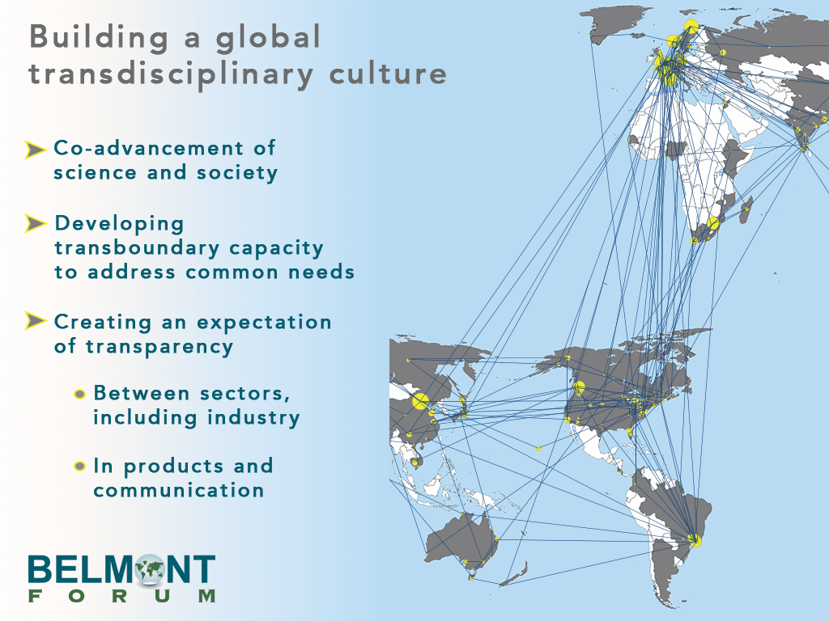
Notes:
Fundamentally, the Belmont Forum is building a global transdisciplinary culture…

Slide 7
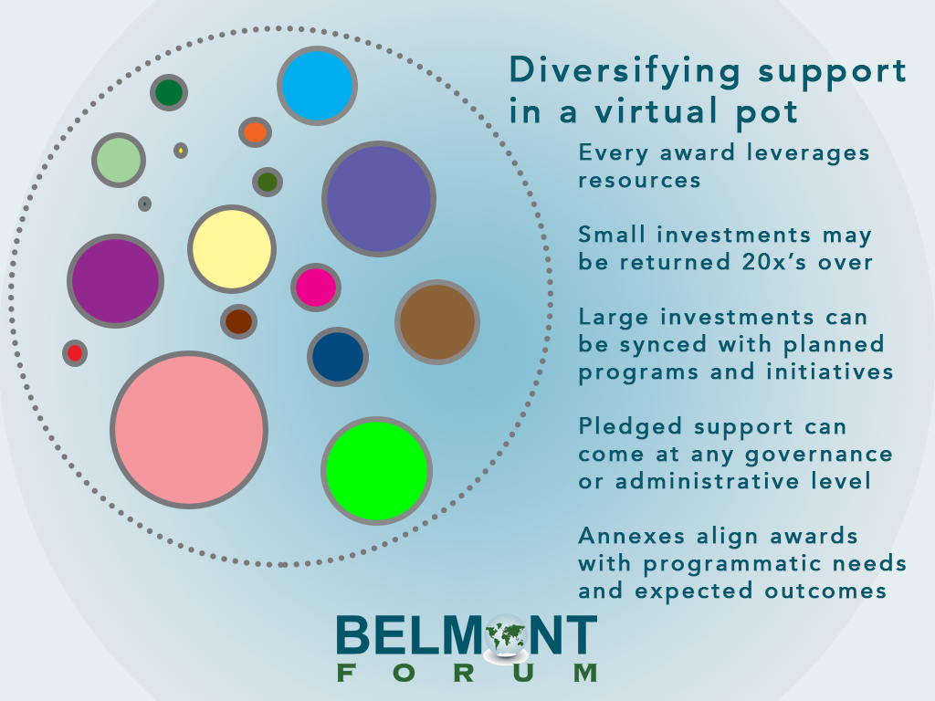
Notes:
The advantages of participating is a Belmont Forum Collaborative Research Action call is that investments are returned 20X over while having the opportunity to align your awarded proposals with programmatic needs and expected outcomes that are important to your organization.

Slide 8
U.S. Involvement in the Belmont Forum
NSF is the U.S. Belmont Forum Member
The U.S. Global Change Research Program (USGCRP) is a Partner Organization
USGCRP Interagency Working Groups had leadership role in scoping activities and hosted a scoping workshop for this Climate, Environment and Health Collaborative Research Action
Participation from U.S. agencies NOAA, NSF, USDA-NIFA, NIH

Slide 9
“IMPROVING UNDERSTANDING OF CLIMATE, ENVIRONMENT AND HEALTH PATHWAYS TO PROTECT AND PROMOTE HEALTH”
The CEH CRA…
9 Nations
13 Total Funders (4 U.S. agencies)
$11.93 million ($2 million + in-kind from U.S. agencies)

Slide 10
BACKGROUND
Policy and decision-makers need to understand and effectively prepare for the additional health risks.
CEH research can reduce uncertainty about how local conditions may be affected from a season to decades ahead, provide insight into local solutions, and build evidence to strengthen decision-making.

Slide 11
MOTIVATION
To strengthen and expand the current understanding of links between climate change, environment and health impacts.
Aims:
  Develop transdisciplinary scientific capacity that:
    Provides information useful to decision makers;
    Improves understanding of risks, behaviors and vulnerabilities across multiple time scales;
    Develops robust prediction and early warning at appropriate scales;
    Stimulates innovative solutions, the use of new technologies and useable policies;
    Facilitates sustained partnerships that develop, deliver and communicate useful science.

Slide 12

RESEARCH THEMES
Food systems and nutrition – changes in the quality and quantity of food from land and the oceans. Health implications include increased risks of stunting, decrease in nutritional quality.
Heat and health – impacts on behavioural, physical and mental health and mortality. Impacts are often amplified in urban areas and can lead to impacts on labour and overall productivity, with associated economic impacts.
Climate-sensitive infectious diseases – acceleration of biodiversity loss and changes in the distribution and incidence of a range of infectious diseases and emergence of novel pathogens.

Slide 13
PROPOSAL AIMS
Proposals should aim to take an end-to-end approach to:
  Bridge knowledge gaps on environment pathways, feedbacks and interactions that connect climate change to human disease, with a view to improve health through prevention, mitigation and/or adaption strategies;
  Understand health risk, vulnerability and resilience according to the amplitude of changes, baseline conditions and existing adaptation measures at all relevant scales;

Slide 14
PROPOSAL AIMS (cont’d)
Proposals should aim to take an end-to-end approach to:
  Improve predictability and early warning of the frequency and extent of climate and climate-related environmental hazards to health, at relevant temporal and spatial scales;
  Deliver usable data, information, tools, services and effective innovative solutions that allow decision-makers to better prepare for increased societal and behavioral resilience, respond to climate change impacts on health, and optimize climate change actions that have health benefits.

Slide 15
PROPOSAL ELIGIBILITY OVERVIEW
  Transnationality - supported financially by at least three participating partner agencies established in three different countries;
    Research can take place within one or more countries anywhere in the world, but the team must be eligible for support from three funding organizations participating in the CRA.
  Data Management – requirement of a data management plan.

Slide 16
PROPOSAL ELIGIBILITY OVERVIEW (cont’d)
  Transdisciplinarity - project must be co-developed and co-implemented by natural scientists, social scientists, health scientists and stakeholders;
    Stakeholder use is broad - potential to work with communities, policymakers, business and industry, unionized bodies, tribal organizations, non-governmental organizations, and many others.
    Social science includes the full breadth of social disciplines, including economics and the humanities.
  Individual partner organization criteria – comply with all partner eligibility requirements as applicable.

Slide 17
ANNEX: National Institutes of Health (NIH)
NIH, specifically NIEHS and the Fogarty International Center are providing in-kind support to the CEH CRA
NIH/NIEHS and NIH/FIC will provide information about this CRA to their investigators, particularly the NIH co-funded seven regional centers for Global Environmental and Occupational Health
Investigators can find currently funded NIH grantees in the online NIH Research Portfolio Online Reporting Tools (RePORT) website: https://report.nih.gov/categorical_spending.aspx
  “climate change” category
  Points of contact:
    NIEHS: Abee Boyles, NIEHS: Abee.Boyles@nih.gov
    Mike Humble, NIEHS humble@niehs.nih.gov
    GEOHealth: Christine Jessup, FIC: Christine.Jessup@nih.gov

Slide 18
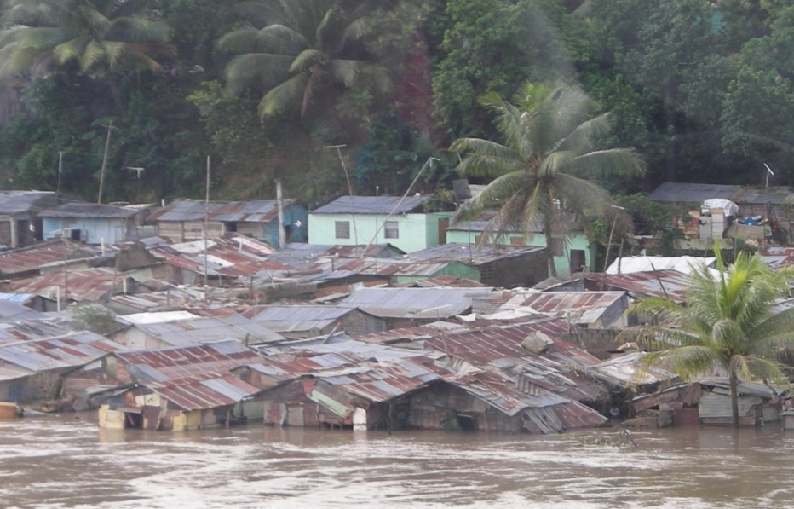

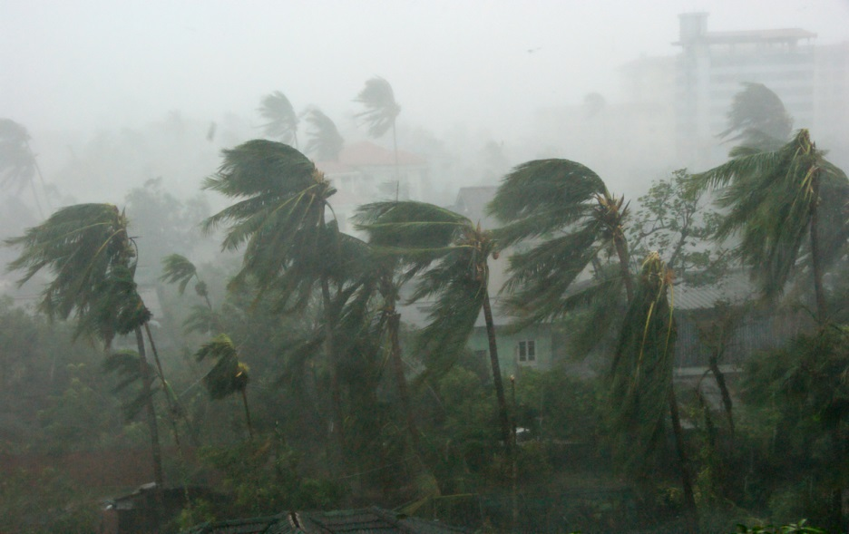
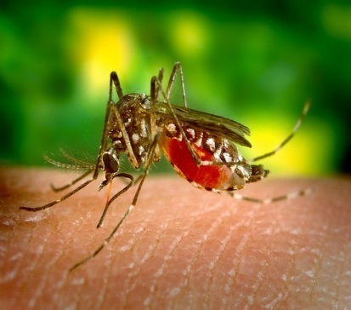
NOAA Engagement in the Belmont Forum CRA CEH:
Grant Funding and In-kind Resources
  Connections to NOAA technical experts and existing grantees who could collaborate with international partners in the CRA to address topics of mutual interest;
  $1M over three years for interdisciplinary, decision support research through a partnership between NOAA’s International Research and Applications Project (IRAP) and NSF
  In-kind technical resources provided by NOAA’s National Centers for Environmental Information (NCEI) to support access to and the appropriate use of NOAA climate and environmental data

Slide 19

National Oceanic and Atmospheric Administration (NOAA)
  Understand and predict changes in climate, weather, oceans and coasts;
  Share that knowledge and information with others; and
  Conserve and manage coastal and marine ecosystems and resources.

Slide 20
NOAA and Health:
What do we do, and how do you connect?
NOAA Capacity
NOAA One Health Thematic areas include:
  Wildlife and Zoonotic Disease
  Air Quality
  Heat (Thermal Extremes)
  Vector-Borne Disease
  Water-borne Illness
  Natural Products
  Safe Food
  Arctic
Data, Observations and Monitoring
Forecasts and Warnings
Climate Predictions and Scenarios
Research and Modeling (including social sciences and interdisciplinary)
Operations (i.e. NWS)
Training and Capacity Building

Slide 21
BF CRA CEH Grant Funding through the
NOAA International Research and Applications Project (IRAP)
NOAA/IRAP will consider proposals focused on understanding, predicting and preventing health risks through the use of climate information; specific interests related to mitigating climate-sensitive risks related to heat, infectious and vector borne diseases
Proposals should incorporate stakeholders and the social sciences
Applicants are encouraged to connect with NOAA research, services and broader network of partners (including NIHHIS and GHHIN)
NOAA/IRAP funding will be provided through NSF, so applicants should read the requirements for both agencies carefully prior to submitting a proposal
Depending on the availability of funding, NOAA anticipates providing support for 5-6 consortia at a level of $1M USD. The maximum total budget request for all US investigators in a single consortium should not exceed 200K USD over a 3 year period, including indirect costs.
For additional information about IRAP: https://cpo.noaa.gov/Meet-the-Divisions/Climate-and-Societal-Interactions/IRAP/Funded-Projects

Slide 22
NOAA/IRAP FY 18 Funded Projects on
Decision Support Research on Climate-Sensitive Health Risks
Safeguarding the health and well-being of communities vulnerable to extreme heat in the Southwestern U.S. and Northwestern Mexico transboundary region
Climate, health, and migration in the Pacific Islands
Use of seasonal climate forecasts to generate a Mosquito-borne Disease Forecasting System in Central America and the Caribbean
The development of climate-informed decision-support tools for the prevention and control of Aedes-borne diseases in the US and transboundary regions
Using global seasonal forecasts to map Chikungunya Risk
Integrating seasonal and sub-seasonal climate information into public health contexts: co-producing decision support applications in Puerto Rico and Dominica
Building Capacity

Slide 23
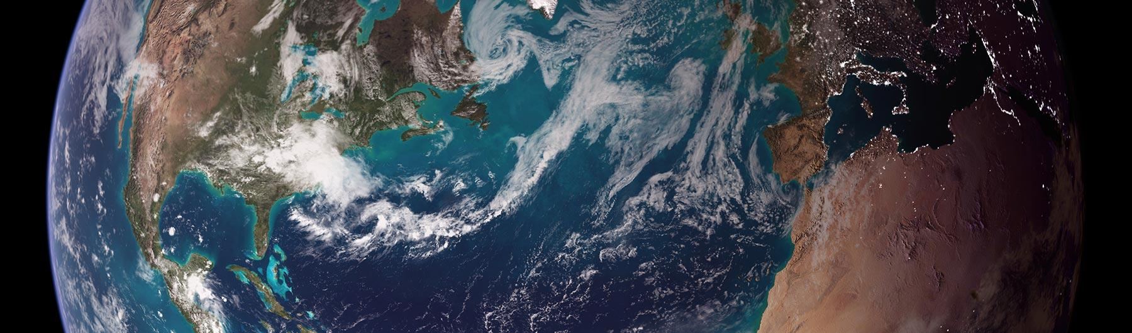

NOAA National Centers for
Environmental Information (NCEI)
Responsible for hosting and providing access to one of the most significant archives on Earth, with comprehensive oceanic, atmospheric, and geophysical data
From the depths of the ocean to the surface of the sun and from million-year-old sediment records to near real-time satellite images
Nation’s leading authority for environmental information

Slide 24
Center for Weather and Climate
Steward the Nation’s Climate Information
  Responsible for preserving, monitoring, assessing, and providing public access to the Nation’s treasure of climate and historical weather data and information.
Be the Nation’s Trusted Authority on Climate and Historical Weather Information
  Be the most comprehensive, accessible, and trusted source of state-of-the-art climate and historical weather data, information, and climate monitoring.

Slide 25
ANNEX: National Science Foundation (NSF)
The total available budget for US investigators funded by the National Science Foundation is approximately 1 million USD (approximately 0.87 million Euros) from the National Science Foundation.
NSF anticipates that a total of 8 consortia will be supported over three years, pending the availability of funds.
The maximum total budget request to NSF for all US investigators in a single consortium must not exceed 130,000 USD including indirect costs.

Slide 26
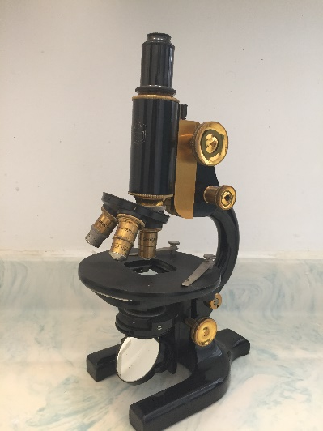

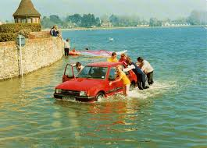
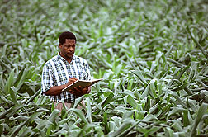

Annex: USDA National Institute of Food and Agriculture
Mission:
To advance knowledge for agriculture, the environment, human health and well-being, and communities
Support research, education and extension programs in Land Grant universities and other organizations through competitive grants programs
Science to mitigate/ adapt agriculture to a changing climate
Impacts of climate change on human, animal, and environmental health associated with the agricultural sector

Slide 27
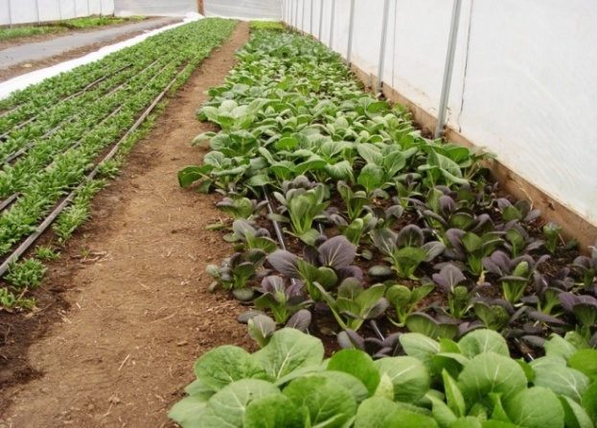
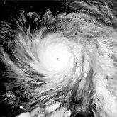
Ecosystem Health and Function
Climate Change
Human Health
Agricultural
Production
NIFA is providing in kind support to enable collaborations
with international research partners. To find a collaborator:
https://nifa.usda.gov/developing-global-partnerships
Additional NIFA funded research projects can be found at: https://reeis.usda.gov/

Slide 28
How to Engage
US Researchers interested in NEW FUNDING
Engage collaborators from at least two other countries that are participating in this CRA in the development of a project concept that addresses the objectives and scope of the CEH CRA.
Read the CEH CRA Annexes from NSF and NOAA, and encourage each of your partners to read the institutional CEH CRA Annexes of their own countries (or countries from which they are eligible for funding) well ahead of time to determine their own eligibility and funding procedures, should the proposal be selected for funding through the BF review process.
Remember that while each multinational team looking for funds/in-kind support must submit one joint proposal to the Belmont Forum, each participating PI/Co-PI will also have to follow the eligibility criteria and guidelines laid out in the annex of the institution to which they are applying.
Submit your Expression of Interest by 06 May 2019, 16:00 GMT. This is mandatory but may be modified in terms of partners and scope before final proposal submission on 23 July 2019 , 16:00 GMT

Slide 29
How to Engage
US Researchers seeking to participate using IN-KIND RESOURCES
Contribution of in-kind resources will count as one of the three required countries. Identify collaborators eligible for funding from at least two other countries outside the United States that are part of this CRA.
Develop a joint proposal. Determine if the joint proposal remains within reasonable scope of your original funded research proposal OR AGENCY CAPABILITIES.
If so, submit your Expression of Interest by 06 May 2019, 16:00 GMT. This is mandatory but may be modified in terms of partners and scope before final proposal submission on 23 July 2019, 16:00 GMT.

Slide 30
How to Engage
Researchers from outside the United States
Partner with an in-kind resource provider (USDA, NIH, NOAA) and find scientists eligible for funding from at least two other countries and submit your Expression of Interest by 06 May 2019, 16:00 GMT. This is mandatory but may be modified in terms of partners and scope before final proposal submission on 23 July 2019, 16:00 GMT.
Partner with a scientist eligible for funding from NSF or NOAA and at least two other countries, and submit your Expression of Interest by 06 May 2019, 16:00 GMT. This is mandatory but may be modified in terms of partners and scope before final proposal submission on 23 July 2019, 16:00 GMT.

Slide 31
CEH CRA Timeline
Activity | Estimated Deadline
Call Launch | 14 March 2019
Deadline for EoI’s | 06 May 2019 (16:00 GMT)
Full proposals invited | TBD
Deadline for full proposals | 23 July 2019 (16:00 GMT)
Review of Proposals | August
Projects funding start* | December 2019 – January 2020
*Based on the availability of funds

Slide 32
Additional Information and Contacts
Relevant Links
Agency Contacts
Call Announcement
Call For Proposals
Expressions of Interest Form
NOAA Annex
NSF Annex
USDA-NIFA Annex
NOAA Grants: Lisa Vaughan Lisa.Vaughan@noaa.gov
NOAA Data: Michael Tanner and Juli Trtanj Michael.Tanner@noaa.gov Juli.Trtanj@noaa.gov
NSF: Maria Uhle
MUhle@nsf.gov
USDA-NIFA: Randi Johnson Randijohnson@nifa.usda.gov
NIH:
NIEHS: Abee Boyles: Abee.Boyles@nih.gov,
NIEHS: Mike Humble: humble@niehs.nih.gov
GEOHealth: Christine Jessup, FIC: Christine.Jessup@nih.gov

Slide 33
Additional Background Information

Slide 34
Center for Weather and Climate
Subject Matter Experts
Aerosols: Tom Zhao Atmospheric Moisture Content: Lei Shi BAMS State of the Climate: Jessica Blunden Climate Analyses: Ken Kunkel Climate Normals: Anthony Arguez Climate Reference Network: Howard Diamond Clouds: Alisa Young Coastal Inundation: John Marra Drought Monitoring: Richard Heim Earth Radiation Budget: Ken Knapp Geospatial Information Systems: Mike Squires Hurricanes: Jim Kossin Land Surface Temperature: Jeff Privette Land Surface Air Temperature: Matt Menne
Madden-Julian Oscillation: Carl Schreck Ocean Color: Viva Banzon Ocean Heat Content: Tim Boyer Ocean Surface Temperature (in-situ): Boyin Huang Ocean Surface Temperature (satellite): Tom Zhao Ocean Surface Winds: Huai-min Zhang Paleoclimatology: Gene Wahl Precipitation (Extremes): Ken Kunkel Precipitation (Radar): Brian Nelson Radiosondes: Imke Durre Scientific Comms/Graphics/Media: Katy Matthews Snow and Ice: Mike Squires Socioeconomic Analyses: Adam Smith US/Global Climate Monitoring: Jake Crouch

Slide 35
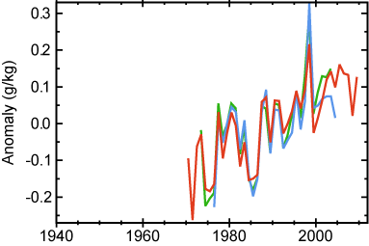
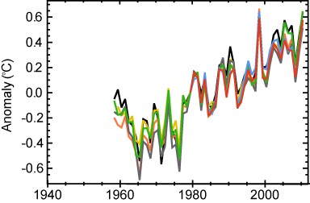
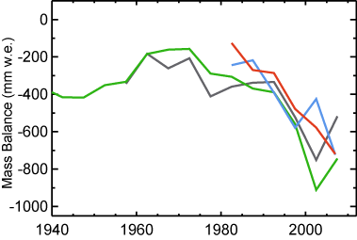
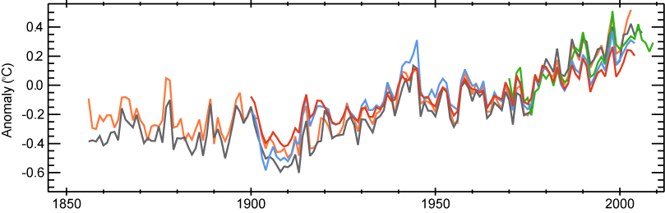
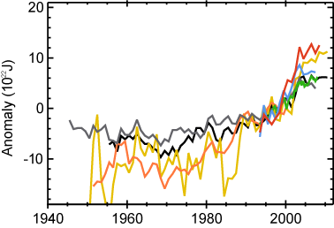
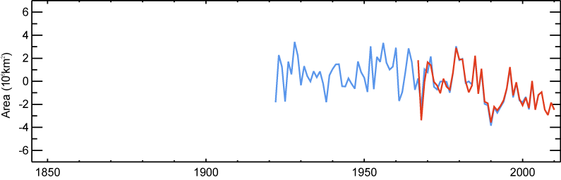
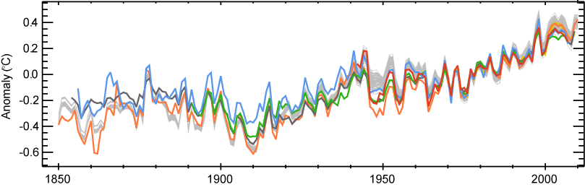
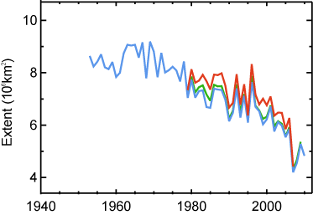
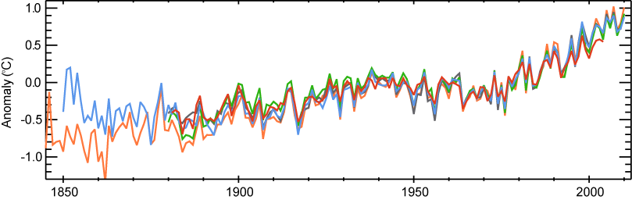
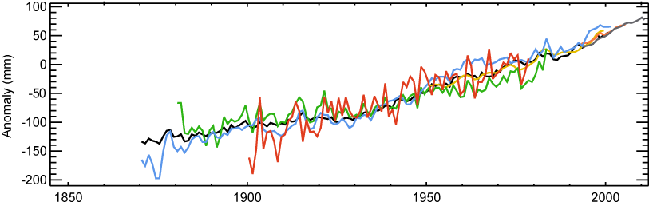
State of the Climate Indicators
Specific
Humidity
Glaciers
Glacier Mass Balance
Air Temperature Near Surface Troposphere
3 Datasets
Temperature Over Oceans
7 Datasets
4 Datasets
5 Datasets
Ocean Heat Content
Snow Cover
March–April,
Northern Hemisphere
Sea Surface Temperature
2 Datasets
7 Datasets
7 Datasets
Sea Ice
Northern Hemisphere in Summer
Land Surface Air
Temperature Over Land
Sea Level
3 Datasets
5 Datasets
7 Datasets

Slide 36
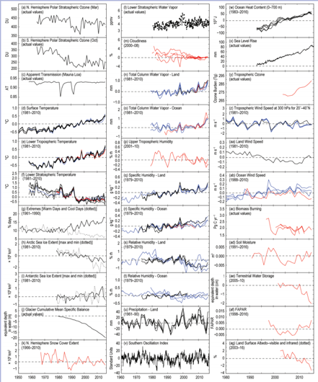
Essential Climate Variables
Fully monitored:
- Atmospheric Surface: air temperature, precipitation, air pressure, water vapor, wind speed and direction.
Atmospheric Upper Air: earth radiation budget, temperature, water vapor, wind speed and direction.
Atmospheric Composition: carbon dioxide, methane, other long-lived gases, ozone.
Ocean Surface: temperature, salinity, sea level, sea ice, current, ocean color, phytoplankton.
Ocean Subsurface: temperature, salinity.
Terrestrial: snow cover, albedo.
Partially monitored:
Atmospheric Upper Air: cloud properties.
Atmospheric Composition: aerosols and their precursors.
Ocean Surface: carbon dioxide, ocean acidity.
Ocean Subsurface: current, carbon.
Terrestrial: soil moisture, permafrost, glaciers and ice caps, river discharge, groundwater, ice sheets, fraction of absorbed photosynthetically active radiation, biomass, fire disturbance.
Source: Blunden, J., and D. S. Arndt, Eds., 2017: State of the Climate in 2016. Bull. Amer. Meteor. Soc., 98 (8), Si–S277, doi:10.1175/2017BAMSStateoftheClimate.1.
Notes:
Reference: Blunden, J., and D. S. Arndt, Eds., 2017: State of the Climate in 2016. Bull. Amer. Meteor. Soc., 98 (8), Si–S277, doi:10.1175/2017BAMSStateoftheClimate.1.

Slide 37
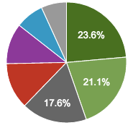
NCEI Stakeholder Profile
Health and
Health
Emergency Management
Science, Technology, and Engineering
6.9%
7.6%
Insurance, Finance, and Legal
10.9%
12.4%
Energy
Ecosystems (Agriculture/Aquaculture)
Transportation and Infrastructure

Slide 38
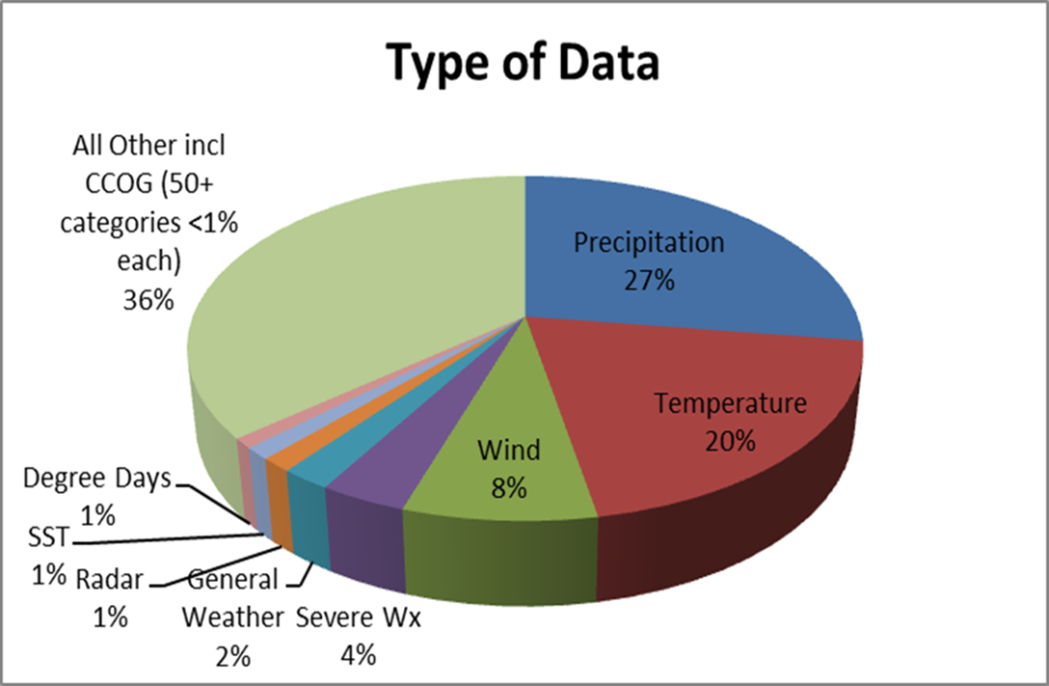
What kind of data is accessed?
- Water resource managers rely on the information to help officials and planners make informed decisions about a finite resource
- The American Society of Heating, Refrigerating, and Air Conditioning Engineers uses the data to develop heating/cooling engineering standards
- Insurance and reinsurance companies make use of weather and climate data to calibrate their catastrophe models

Slide 39
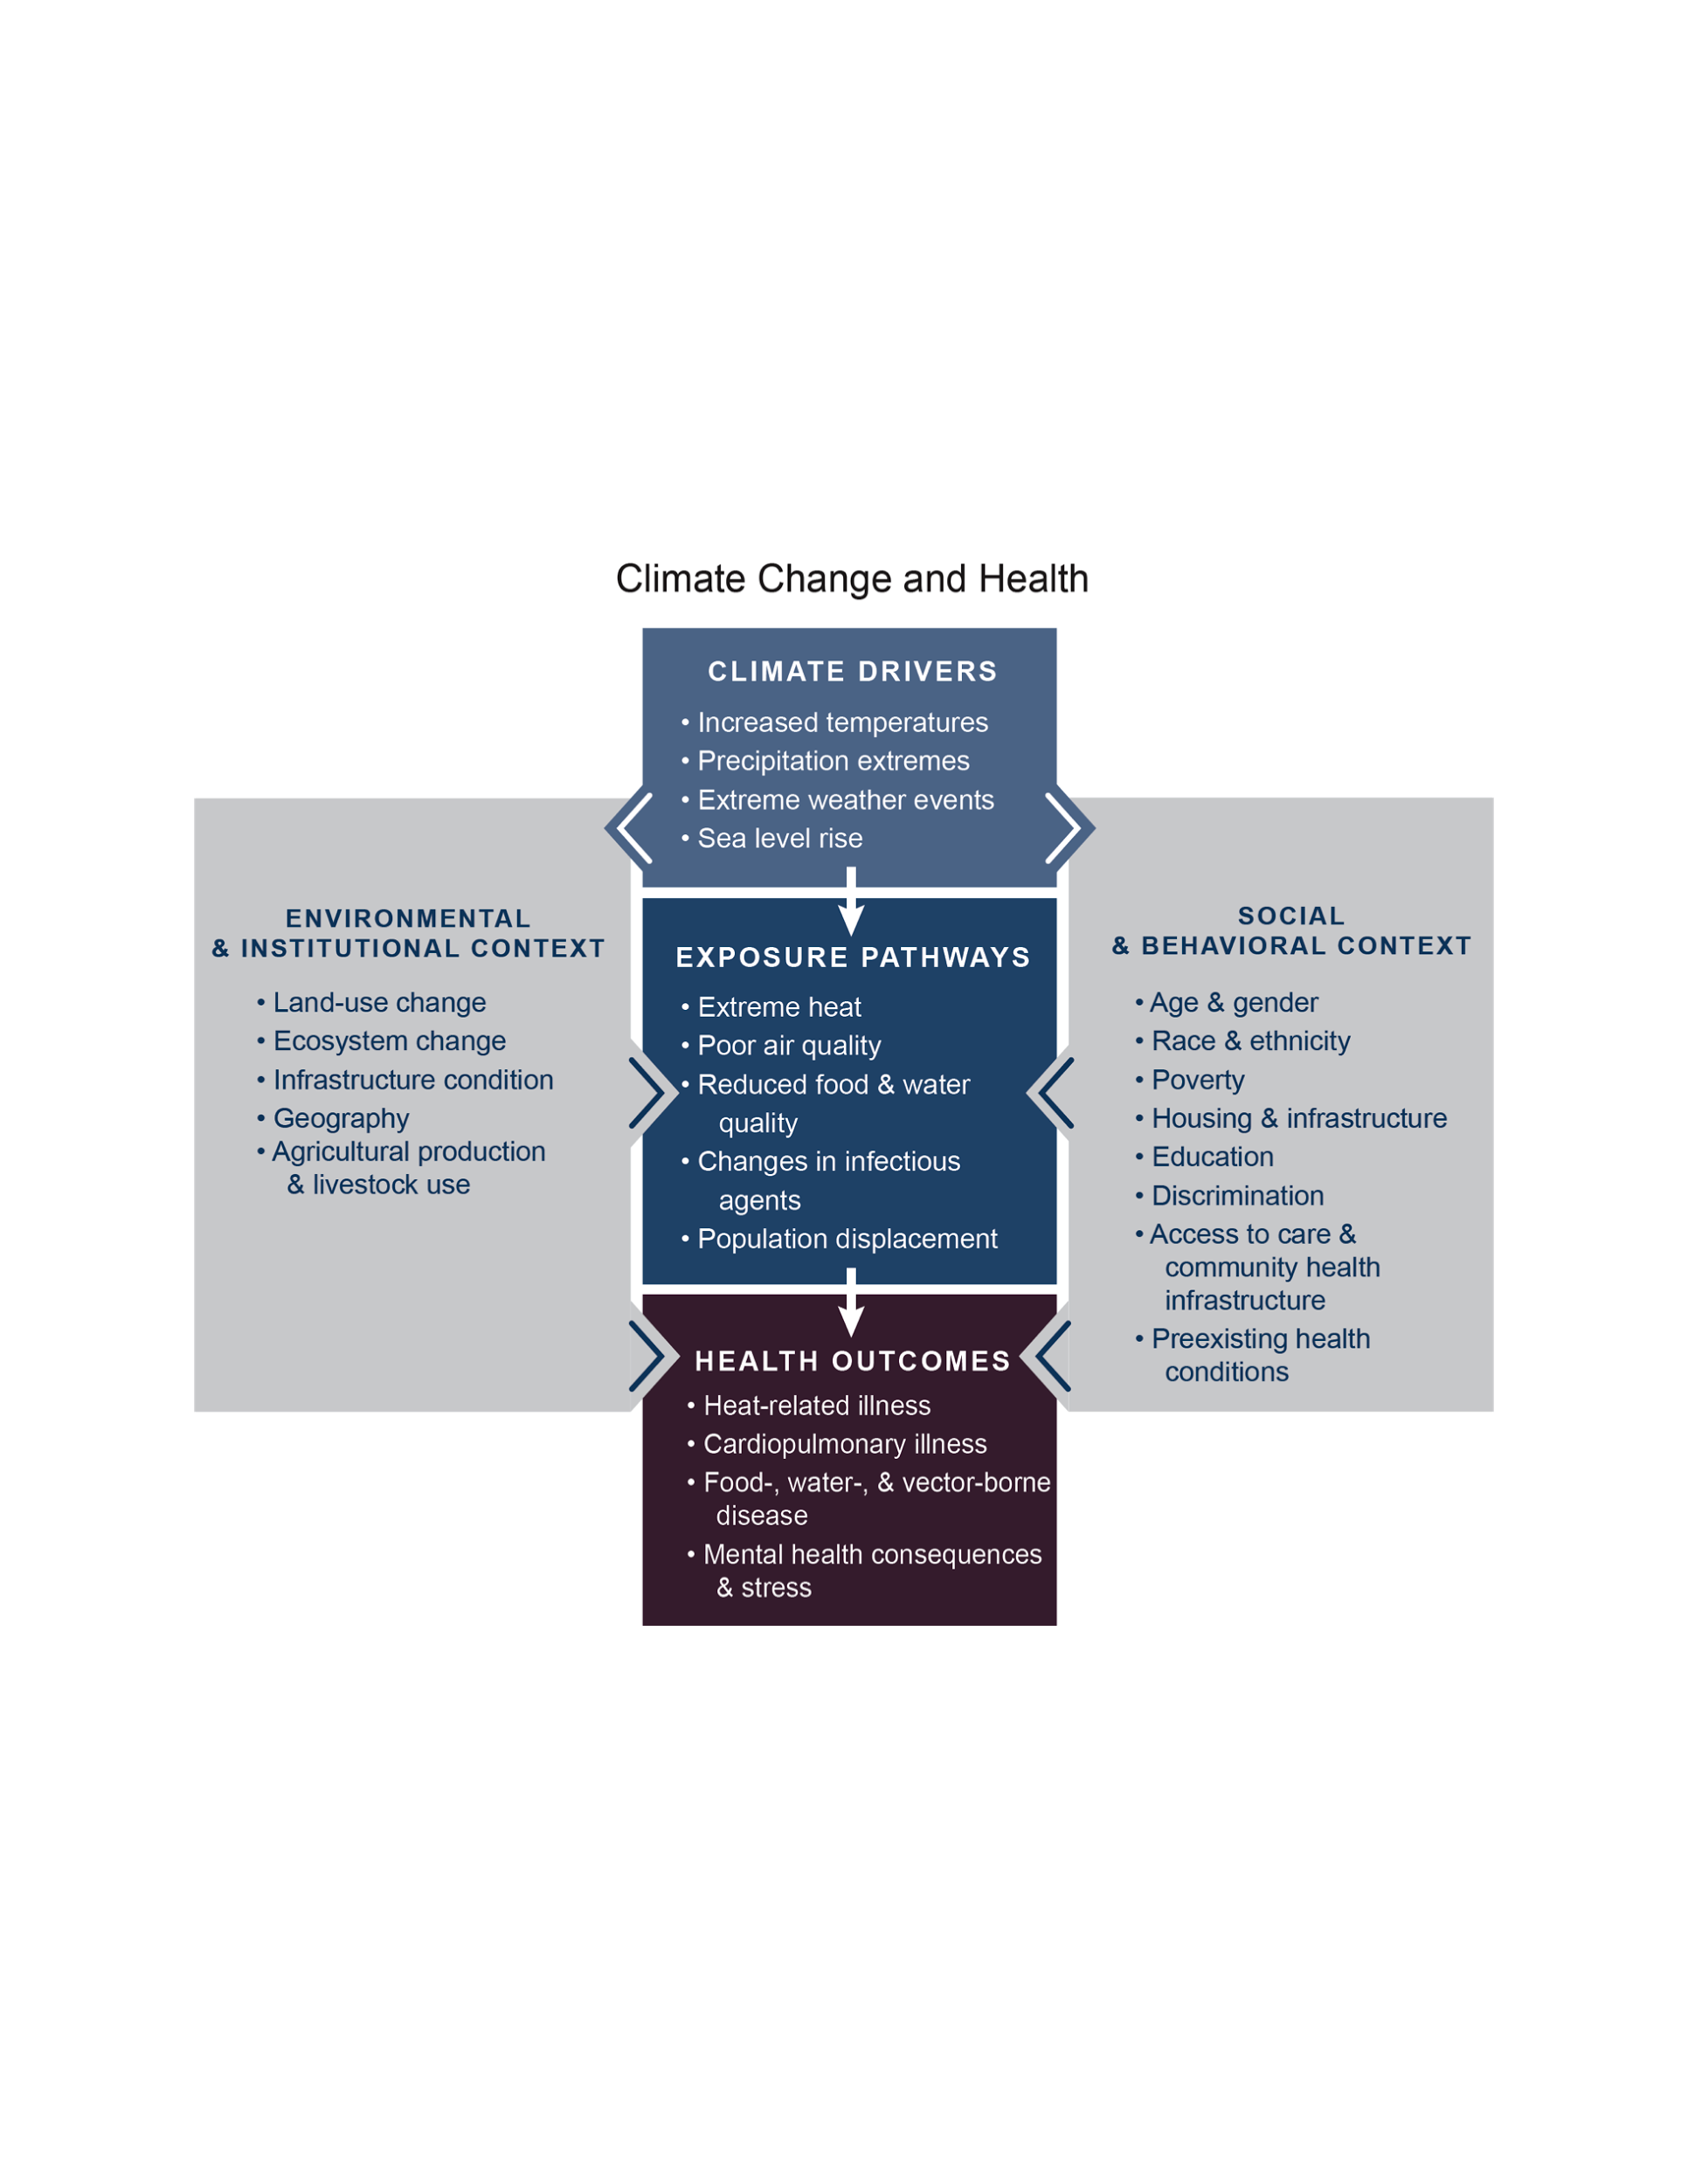

Slide 40
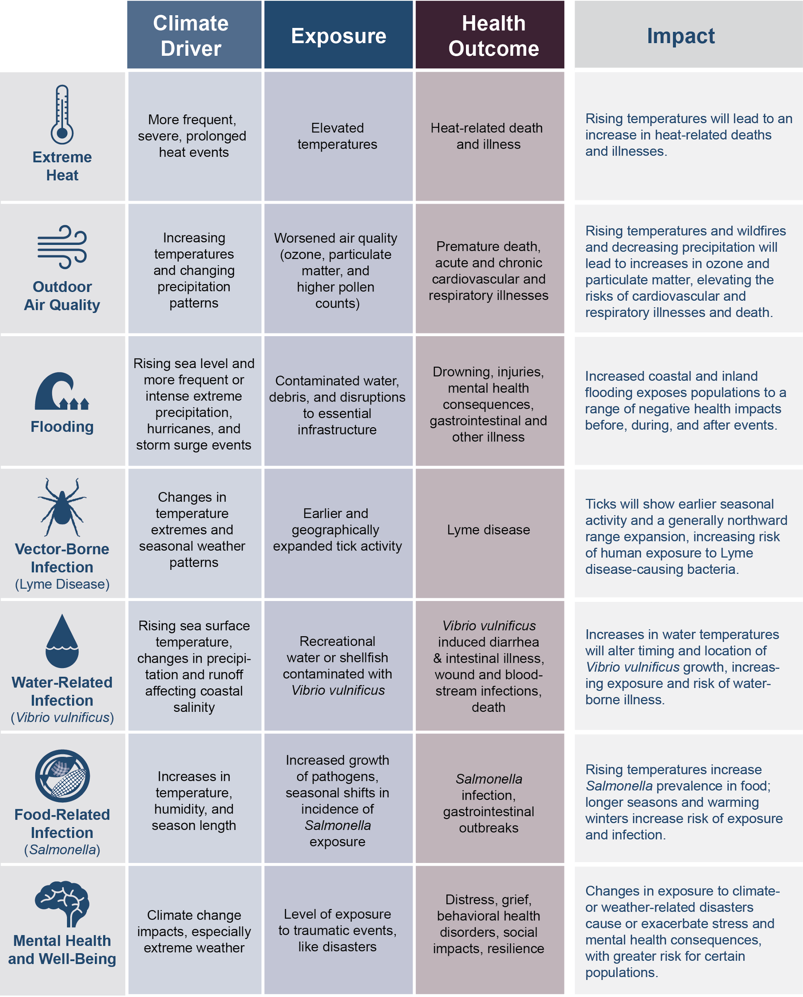
Climate Impacts on Human Health

Slide 41
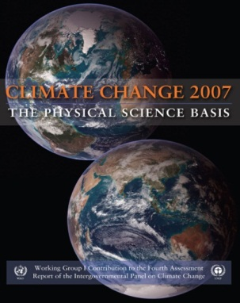
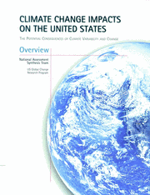
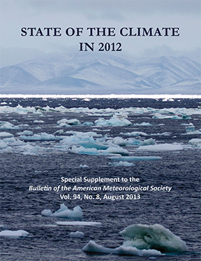
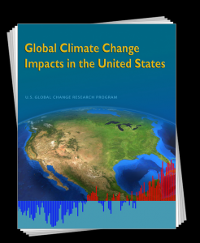
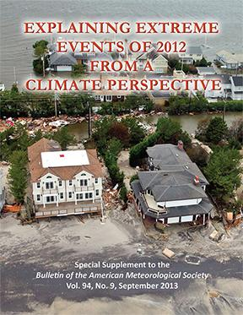
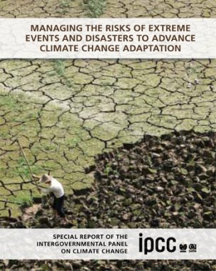
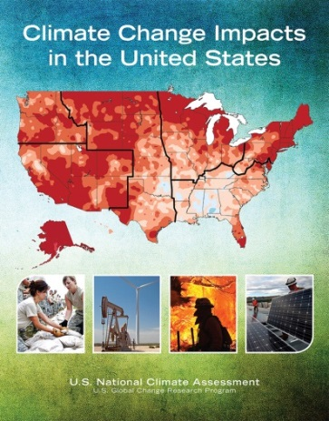
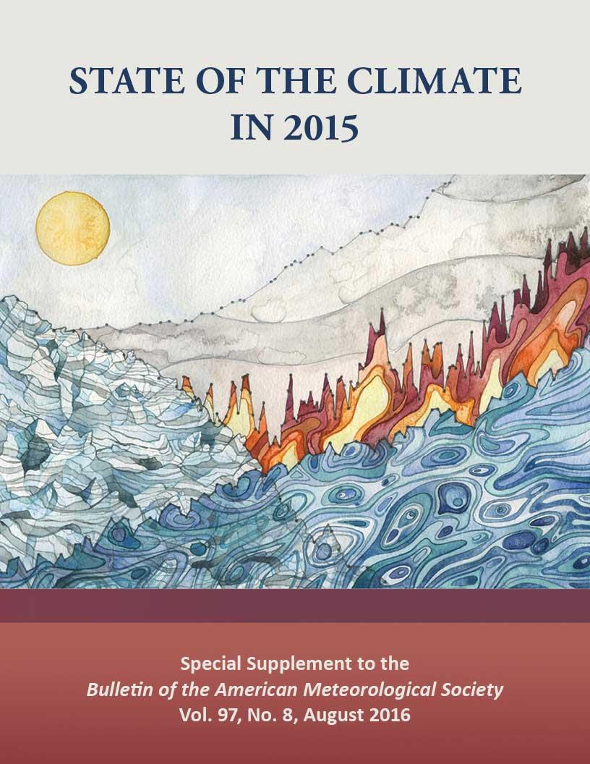
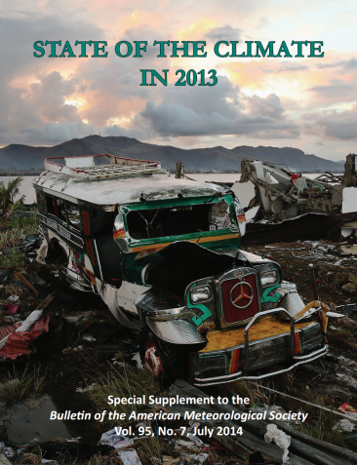
Monitoring and Assessing the Earth’s Climate:
International, National, Annual Assessments
Over 50 peer-reviewed papers every year
International
Assessments
Lead authors and review editors on Fourth Assessment Report
Lead authors on Fifth Assessment Report
Lead authors on Special Report on Extremes
National
Assessments
Provides leadership for all National Climate Assessments
Hosts National Assessment’s Technical Support Unit
Annual
Assessments
Coordinates 378 authors from 48 countries
Covered by all major news networks, briefed to Hill staff
41

