Slide 1


Slide 2


Slide 3


Slide 4


Slide 5


Slide 6


Slide 7


Slide 8


Slide 9


Slide 10
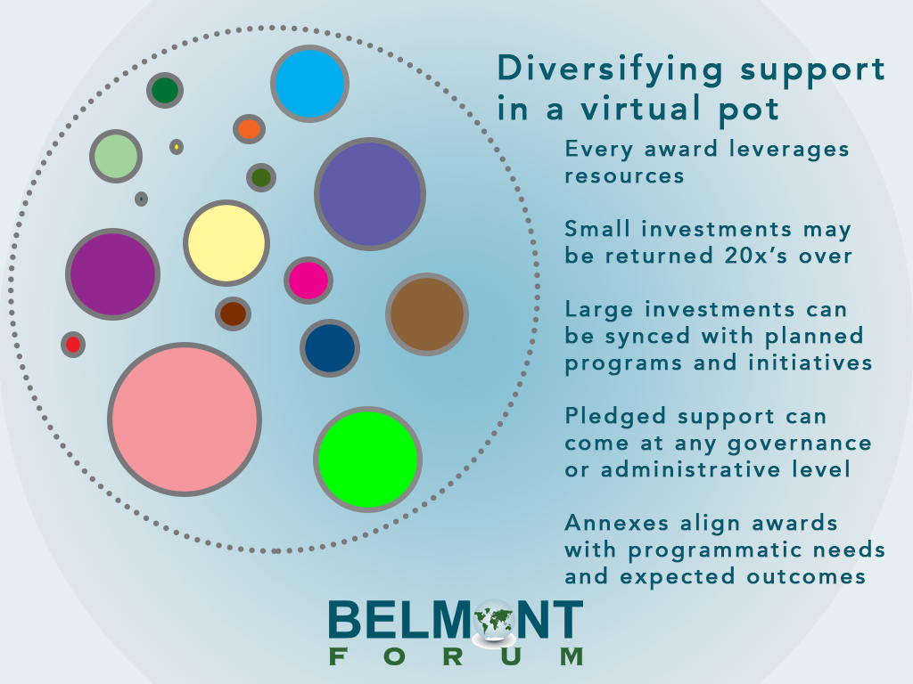

Slide 11
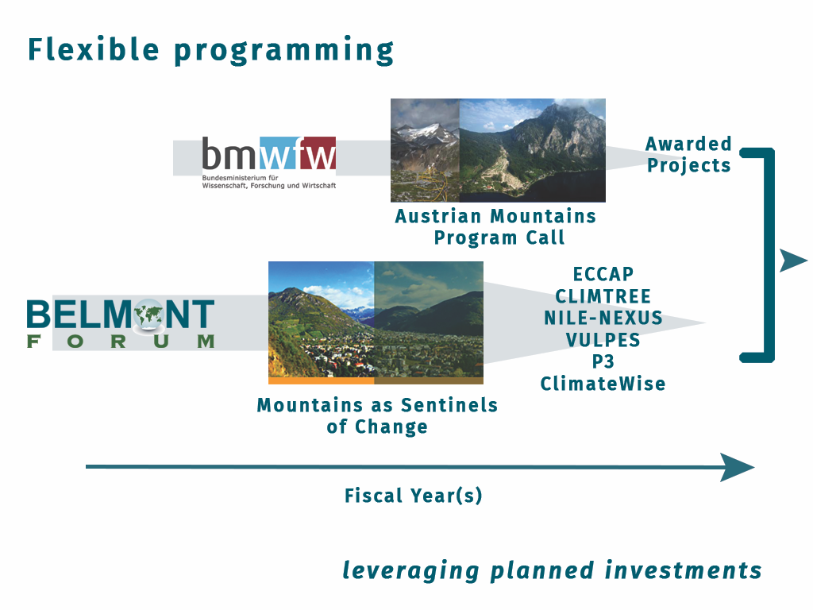

Slide 12
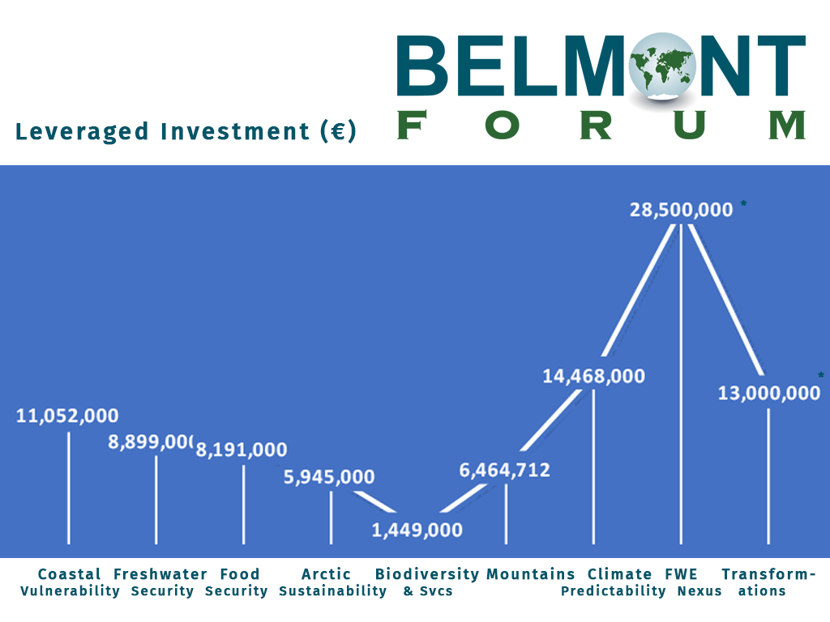

Slide 13
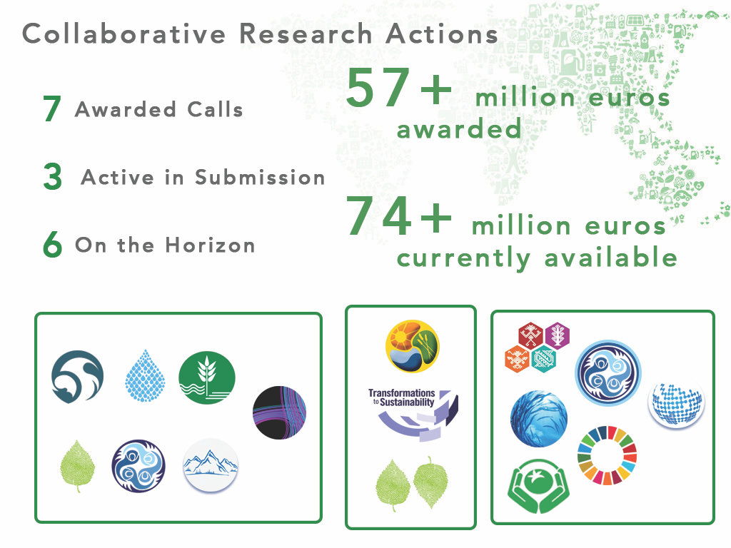

Slide 14


Slide 15


Slide 16
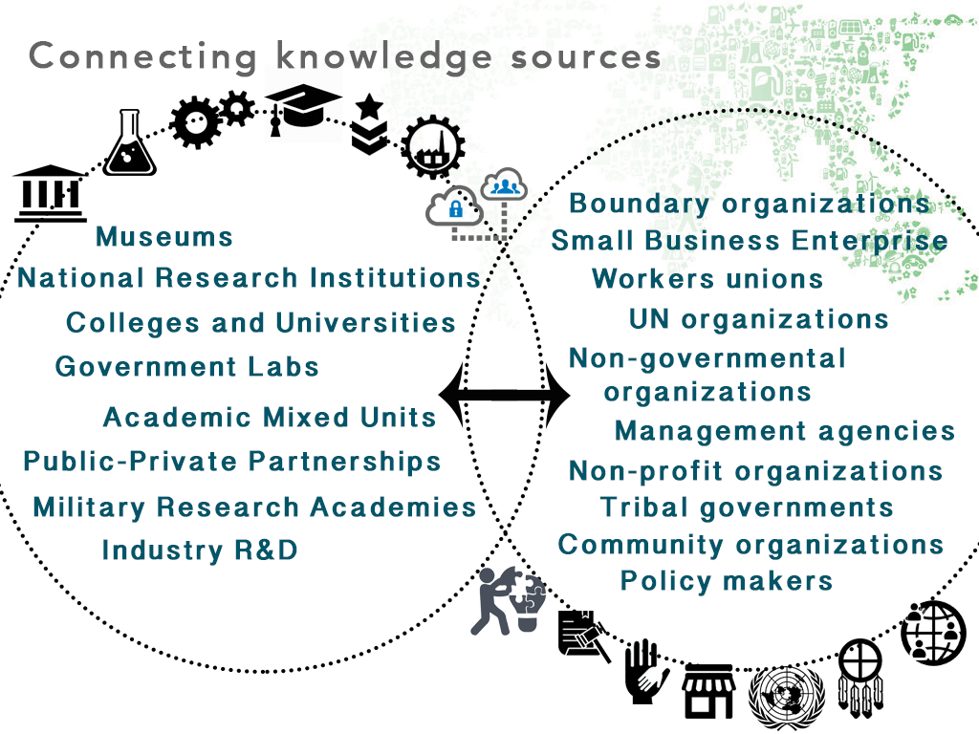

Slide 17
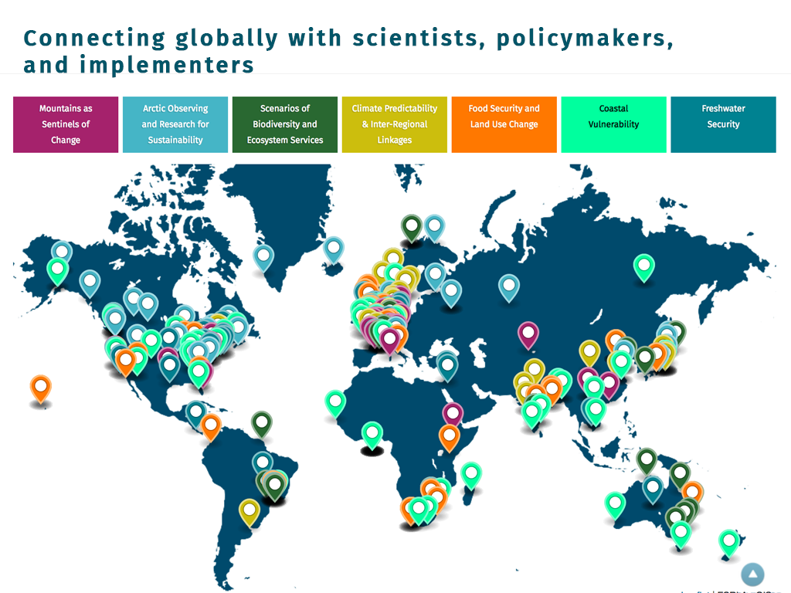

Slide 18
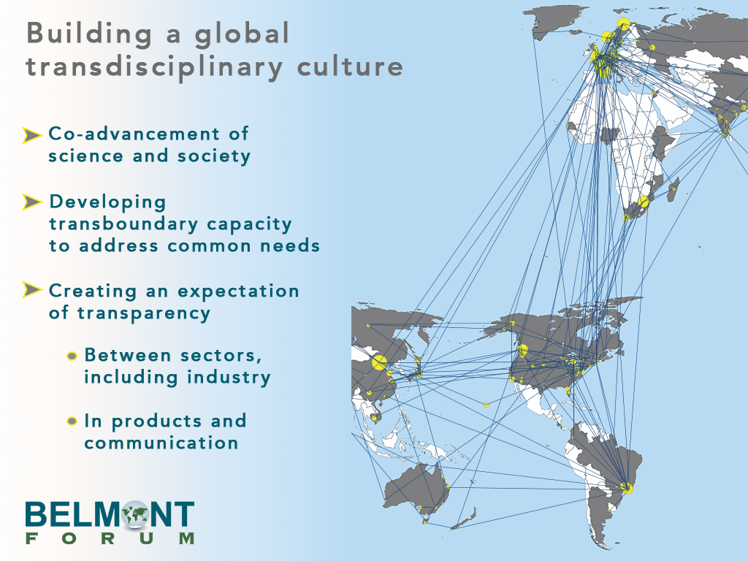
Notes:
Building a culture slide

Slide 19


Slide 20


Slide 21


Slide 22
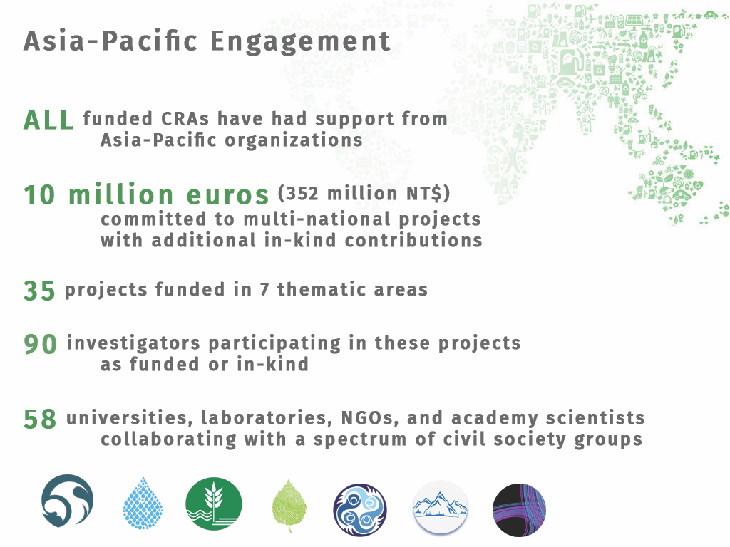

Slide 23


Slide 24
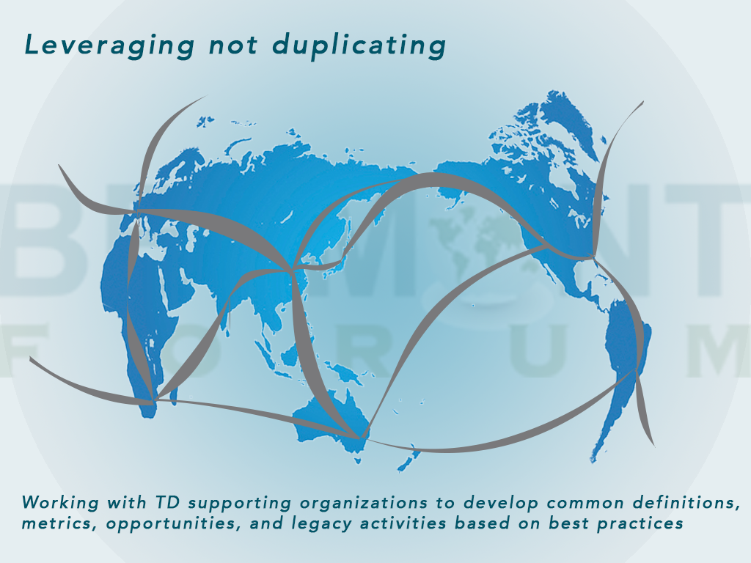
Notes:
TD training, open data access, etc

Slide 25


Slide 26
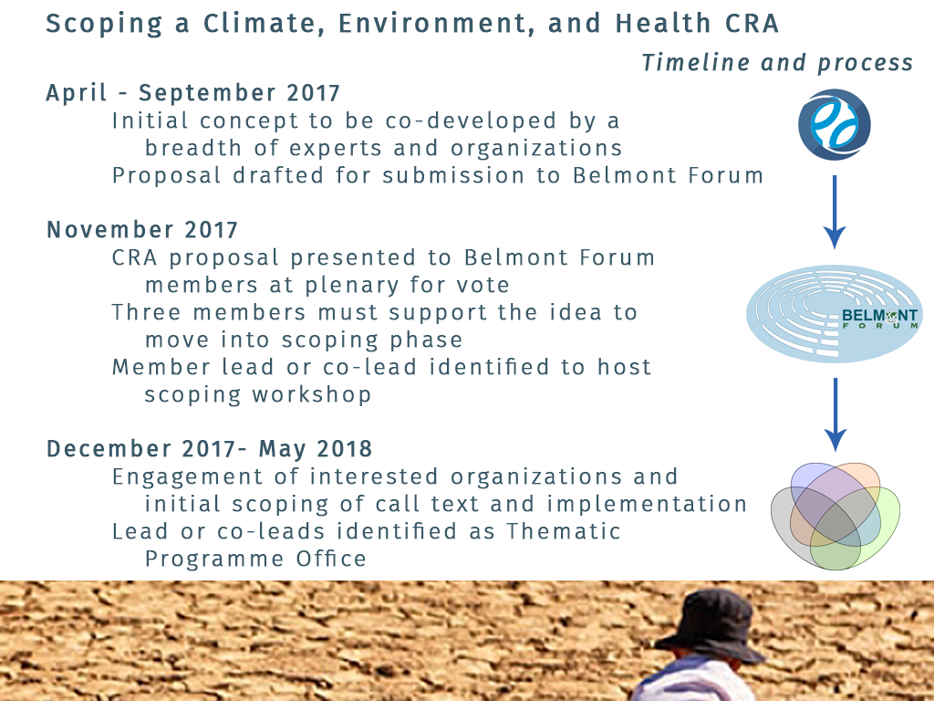

Slide 27
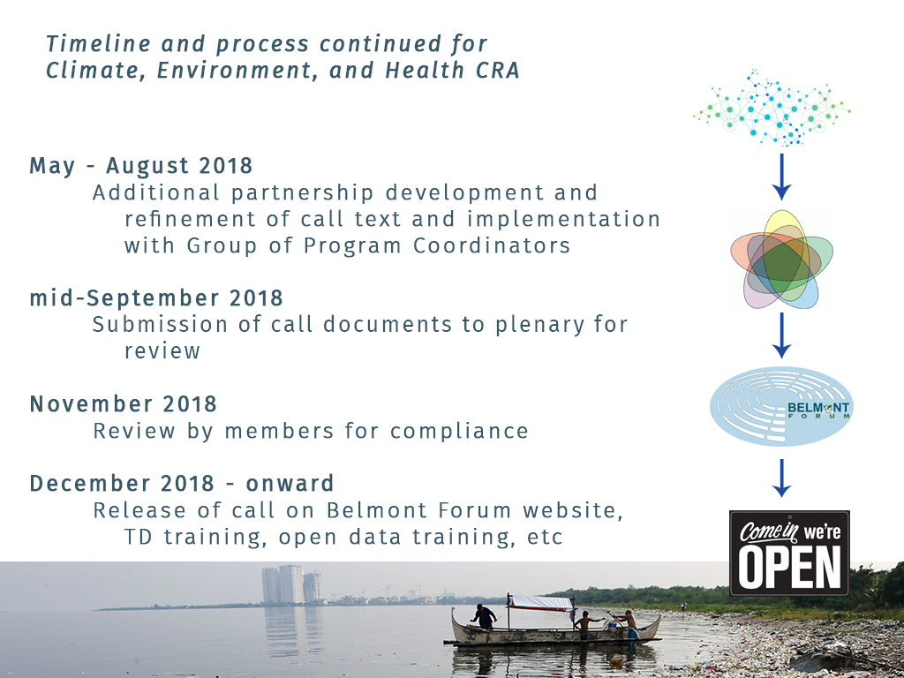

Slide 28


